Slide 1
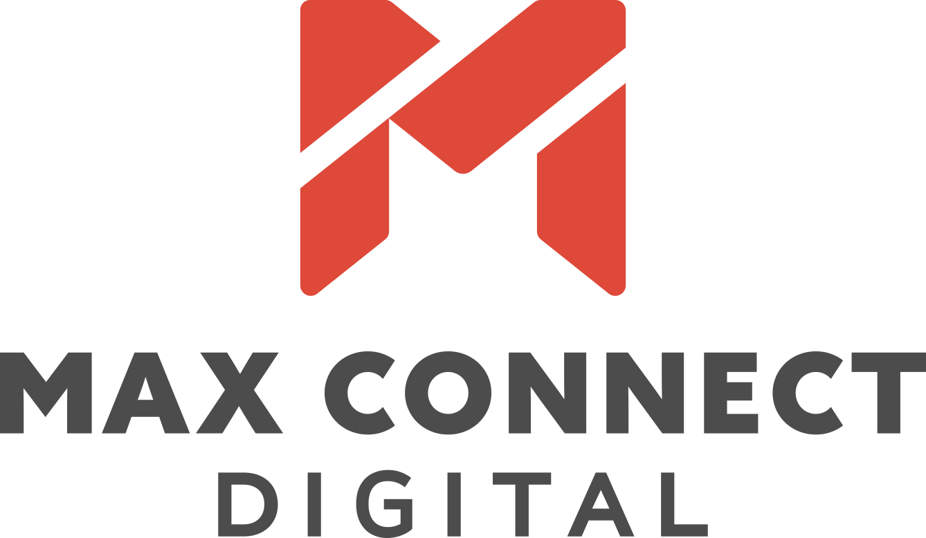
Digital marketing
introduction

Slide 2
Industry Insider Summit:
Where brand & performance meet

Slide 9
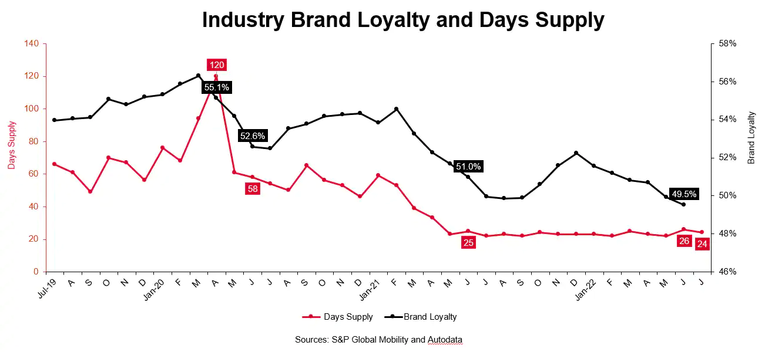
Notes:
1 in 3 customers lack loyalty to a specific brand?
Consider Lifestyle, Convenience and Relevance as key to purchasing decisions
Relevance and timing is key

Slide 10
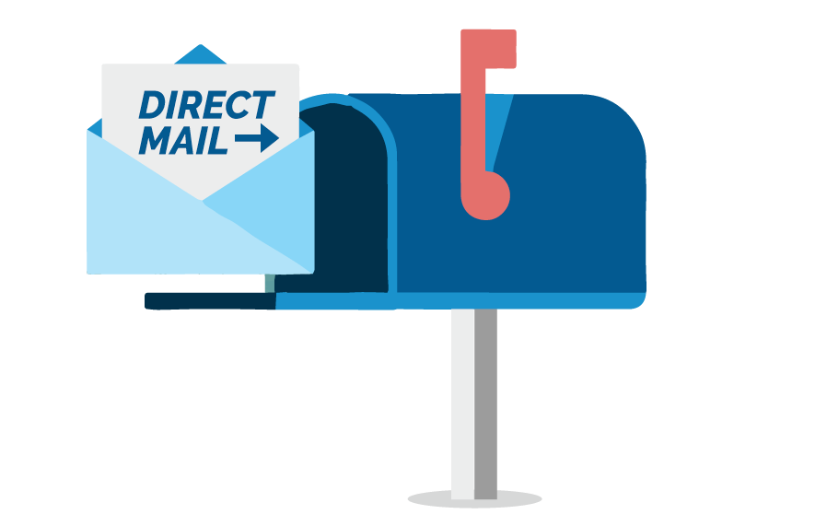
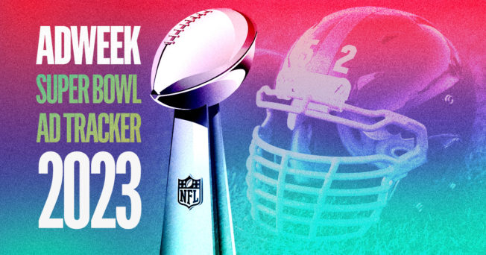
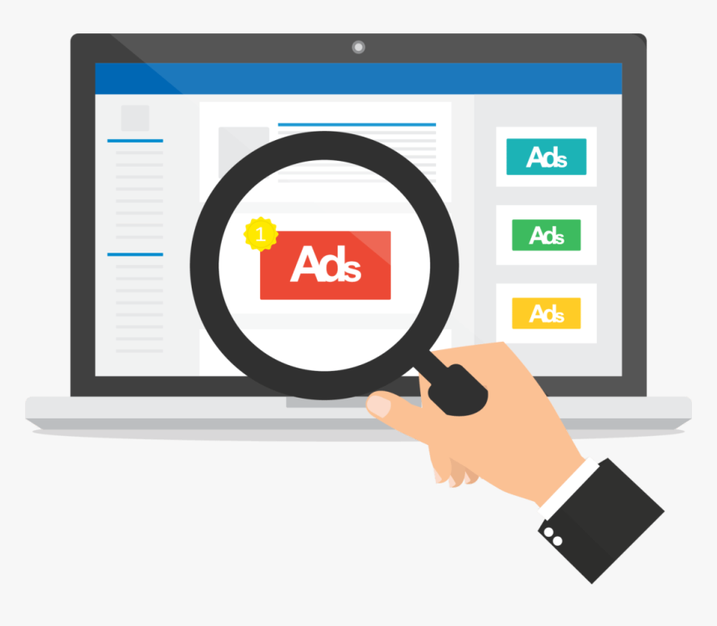
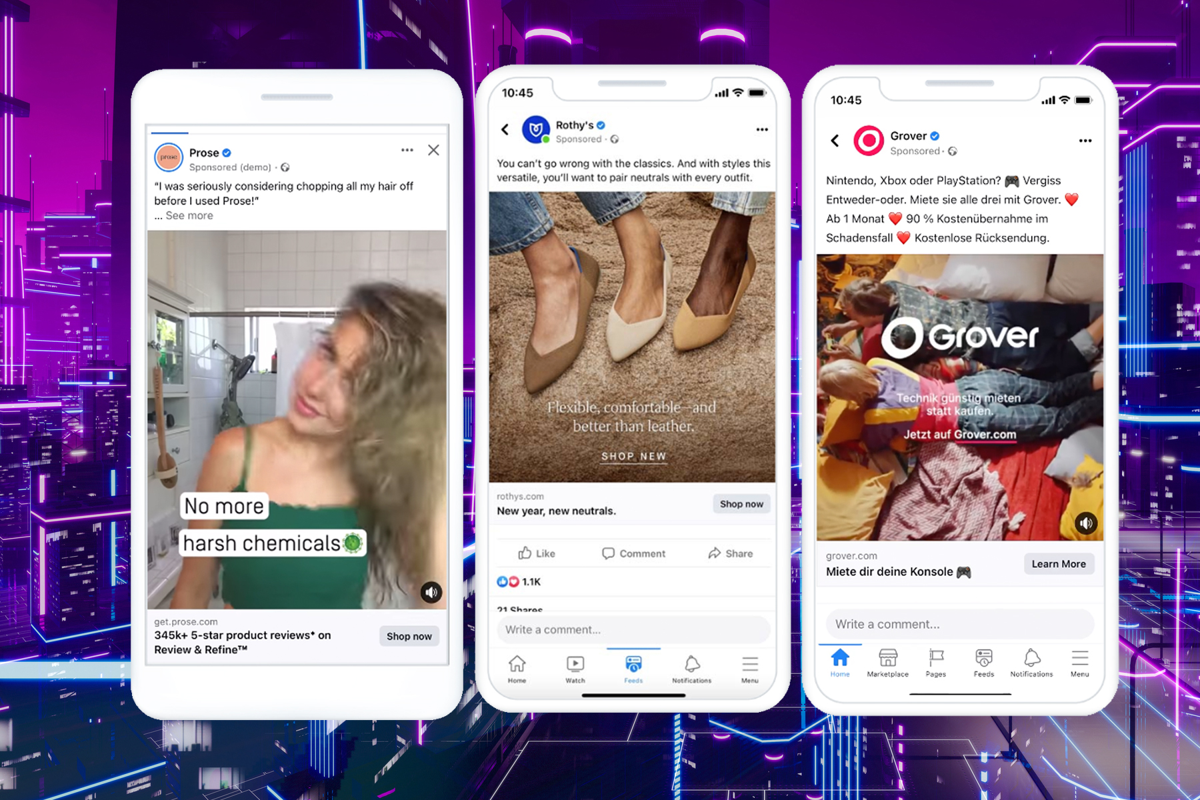
Brand or performance?

Slide 11
2022 Cannes Lions International Festival: Burning issues among CMOS?
Managing the tension between brand & performance marketing

Slide 12
“Half the money I spend is wasted; the trouble is I don’t know which half.”
- John Wanamaker

Slide 13
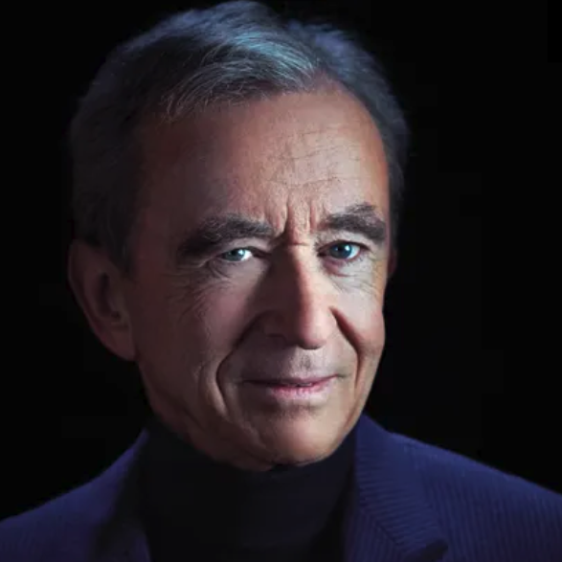
Wealthiest person?
Bernard Arnault
Notes:
Performance winning
COVID Comes. Those with Brand Equity are the strongest.
Both voices are loud
Work together

Slide 14
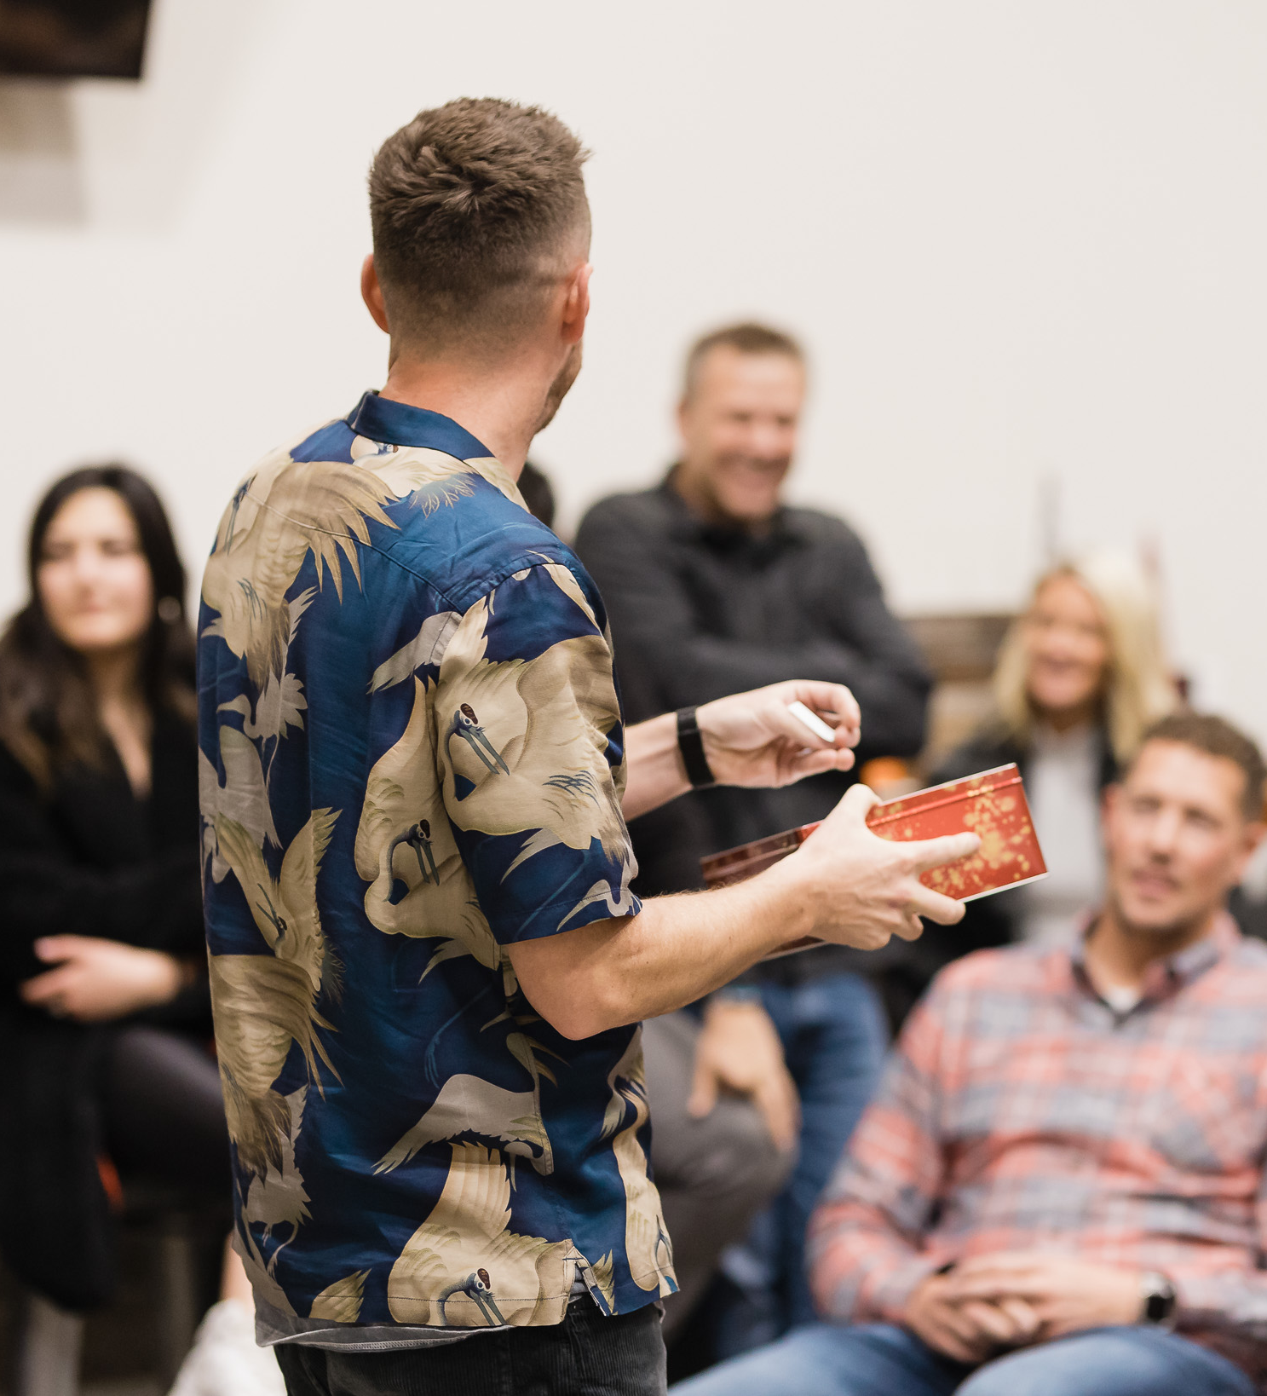
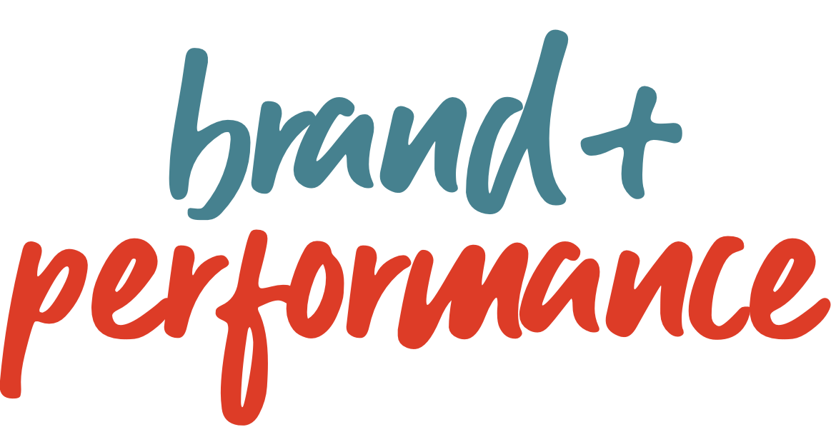
Ultimately, brand marketing and performance marketing share a common goal: to help raise awareness of your brand by consumers and ultimately drive them to make a purchase.
These marketing methods have distinct similarities, as well as differences.

Slide 15
brand
performance
Brands focused on long-term growth, becoming a category leader, and achieving mind- and market-share build awareness and consideration, while driving revenue and new customers can achieve great efficiency across their total investment*.
Outcomes:
Brand KPIs: Build a loyal customer base, total impressions, website visits and views, brand search growth, direct and organic traffic, mind- and market-share.
Performance KPIs: conversions rates, website site | store revenue, store visits, customer acquisition costs, # of new customers, qualified leads and calls, business outcomes.
results
*MediaPost, May 30, 2023, “Stop Scraping Funnel Bottoms: Go Upstream To Pan For Gold”, Bryan Karas.
*WSJ, Nov 22, 2022, “Airbnb Says Its Focus on Brand Marketing Instead of Search Is Working”, Megan Graham.
Notes:
AirBnB posted largest profits ever

Slide 16
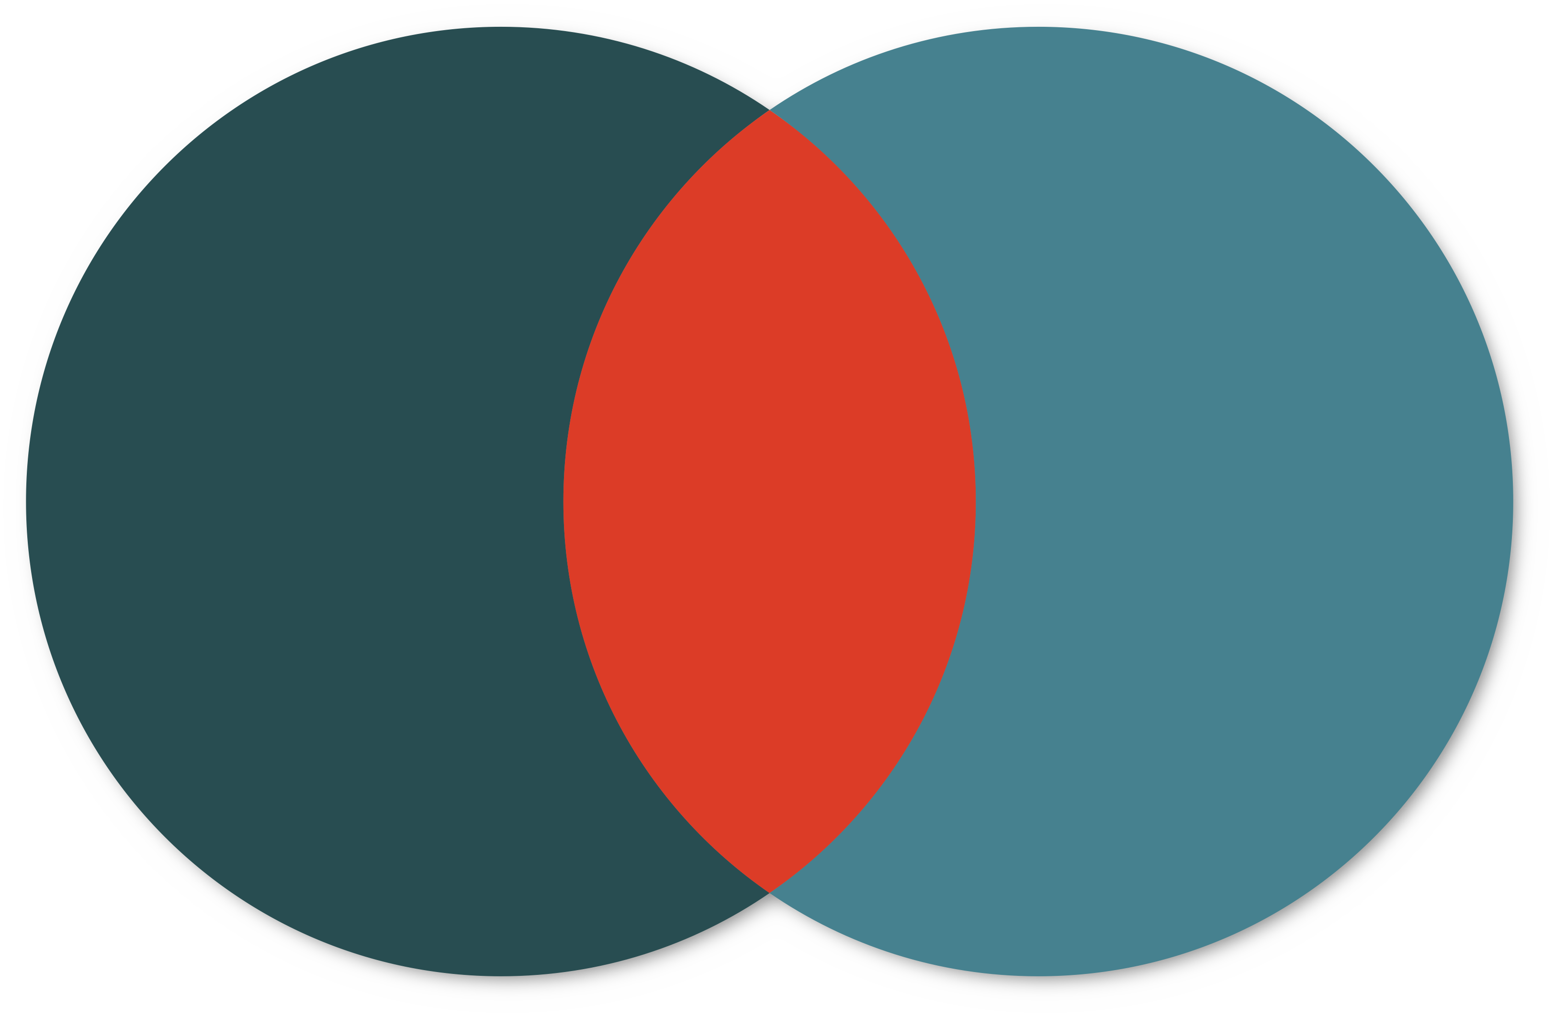
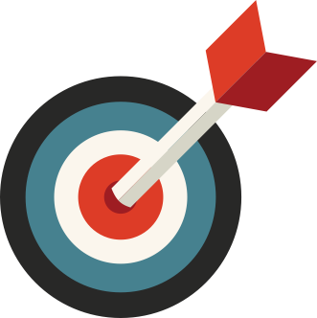
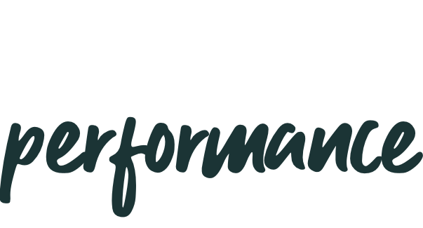
brand
performance
Marketing
=
Marketing
Long-term investment
Bottomline outcome
>
>
>
>
>
Long-term growth
Build loyal customer base
Brand awareness
Mind and market share
High funnel
Results
>
>
>
>
>
Short-term growth
Results now
Click rate
Conversions
Low funnel

Slide 17
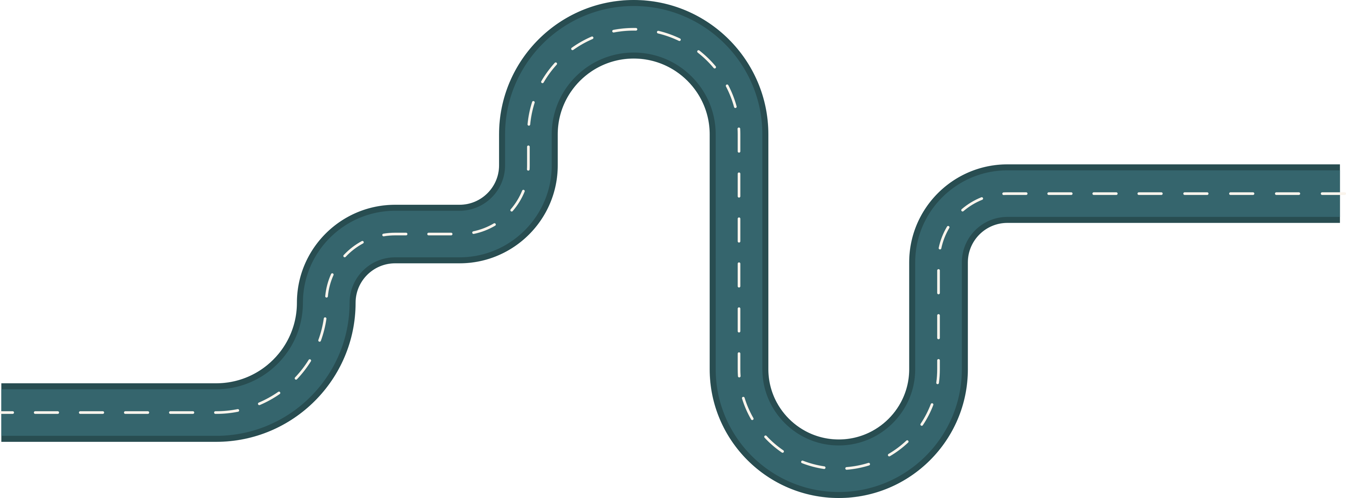
+
Driving holistic performance
+
$
$
+
Channel Performance & Optimization
The right combination of Brand + Performance. Every interaction matters to demonstrate genuine authenticity with continued learning / optimization of campaign channels.
+
+
Robust Digital Ecosystem
Consumers arriving at your website and other digital experiences should see the value proposition & path to purchase.
Unrivaled Growth
When brands are able to create an experience that connects with their customers beyond just a single transaction but engenders brand loyalty, customer lifetime value and creative brand ambassadors, true magic happens.
=
+
+
Hyper-Targeted Audiences
Effectively leverage 1st and 3rd Party Data, proper segmentation and personalization. Empirical audience data used before & on-going to expand reach | performance.
+
Brand Messaging & Offer
Brands need to align with what that consumer segment is looking for and emotionally connect. Align with their Why.

Slide 18
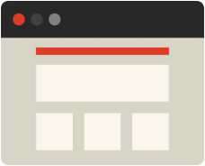
Digital strategy
An omnichannel approach is the best strategy for meeting consumers at every stage of their buying journey and funneling them to an eventual conversion.
Display
Conquest
Social
Pre-roll & CTV
Paid search
Retarget

Slide 19
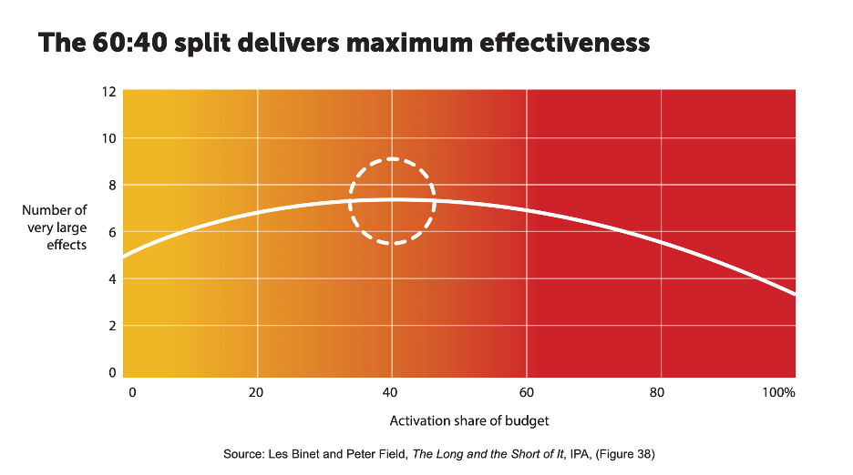
Go upstream to pan for gold!

Slide 20
performance branding
Pitting brand building and performance marketing against each other in a competition for budget unnecessarily damages the effectiveness of both.
Brand building is losing out more and more, in large part because performance marketing is considered to be much more closely linked to measurable business results.
You are running a month-long promotion for your business and the you see a 30% decrease in campaign ROAS. Was it a brand or performance issue?

Slide 21
Reducing cost in digital mktg.
Notes:
U of U story

Slide 22
Cost of conversion: brand + performance DUO
If every interaction with a potentional customer is made with a lower funnel marketing channel, average costs can be $4 to $15+ per click | interaction.
Lower average costs by incorporating more efficient touchpoints that are both brand rich and can provide value back: CTV, Pre-roll, Display, etc.
Create Demand for your product and actually enlarge the market overall. How do you get more branded searches?
Notes:
Traeger Example with Camp Chef. Enlarge the market.

Slide 23
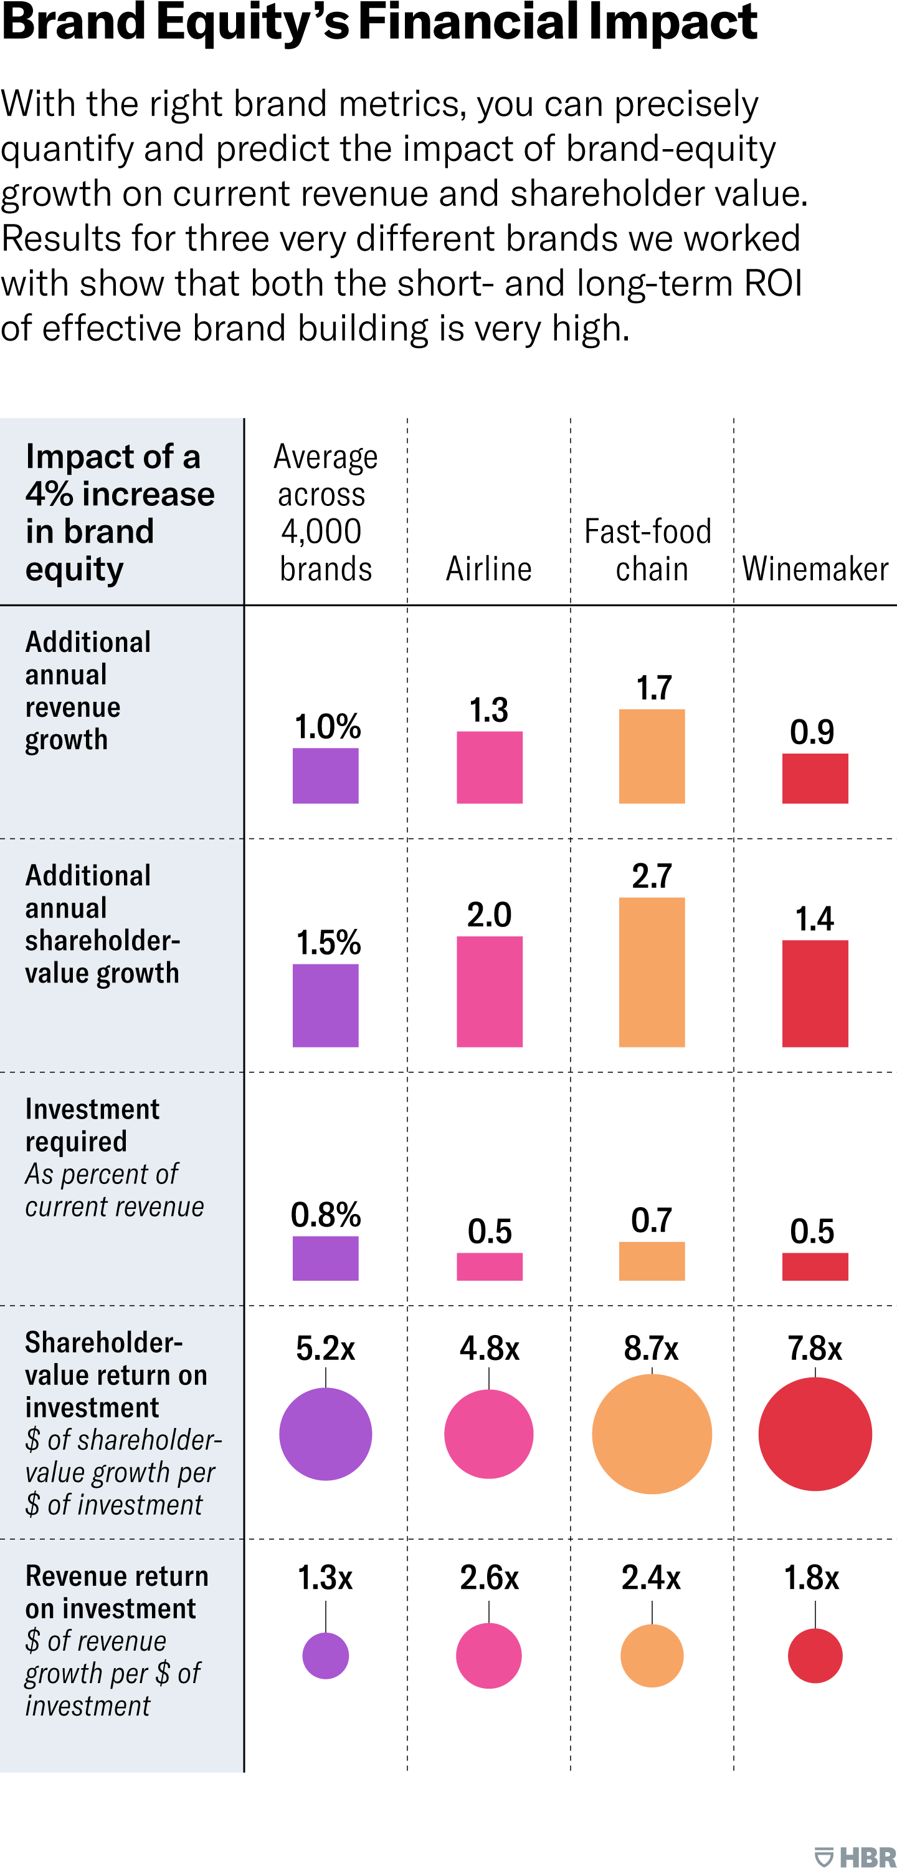
Brand equity’s impact
Create and connect brand-positioning and activation metrics.
Create a composite metric of brand equity.
Make brand equity a KPI for performance marketers.

Slide 24
three takeaways
Treating performance marketing and brand building as a short-term/long-term trade-off is dangerously wrong.
Brand building is as financially measurable as performance marketing.
Your current performance marketing may not be as measurable as you think.
BONUS: Giving value back to the customer thru-out the journey and investing in their experience will always pay off.

Slide 25
Thanks!
From the max connect family

Slide 26
Kudos..
But First

Slide 27
VIDEO
SEARCH
AMAZON
SOCIAL
Website

Slide 28
Kudos..
A CHANGE IN MINDSET

Slide 29
Marketing Channel Focus
Social
Search
Display
Video
Campaigns
Creative Testing
A/B & MVT
Creative Testing
Mobile
Engagement

Slide 30
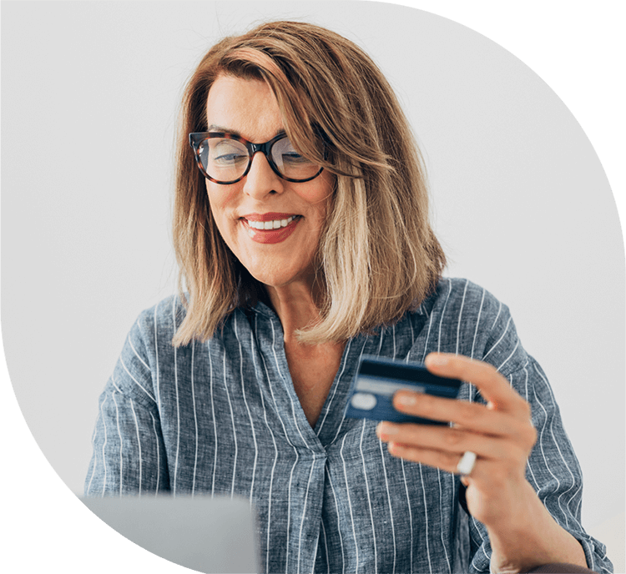
CUSTOMER Focus
Social
Search
Display
Video
Campaigns
Creative Testing
A/B & MVT
Creative Testing
Mobile
Engagement

Slide 31
UA w/last click attribution:
Display - 5 conversions
VIN Retargeting - 18 conversions
Direct Traffic - 44 Conversions
Shift IN MINDSET
Social
Search
Display
Video
Campaigns
Creative Testing
A/B & MVT
Creative Testing
Mobile
Engagement

Slide 32
Shift IN MINDSET
KUDOS Customer focused attribution:
Display + VIN RETARGETING = 80+ Conversions
Social
Search
Display
Video
Campaigns
Creative Testing
A/B & MVT
Creative Testing
Mobile
Engagement

Slide 33
Kudos is our marketing attribution
& reporting software.
BUILT 100% In-House by Max Connect

Slide 34
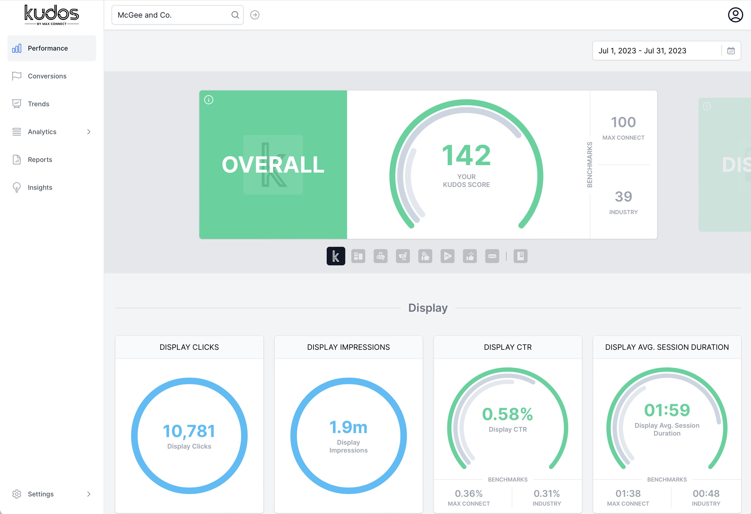
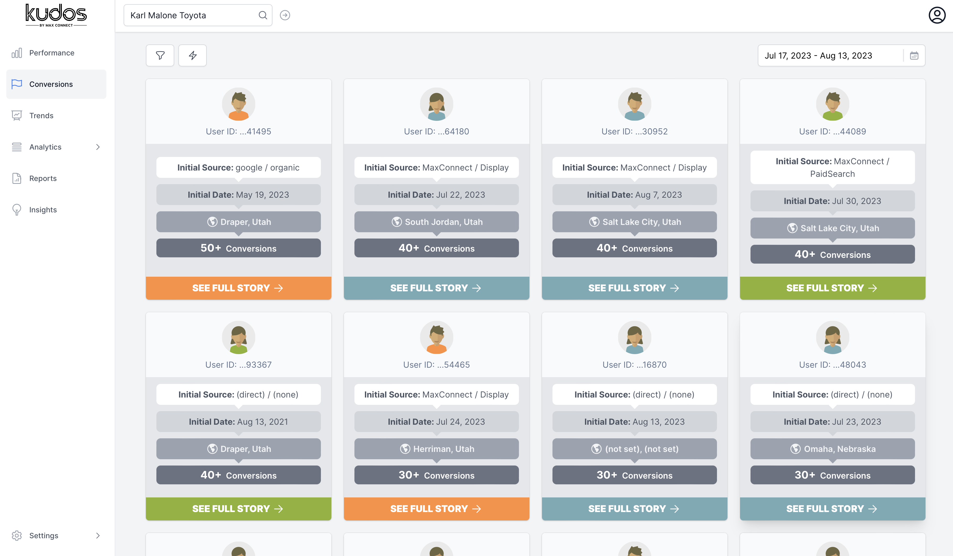
KUDOS HELPS CLIENTS WITH…
Customer ACQUISITION JOURNEY
campaign Scoring
Business Trends and More…

Slide 35
THE KUDOS SCORE

Slide 36
KUDOS SCORE
1
2
Your Kudos Score
3
Max Connect
Benchmark
Color (Green or Yellow)
4
Industry Benchmark
Finally… Data with some relevance

Slide 37
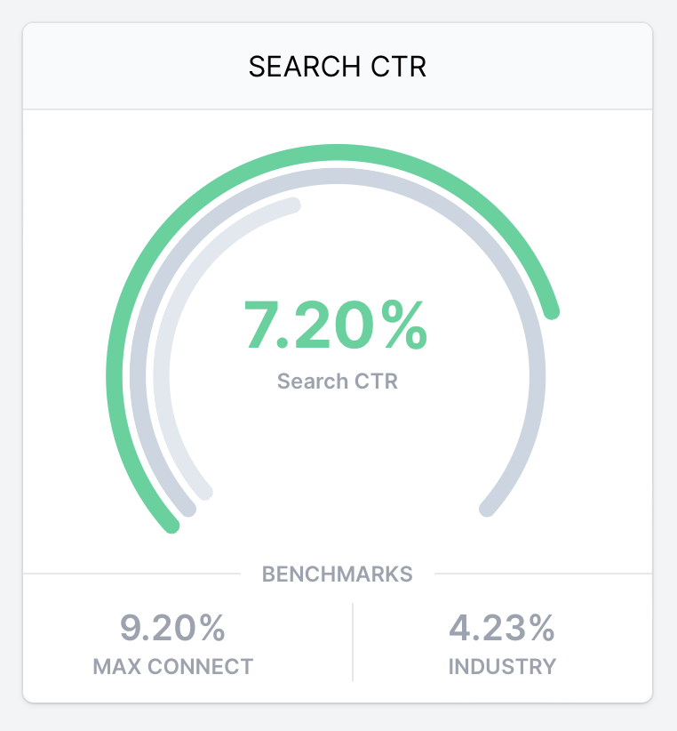
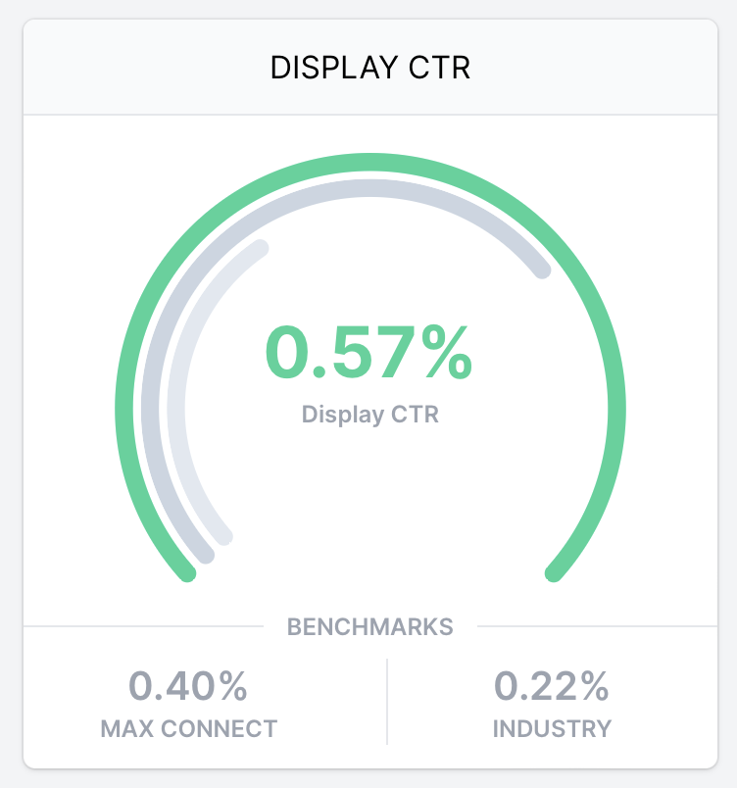
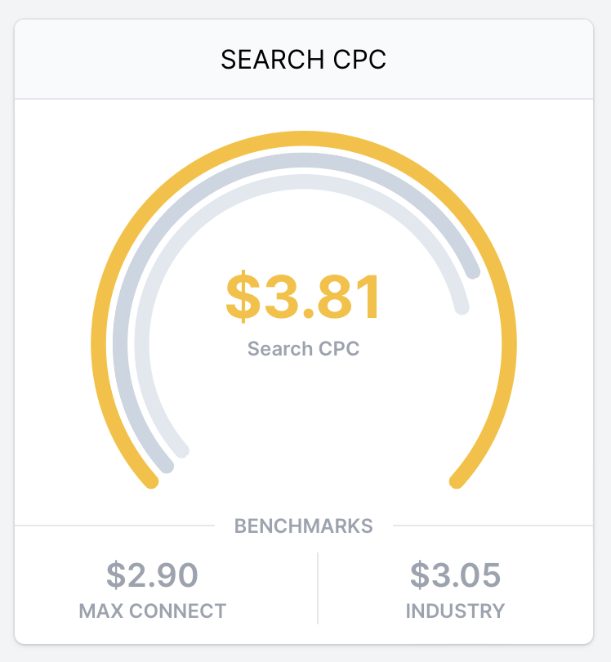
KUDOS SCORE
Above Benchmark: Green
Max Connect or Industry
Below Benchmark: Yellow

Slide 38
Thanks!
From the max connect family

