Slide 1
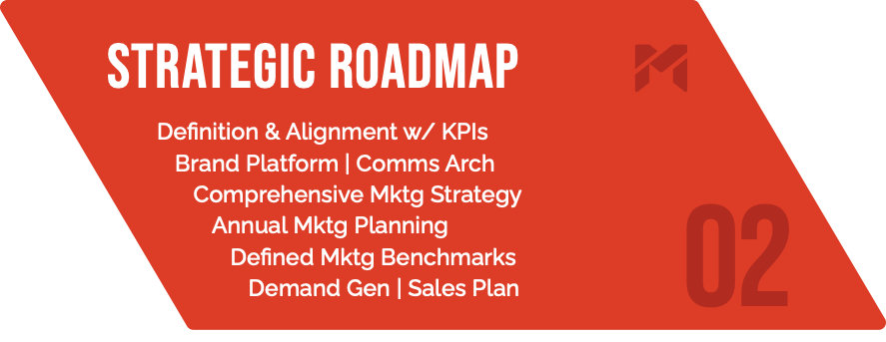
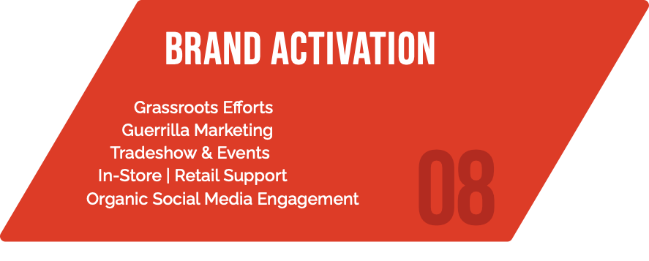
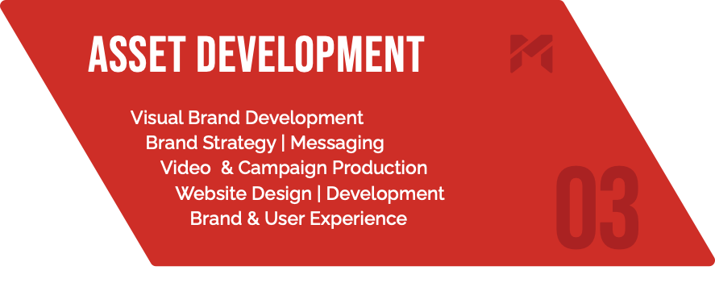
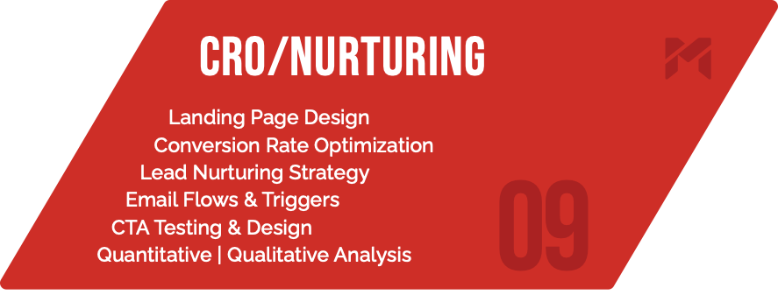
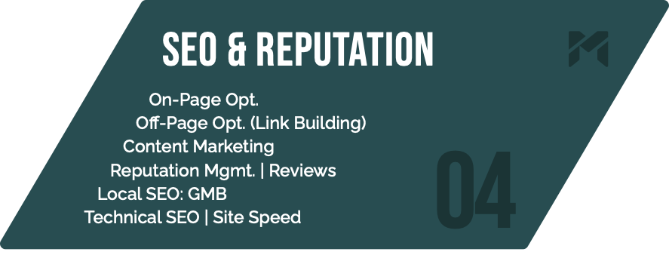
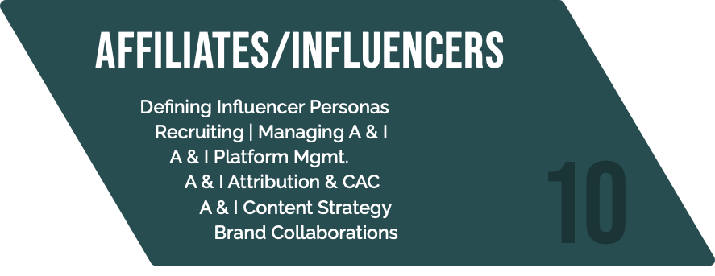
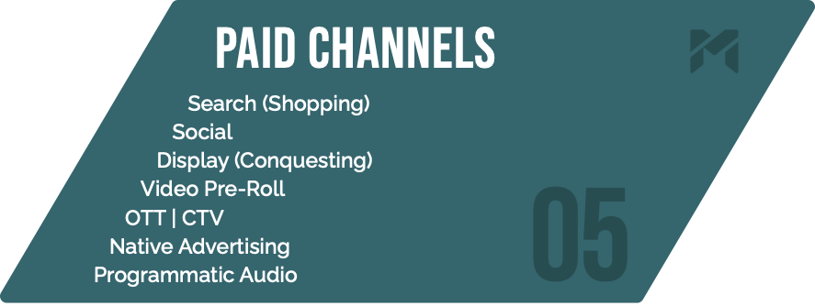
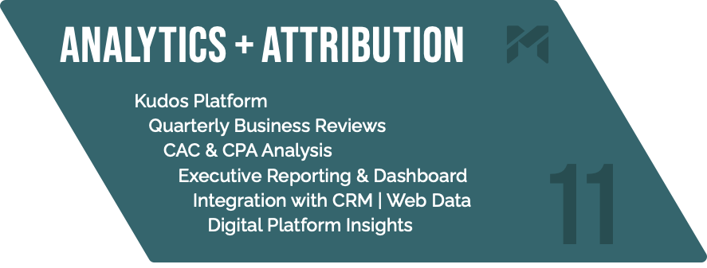
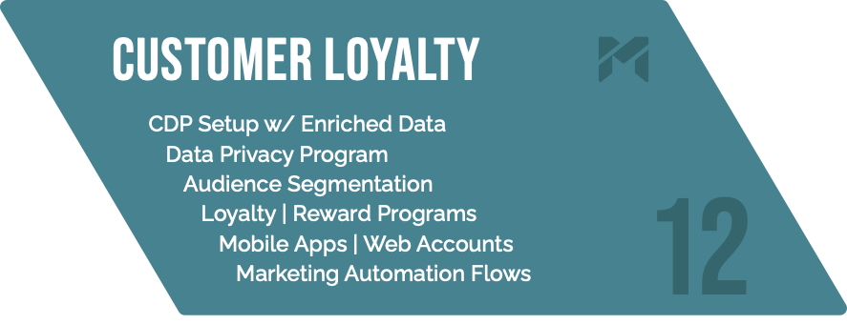

Slide 5
Definitions
POP: Point of Purchase
Value Proposition: A statement that summarizes why a customer would choose your product or service.
Market Positioning Map: A diagram that allows you to compare your product to the competition and identify opportunities for new products in the marketplace

Slide 6
Market | competitive research

Slide 7
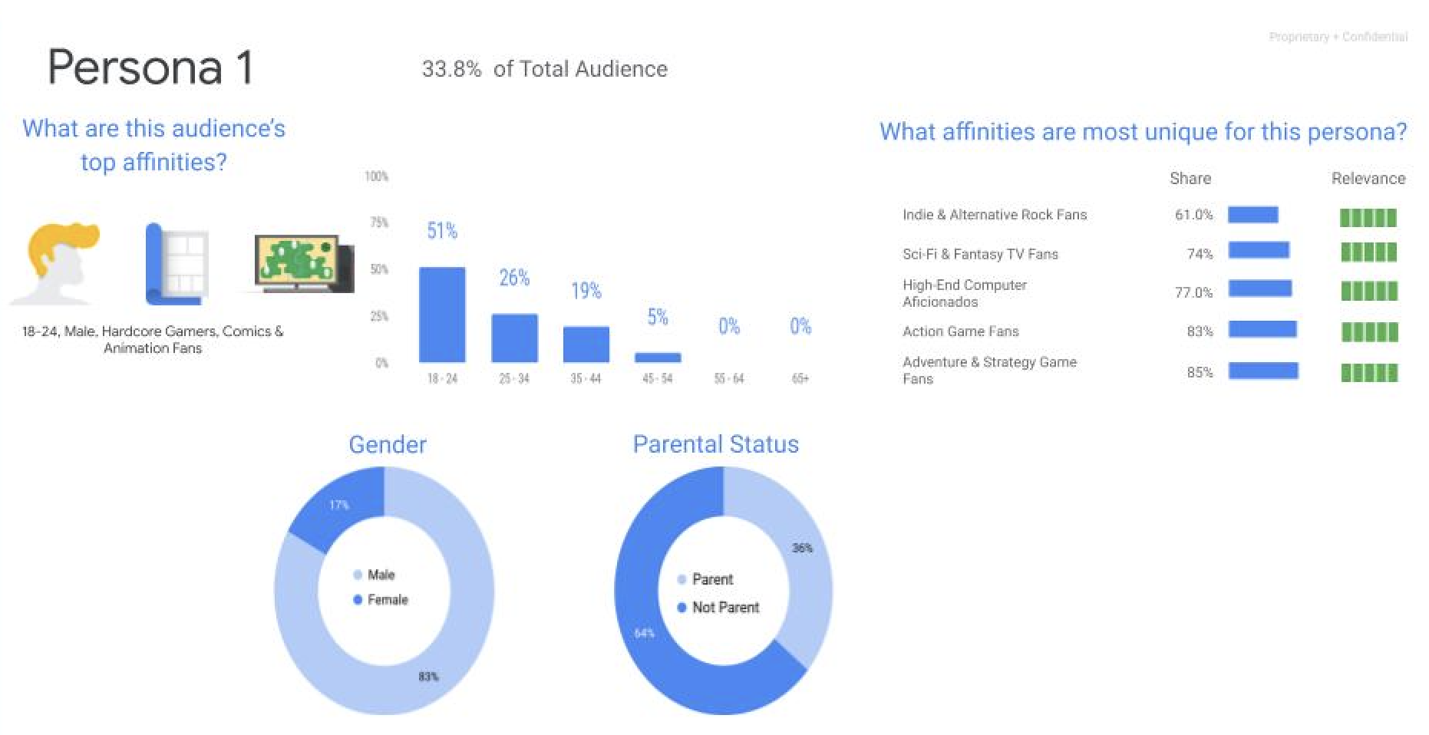
Persona RESEARCH

Slide 8
Personas
Teresa
Age: 27
Education: Family and Consumer Sciences
Occupation: High School Counselor
Teresa will be a first time mother with a baby on the way. She is an avid home decorator who keeps up with the latest household trends. Teresa and her husband purchased their home 3 years ago. She spends much of her time working at the high school, walking the dog with her husband, and values sharing/consuming life events on social media platforms.
Frustrations Lacks overall flooring knowledge and wants to find the best and safest flooring for her newborn baby. Has yet to find the flooring that matches her nursery design mock-ups.
Motivations
Community Reputation
Instagram/Pinterst
Support Local Businesses
Goals Transform the old office into a comfortable nursery for the newborn baby. Plan to have the husband install the flooring in the new room. Want the floor to match the esthetic of the nursery design.
Nursery Design & Esthetic
Child Safety
DIY Bloggers

Slide 9
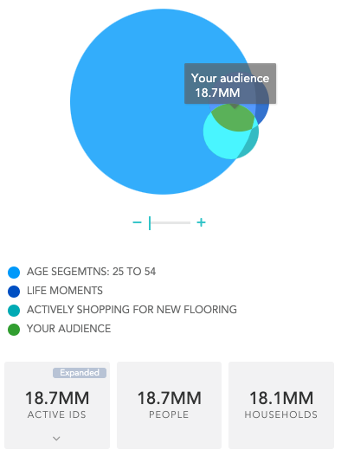
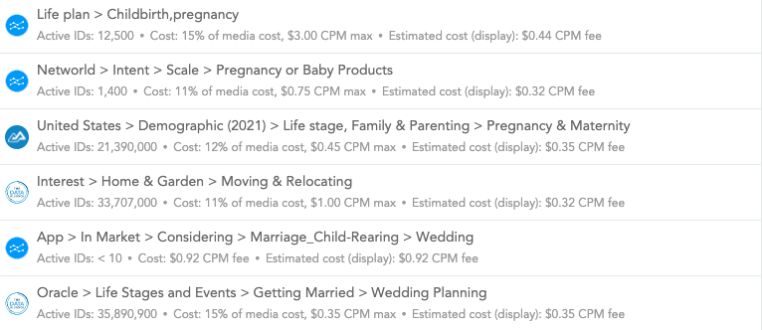
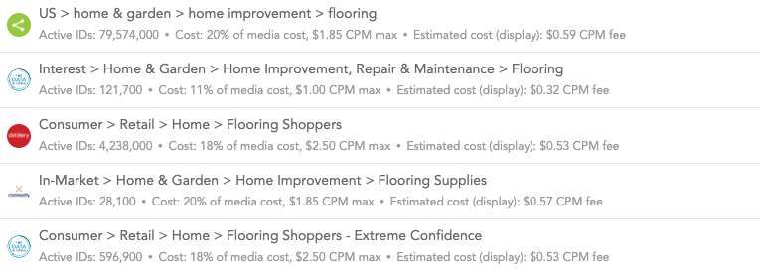
Life moments - united states
Audiences

Slide 10
Definitions
KPIs: Key Performance Indicators.
Brand Platform: A document designed to compile all the elements that make up the DNA of your brand, both visually and ideologically. It is a strategic foundation for thinking and designing a cohesive brand identity

Slide 11
BRAND PLATFORM example

Slide 12
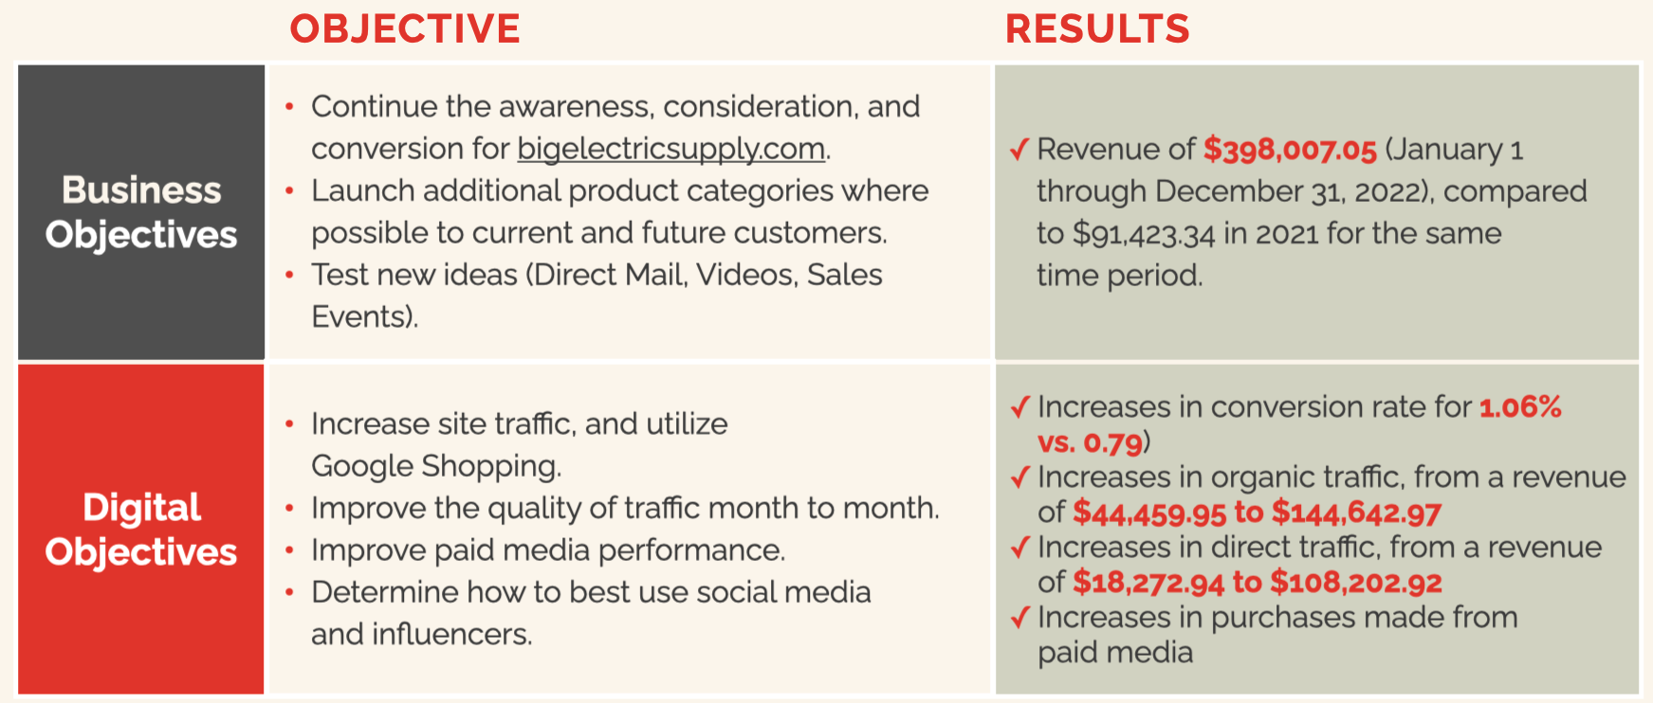
Annual marketing planning

Slide 14
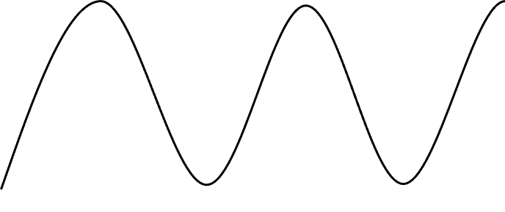
CUSTOMER JOURNEY MAPPING
Visit Website & Completes Interest Form
Signed Contract | Funding
Follow-up and Welcome Gift
Provide recommendations to prospects | referrals
Consumption of area specific content
Decision to Purchase | Reservation
Discussion with Sales Team; Further Q&A
Initiates the Design Experience
Online Search
Request client review and testimonial
Watches Brand Video |Re-marketing
Research
AWARENESS
CONSIDERATION
PURCHASE
LOYALTY
Social Ads
Social Ads
Display Ads
Plans a visit to Padre Canyon
Discussion with Sales Team | Email Drip Marketing
Travel | Vacation Rentals
Welcome to Sentierre Email Drip Series
Construction Begins of New Home
In-Market |
Life Events
Heavily considering a purchase; Discussion with Friends, Family & Colleagues
Home Complete | Furnishing
In-person experience with Padre Canyon

Slide 15
CUSTOMER JOURNEY
Phase 1: Research and Discovery | Phase 2: Planning and Deciding | Phase 3: Committing | Phase 4: Participating | Phase 5: Advocating and Loyalty
Seeking Solutions | Consider Options | Buy Luxury Home | Move-in and Living | Advocate
The beginning is about investigation for the prospect. Our responsibility is to spark overall interest in the area, creating a legacy of time together made possible through Sentierre.
Potential Touch points
Online Research
Native Articles | Intent
Search and Display Ads
Pre-roll Video
SEO
Referrals
Social Ads
We want to focus on turning the idea of buying another luxury home into a desire. Our responsibility is to explain the luxury amenities, superiority and breathtaking landscape of Sentierre Padre Canyon.
Potential Touch points
Online Research
Search, Display, Video and Retargeting Ads
SEO
Form Fills
Email Series
Phone call
Scheduling a Visit
This phase is critical for success. This is where validation of the decision takes place and where full commitment kicks in for the client. Our responsibility is to create a feeling of wellbeing and excitement for purchase.
Potential Touch points
Search, Display, Video and Retargeting Ads
SEO
Phone calls/Emails
2nd visit
Home Reservation
This phase is as equal to success as the commitment phase where the hard work takes place and leads to ultimate success. Our responsibility is to continue and reinforce that they have invested in future time together.
Potential Touch points
Customer Excitement
Expectation Met/Exceeded
Homebuilding complete
Welcome home gift
In order to continue the ongoing success and continued reservations, we hope clients will advocate for Sentierre by leaving their own testimonials, and sharing their story. Our responsibility is to enable their passion to permeate to others.
Potential Touch points
Client Referrals
Online Reviews
Testimonials
Continued interaction with Clients (Email Series)
SPARK
CONVINCING
CONFIDENT
EXCITED
ENTHUSIASTIC

Slide 16
GO-TO-MARKET STRATEGY
Platform
Once in a life-time opportunity to become one of 50 members of a luxury resort community with real life experiences, long-term interpersonal connections, a lifetime concierge, and creating a family legacy.
Goals
Seeking Solutions
Consider Options
Buy Luxury Home
Move-in and Living
Advocate
Barrier
Considering luxury housing options and other potential locations
Is this the right investment and location?
Timeline and buyer process, financing
Closing within defined timeframe
Padre Canyon is everything we imagined, Exceeded expectations.
Message
Ultra-luxury resort, onsite amenities, location and property
List of membership and resort amenities, services, customizations
Customer satisfaction
Welcome to our community
We want to make sure you have everything you need.
RTBs
Images, Videos, Website and nurturing email series.
Luxury amenities, nature surroundings, concierge, finest materials used
Customer reviews, Testimonials
Experiences nearby, amenities usages
Testimonials and customer reviews
Desired Action
Educate on property, amenities and services
Phone call, form submissions, plan a visit & experience Sentierre
Reservations, complete financing and buying home
Become a satisfied owner, resort-rental
Buyers/renters sharing their living experience, renting out villa

Slide 17
GO-TO-MARKET STRATEGY
Goals
Seeking Solutions
Consider Options
Buy Luxury Home
Move-in and Living
Advocate
Desired Action
Educate on property, amenities and services
Phone call, form submissions, plan a visit & experience Sentierre
Complete financing and buying home
Become a satisfied owner
Buyers sharing their living experience, possibly renting out
Channels
Hyper-targeting of qualified audiences. Use of search, display, social ads and video pre-roll.
Continued hyper-targeting of audiences. Use of search, display, social and retargeting ads, email series.
Targeted messaging through email, text and phone from Sales | Marketing team.
Targeted messaging through email, text and phone, including welcome gift
Targeted messaging and updates through email, text, phone, social media and customer appreciation events

Slide 19
THE X FACTOR FOR BRANDS: Boosting your Advertising

Slide 20
“
Nothing is more efficient than creative advertising. Creative advertising is more memorable, longer lasting, works with less media spending, and builds a fan community…faster.”
Stephan Vogel, Ogilvy & Mather Germany’s chief creative officer

Slide 21
Numerous laboratory experiments have found that creative messages:
Get more attention
Lead to positive attitudes about the products
Builds brand loyalty
Positively impacts sales

Slide 22
“
A euro invested in a highly creative ad campaign had, on average, nearly double the sales impact of a euro spent on a noncreative campaign.”
Harvard Business Review

Slide 23
“
Overall, more-creative campaigns were more effective—considerably so. We also found that certain dimensions of creativity are more effective than others in influencing purchasing behavior”
Harvard Business Review

Slide 24
What is Creativity?

Slide 25
Creativity is Divergent thinking
The ability to find unusual and nonobvious solutions to a problem.

Slide 26
“
the extent to which an ad contains brand or executional elements that are different, novel, unusual, original, unique, etc.”
Robert Smith, Indiana University communications researcher

Slide 27
five dimensions of advertising creativity
Originality - Has elements that are rare or surprising, or that move away from the obvious and commonplace.
Flexibility - links the product to a range of different uses or ideas.
Elaboration - contain unexpected details or extend simple ideas so that they become more intricate and complicated
Synthesis - blending or connecting normally unrelated objects or ideas
Artistic Value - aesthetically appealing verbal, visual, or sound elements

Slide 28
“
The most-used pairing, flexibility plus elaboration, is one of the least effective. The most effective pairing, originality plus elaboration, had almost double the impact. Flexibility is one of the least effective dimensions, whether used alone or in combination. Although originality has little impact on sales on its own, it appears to play an important enabling role, appearing in three of the four most effective pairings.
”
Harvard Business Review

Slide 29
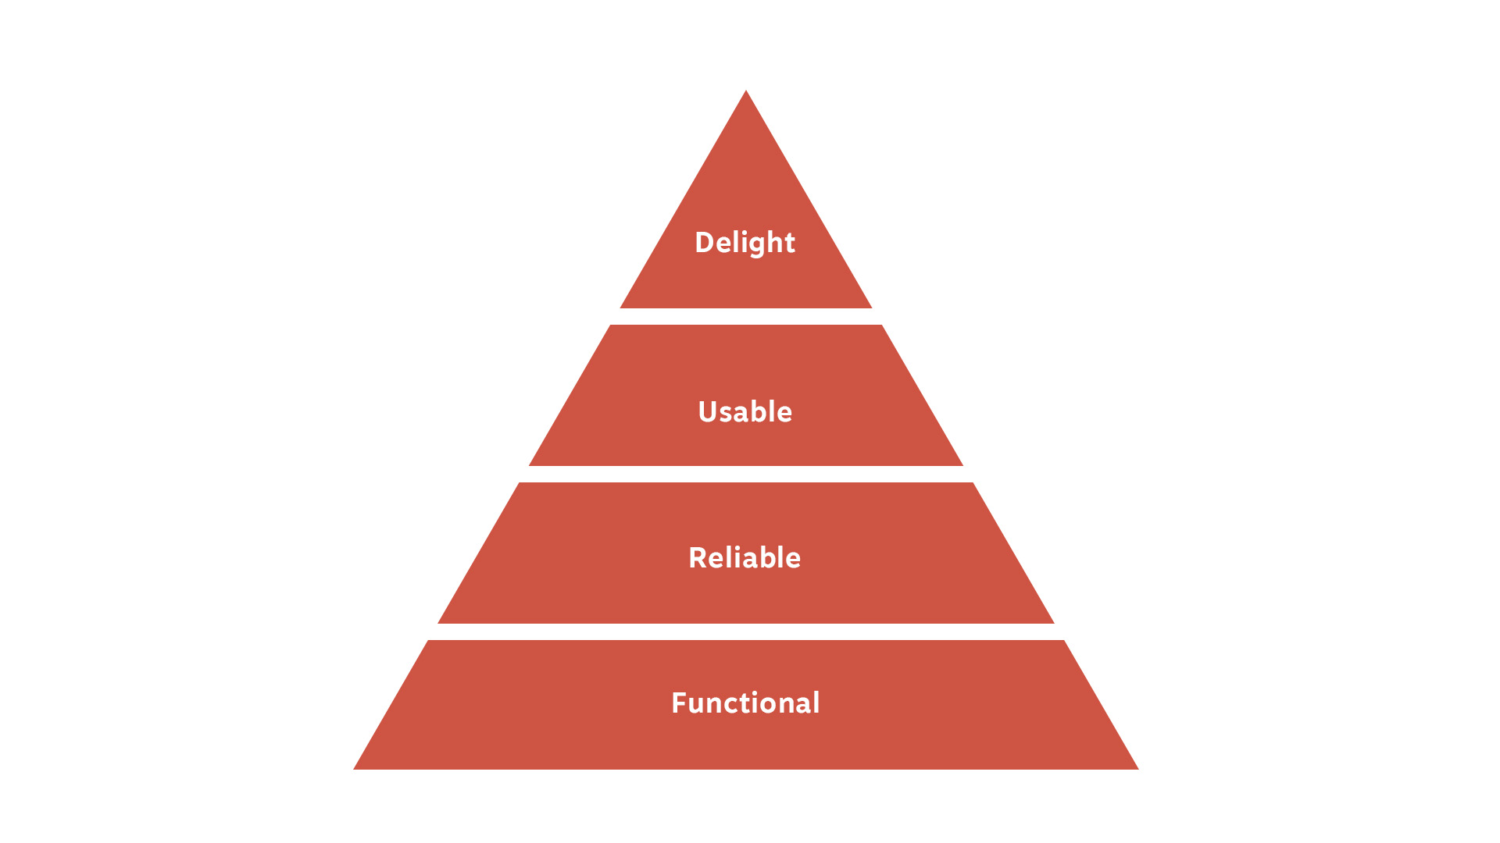

Slide 30
“
People will forgive shortcomings, follow your lead, and sing your praises if you reward them with positive emotion. To engage your audience emotionally, you must let your brand’s personality show.”
Andrew Walter, Author of Designing for Emotion

Slide 31
Studies show that purchases are mostly emotionally driven, even among the B2B community.
90% of purchasing decisions are made based on emotion rather than logic alone.
Business professionals are nearly 50% more likely to buy something that demonstrates personal value through emotional appeals.
B2BMarketing.net

Slide 32
What does this mean? It means employing market research tactics to make sure you understand what your audience cares about is worth its weight in gold.
Thinkwithgoogle.com

Slide 33
“
Emotional design is not just about delight and positive emotion. In Reality, …Its about all emotion—Good, and especially bad. IF the customer is feeling uncertain or fearful, don’t shy away from that or sweep it under the rug.”
Garron Engstrom, former designer, TurboTax

Slide 34
Create an identifiable character.

Slide 35
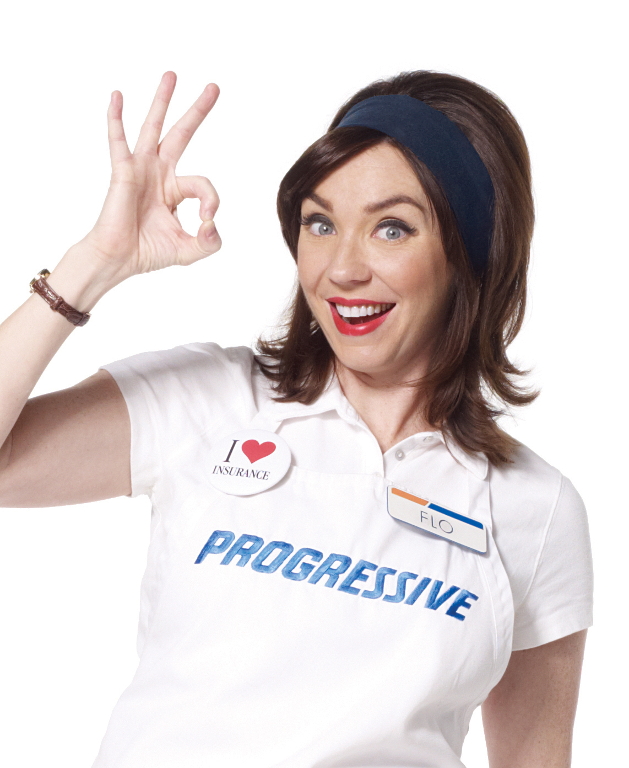
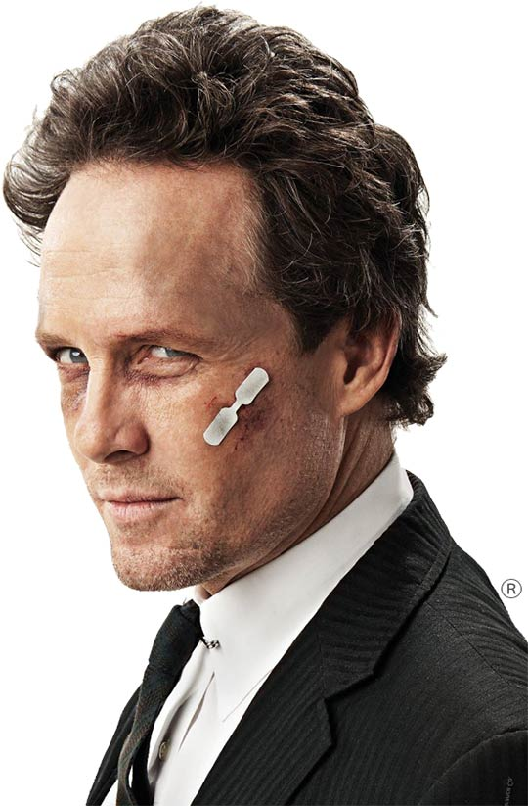

Slide 36
Tell an emotional story.

Slide 38
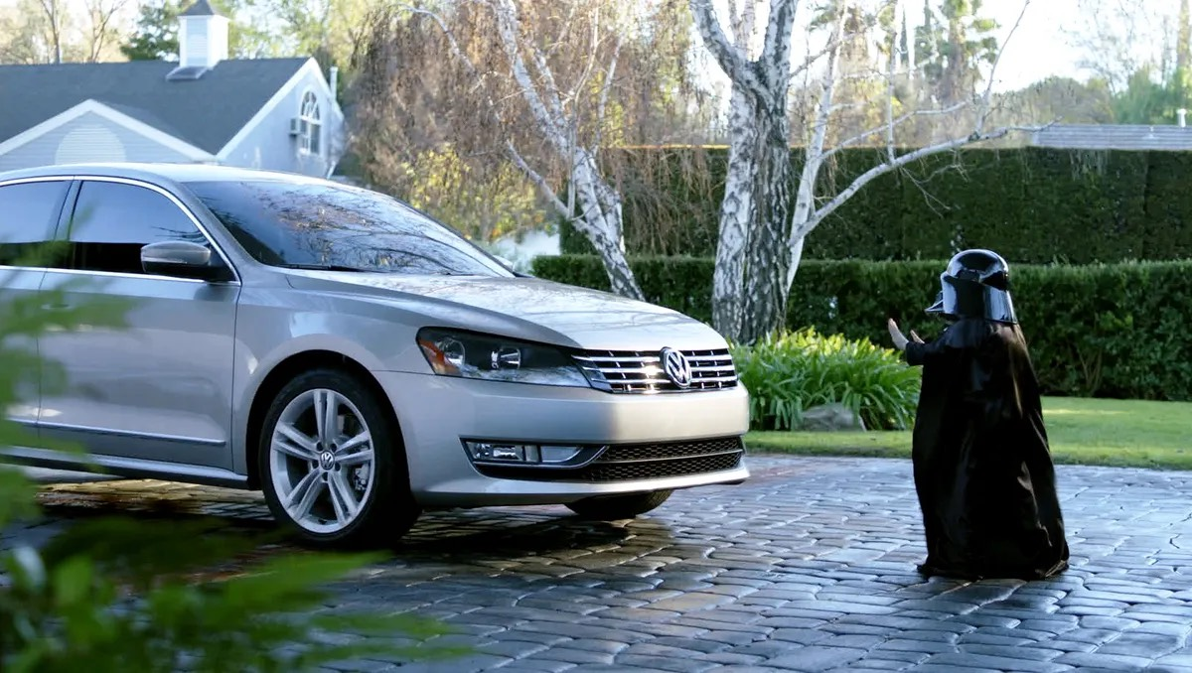

Slide 39
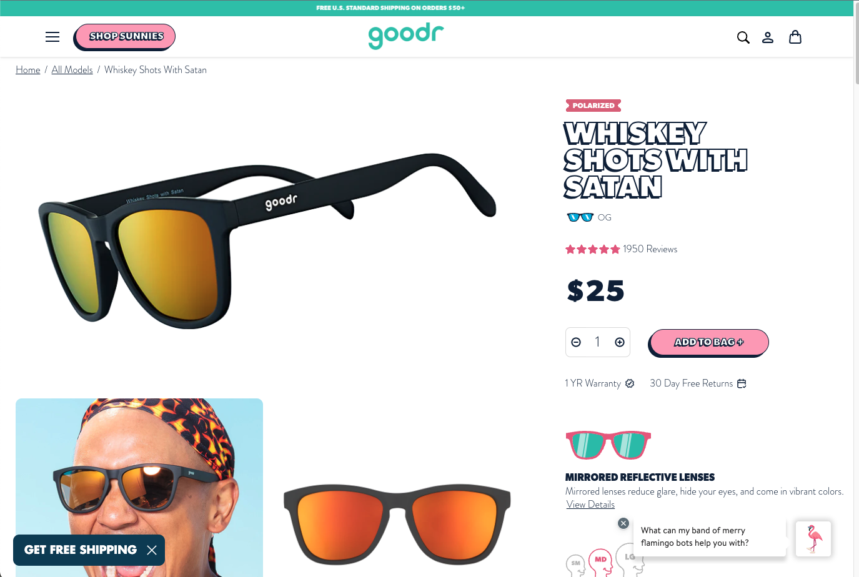

Slide 40
Create a community with a cause.

Slide 41
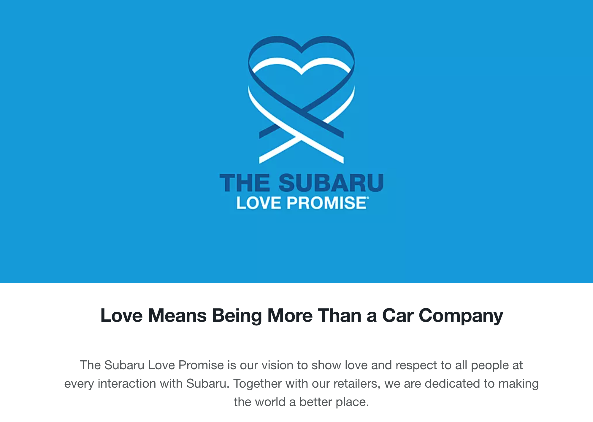

Slide 42
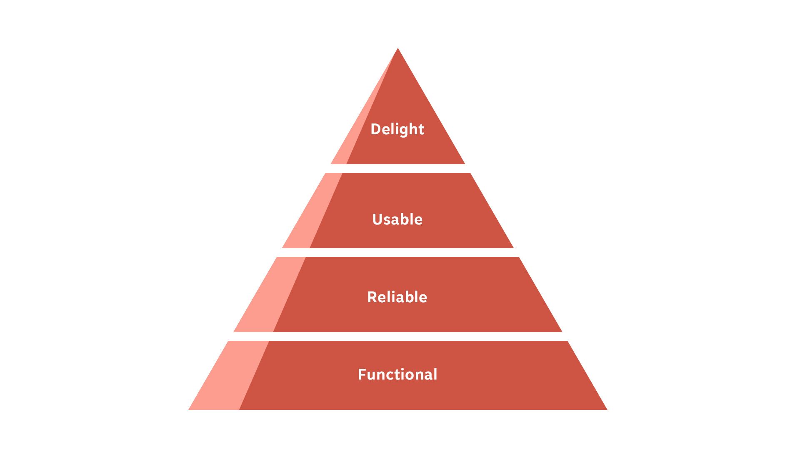

Slide 43
“
In… most cases, companies will find that they are underinvesting in creativity… Increased investment will usually pay for itself: More-effective creative ads will allow other parts of the ad budget to be significantly reduced.
Harvard Business Review

Slide 44
Recap: How to integrate emotion into your brand.
Step 1 Investigate the emotional needs of your customers
Step 2 Map the customer journey
Step 3 Find your moments

Slide 45
Creative
Overview
We offer full-service creative that can execute on all fronts including content ideation, graphic design, videos, ad variants, and compelling visuals.
We will help your brand create a more distinct visual identity and differentiate from the competition.
Strategy
We use data to empower creative decision making. By analyzing what types of creative perform the best, we can cultivate your campaigns with stronger messaging and visuals that resonate with consumers and increase conversion rate. We deliver creative that not only looks great, but also delivers phenomenal results to drive business outcomes.

Slide 46
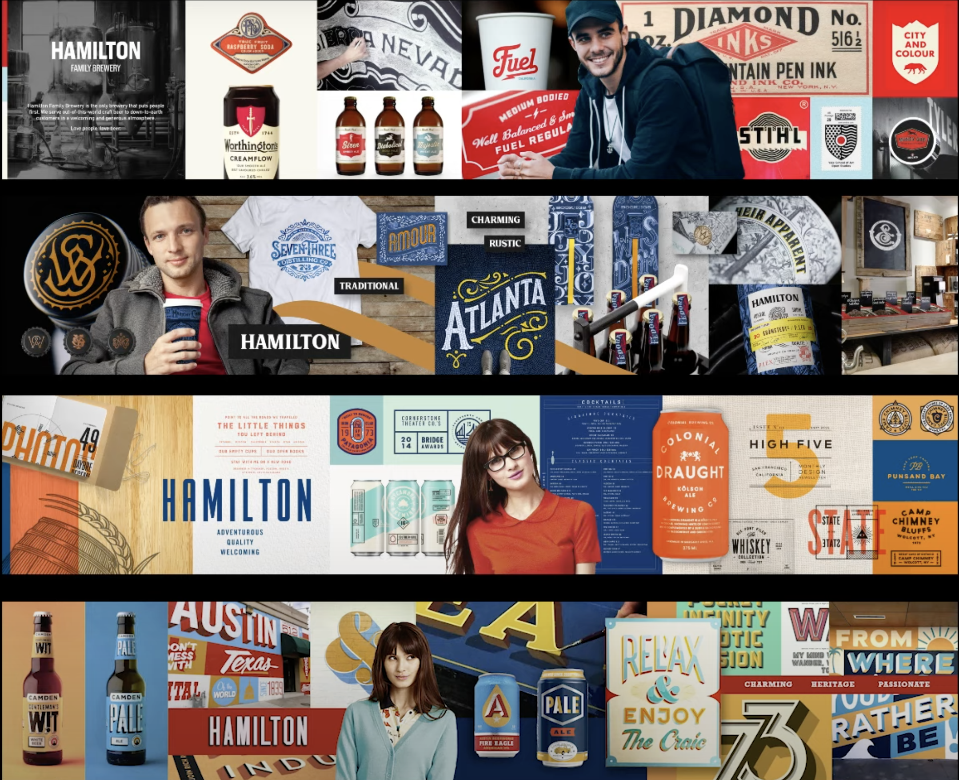
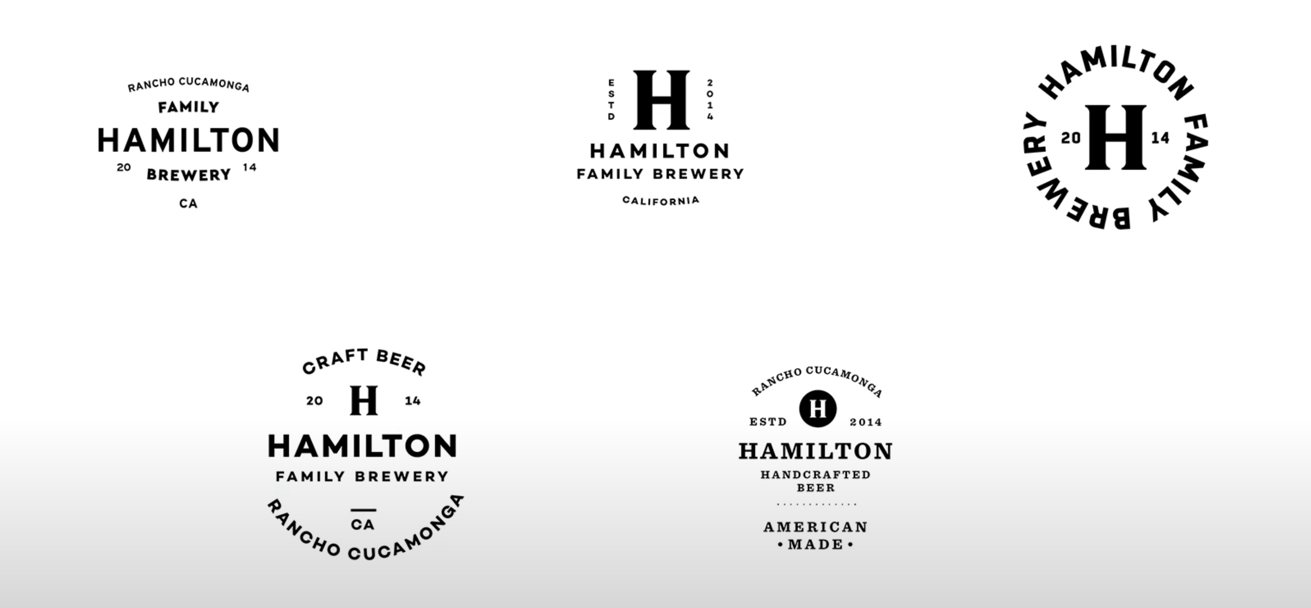
Brand development

Slide 47
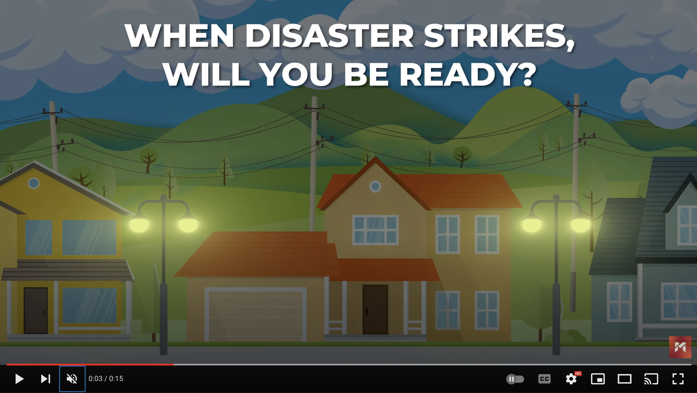
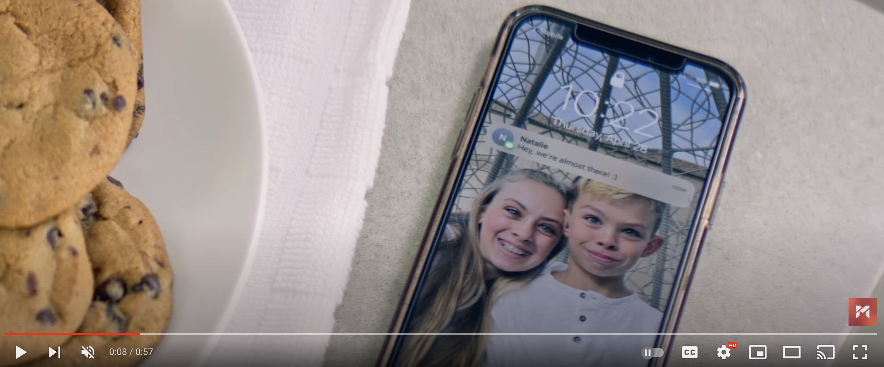
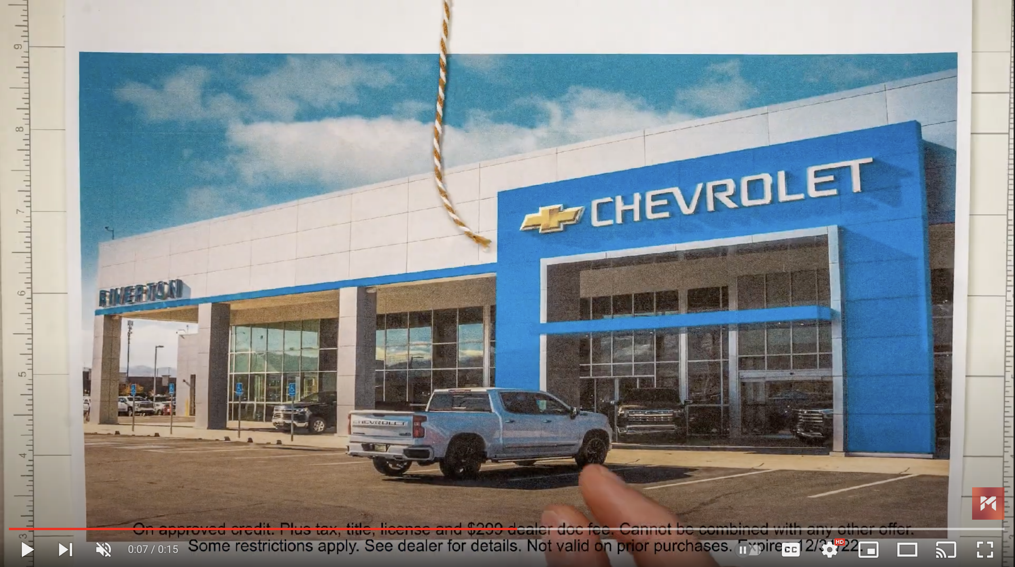
video production

Slide 48
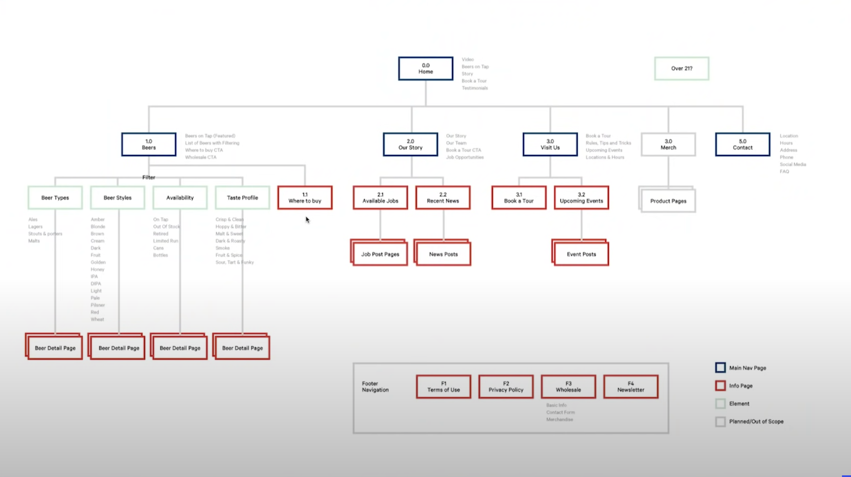
Website UX & visual design

Slide 49
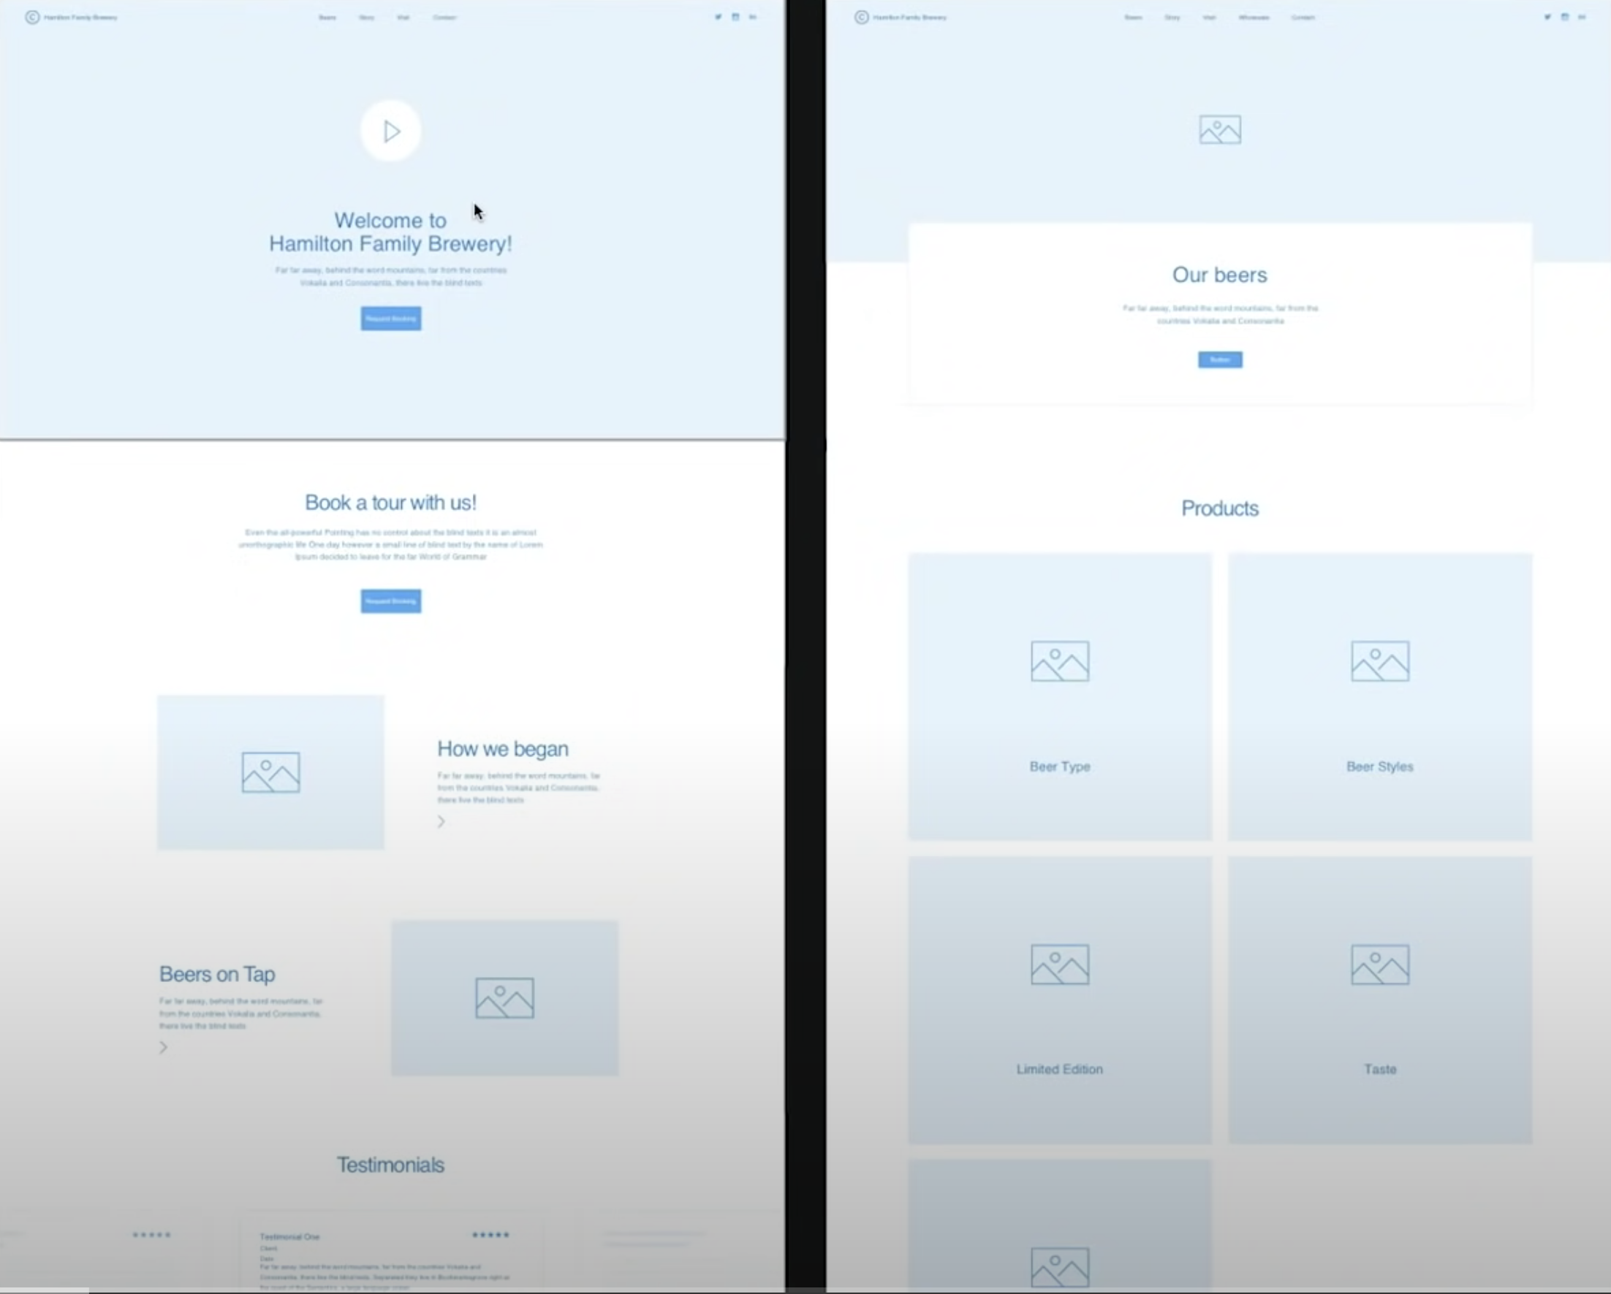
Website UX & visual design

Slide 50
Definitions
SEO: Search Engine Optimization
GMB: Google My Business Profile
Reputation Management: influencing perceptions and public conversations about a brand. It includes monitoring perceptions and conversations, responding to reputation threats and boosting reputation | reviews

Slide 51
ProoF is in the pudding
Metrics | SEO Performance | Growth YoY
Domain Authority | 21,72 | +3.80
# of Ranking Keywords | 13.213 | +4,862
Organic Traffic | 18.942 | +5,887
SEO Monetary Value | 13.554,65 | +$2,768.39
* These metrics are averages from the max connect digital SEO portfolio

Slide 52
SEO Dominance: The Power of Strategic Investment for organic Visibility

Slide 53
Domain AuthoritY
* Domain authority is your websites’ organic credibility. higher scores correlate heavily with more organic success.

Slide 54
SEO + paid ftw!
Metrics | SEO Only | SEO + Paid | Growth Differential
Domain Authority | 3,80 | 3,87 | +0.07
# of Ranking Keywords | 13.213 | 15.174 | +1,961
Organic Traffic | 18.942 | 21.801 | +2,859
SEO Monetary Value | 13.554,65 | 13.931,13 | +$376.48
* These metrics are averages from the max connect digital SEO portfolio

Slide 55
Key takeaways
SEO
Paid Search
Takeaway 1
SEO efforts gets results.
Takeaway 2
The more you invest the better you perform
Takeaway 3
SEO + Paid offers more upside
results

Slide 56
Definitions
Social: Facebook, Instagram, Linkedin, Pinterest, TikTok
OTT | CTV: Over-the-Top or Connected TV media placements that are placed in real-time based on audience matching.
Native Advertising: Material in an online publication which resembles the publication's editorial content but is paid for by an advertiser and intended to promote the advertiser's product.

Slide 58
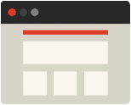
Digital strategy
An omnichannel approach is the best strategy for meeting consumers at every stage of their buying journey and funneling them to an eventual conversion.
Display
Conquest
Social
Pre-roll & ott
Paid search
Retarget

Slide 59
cross-channel
We rely on empirical audience data - not personal opinion - to determine where your messaging will yield the most conversions.
Differentiated campaigns
Segmented audiences
Attribution & campaign insights
Integrated media

Slide 60
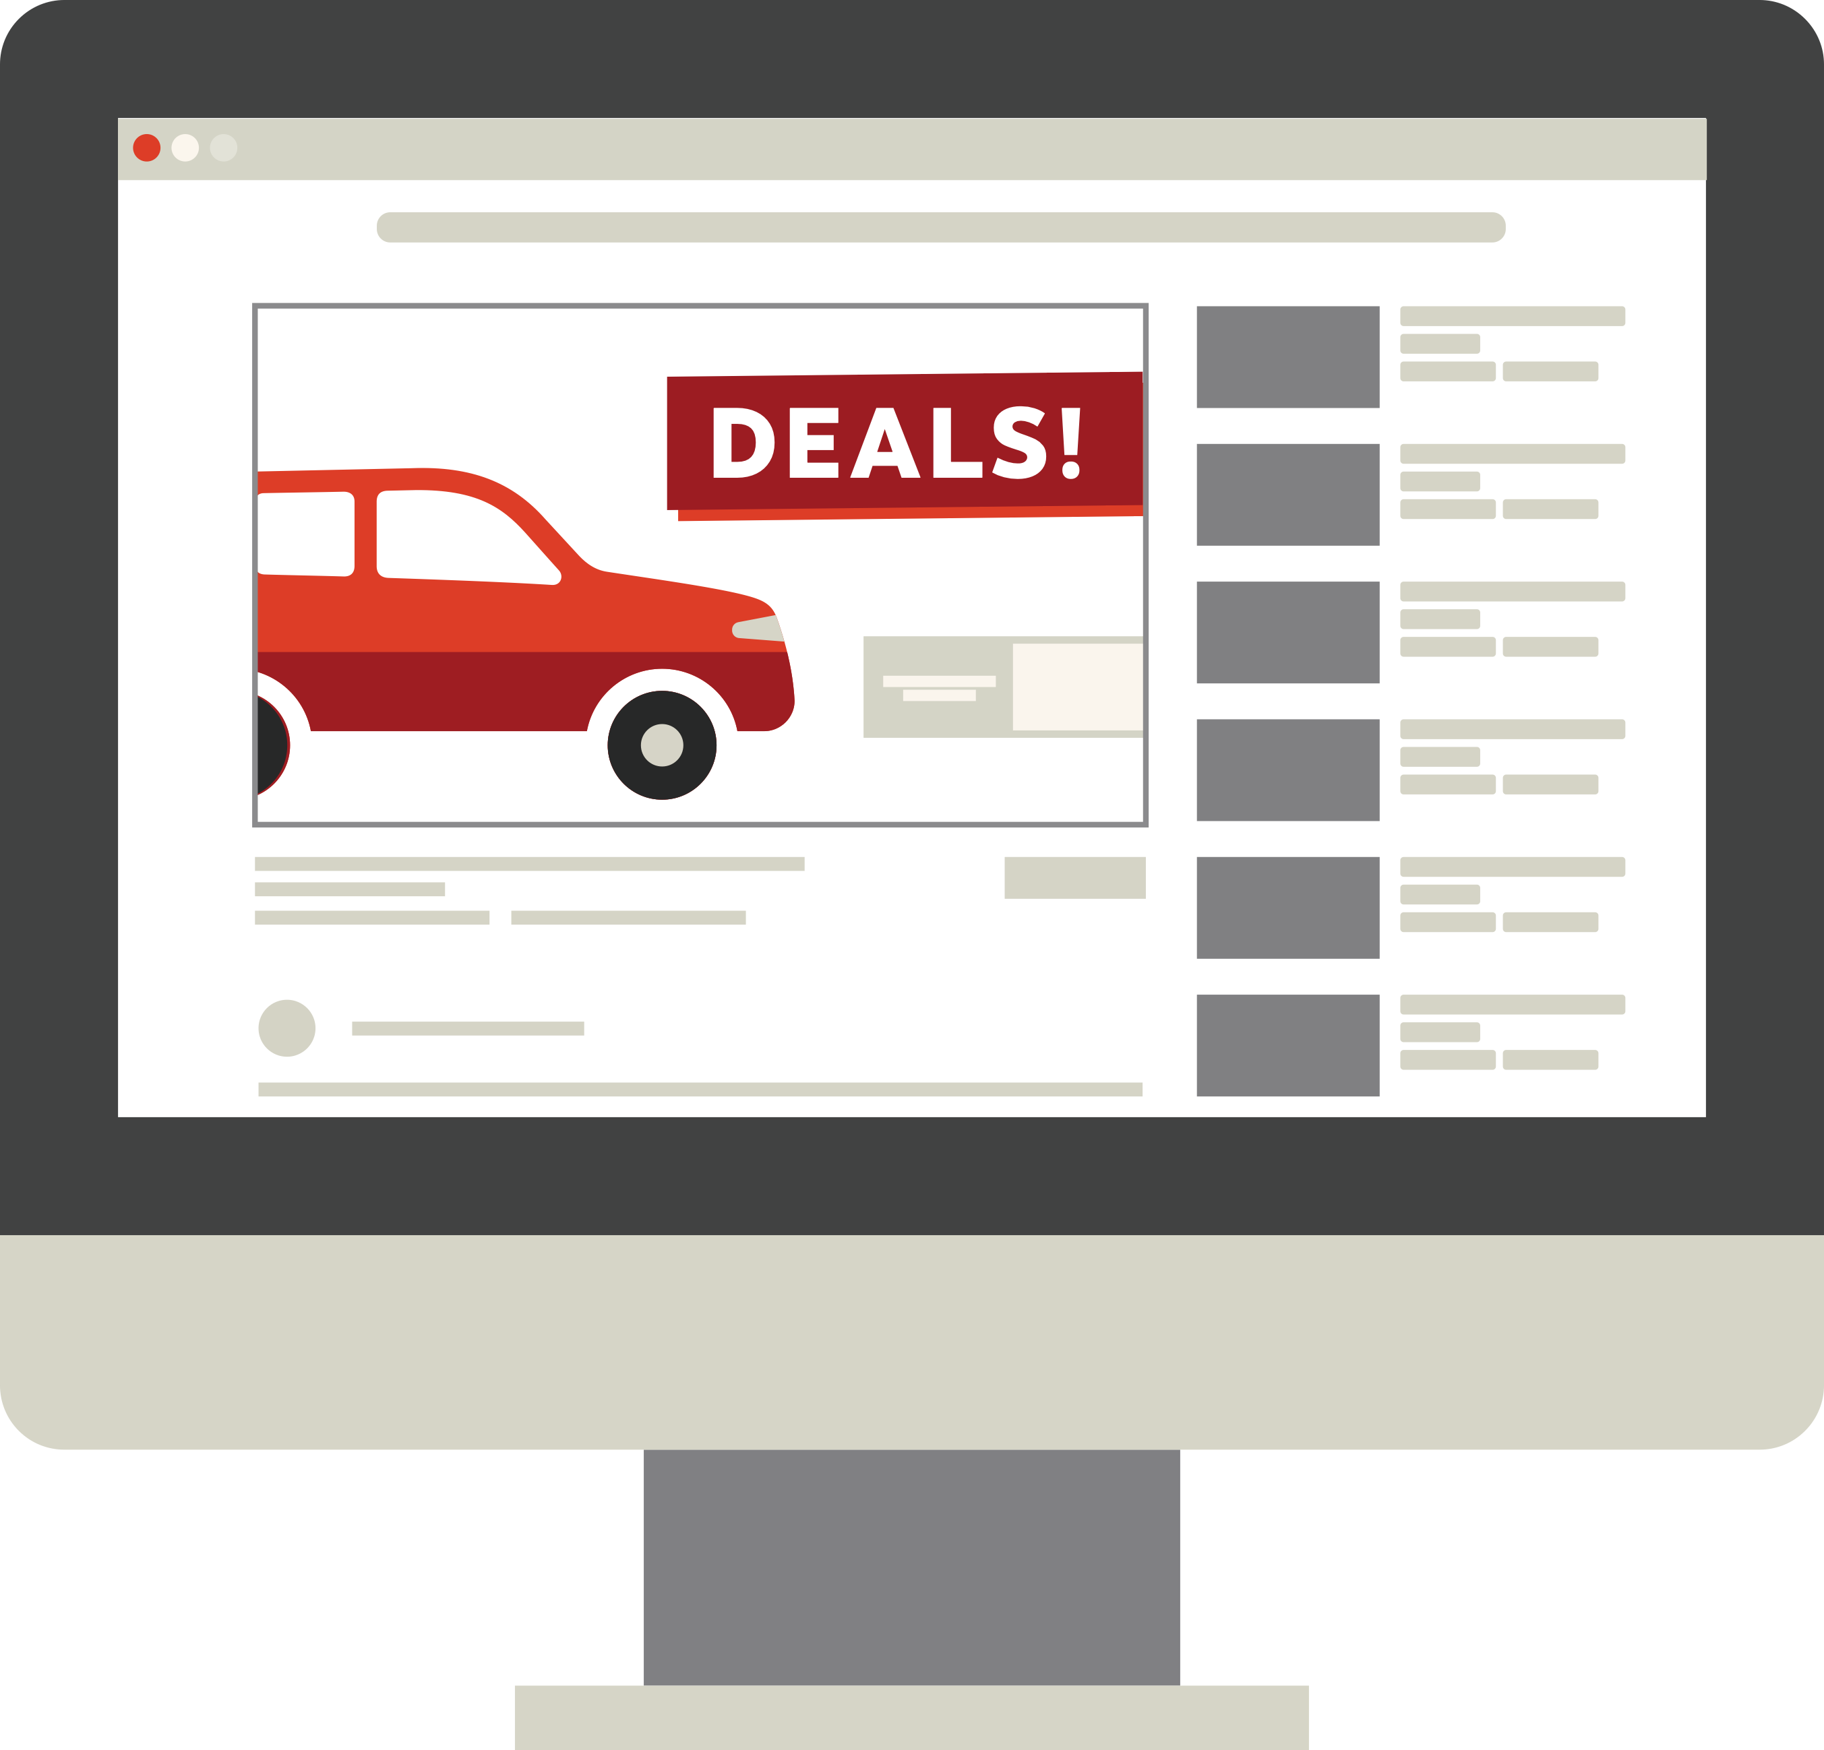
Video pre-roll
Overview
Enlarge awareness and interest in your brand with information-rich content and clickable ads on videos.
Strategy
Supports an omnichannel strategy.
Does more to educate consumers than any other type of content. This allows your brand to funnel customers to a desired conversion.
Helps build brand image and claim consumer mindshare.

Slide 61
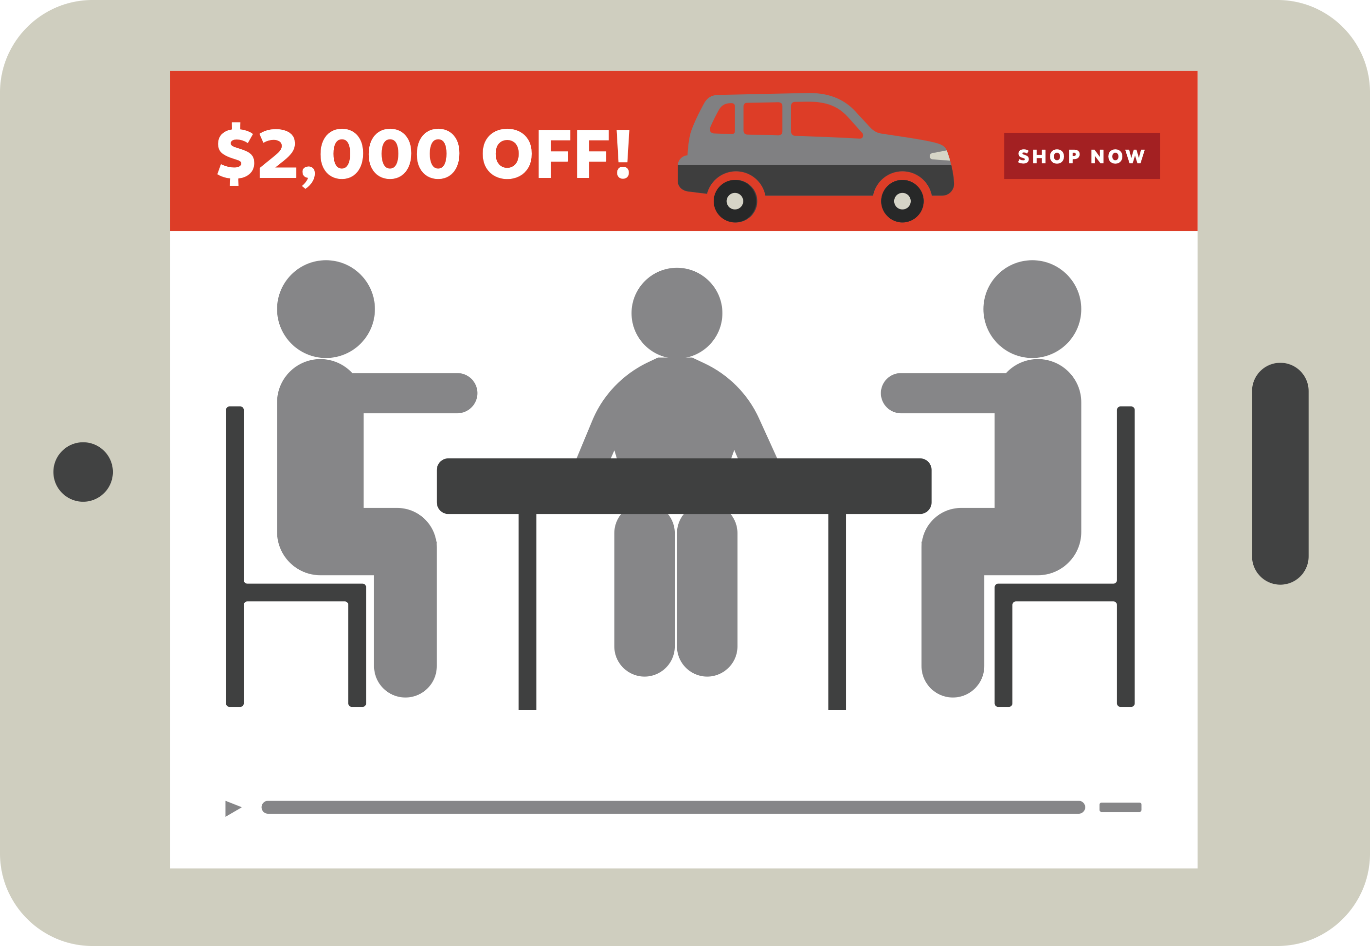
ott | ctv
Overview
Highly dynamic and granular compared to traditional TV - allows your brand to target in-market customers.
Strategy
Supports an omnichannel strategy.
Does more to educate consumers than any other type of content. This allows your brand to funnel customers to a desired conversion.
Helps build brand image and claim consumer mindshare.

Slide 62
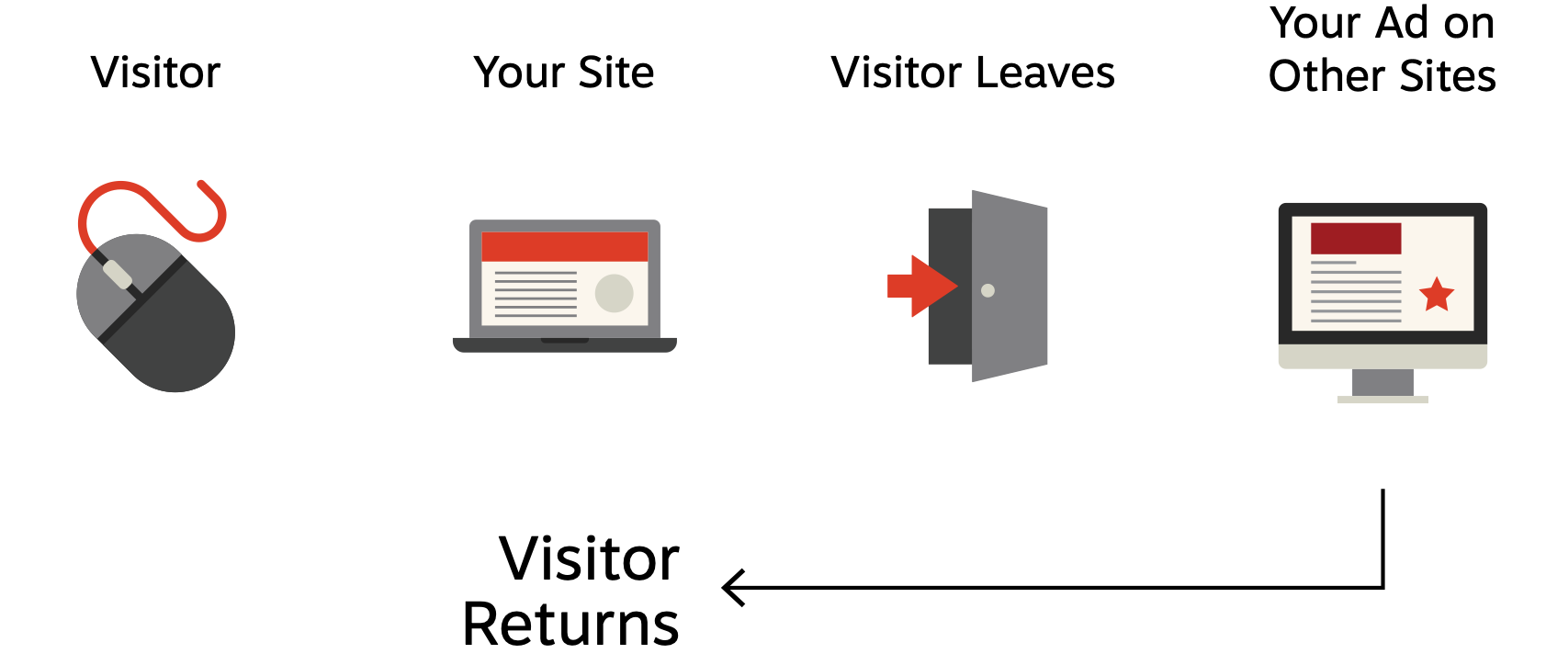
display
Overview
Brand awareness
General prospecting
Remarketing
Product-specific targeting
Layered audiences for hyper-targeted and performance-driven marketing
Strategy
Helps build a memorable brand image.
Dynamic Retargeting: Bring visitors back to the website for a less expensive click compared to their initial visit (ie. much less than paid search).

Slide 63
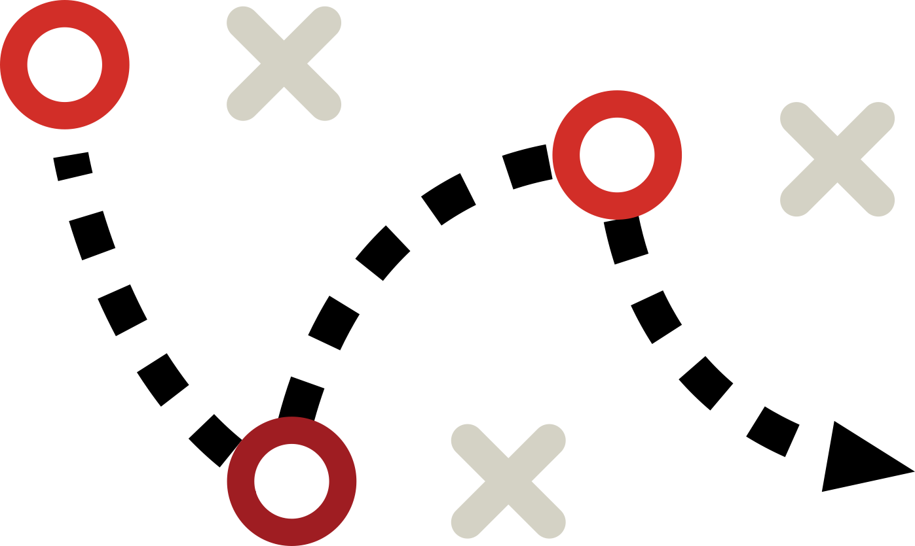
Conquest ads
Overview
Target people who visit your competition online or in-person.
Build audiences around competitor websites and third-party data.
Strategy
Identify key competitors and place ads on their search terms to redirect competitor traffic to your site.
Make value propositions to competitors’ customers, allowing your brand to capture new market share.

Slide 64
Paid social
Overview
Paid social supports your organic presence on social media and guarantees your brand a place in user feeds. Paid social amplifies the reach of your brand, allowing you to increase customer retention rates and drive high-quality traffic to your website.
Strategy
Using audience segmentation, we ensure that your ads are placed in front of the customers who are most likely to convert. We are meticulous in crafting messages that resonate with your target market so your brand can effectively engage with and find new customers.

Slide 65
Paid search
Overview
Our comprehensive search marketing strategy aims to draw in audiences from intent-based keyword search. Utilizing Google Ads, we can hyper-target individuals who are already wanting to learn more about a product or service your brand may offer. This results in a cost-effective method for building awareness and driving traffic to your website.
Strategy
Google Search is a hotspot for high-converting traffic, making it imperative for your brand to have a robust paid search strategy.
We research keywords that consumers are using to find your competitors and then bid on those search terms to highlight your brand above your competitors. This allows your brand to capture new leads and drive sales.

Slide 66
Your growth track
Results
0 days
30 days
90 days
Driving growth through campaign digital ecosystem optimization
Scaling growth, additions of new channels and audiences
Establishing
A baseline

Slide 67
Definitions
Guerilla Marketing: innovative, unconventional, and low-cost marketing techniques aimed at obtaining maximum exposure for a product.
OOH: Out of home advertising (OOH) is a form of advertising that can be found outside of a consumer's home. Traditionally this includes everything from billboards to bus shelters, benches, and everything in-between.

Slide 68
Traditional media

Slide 69
Definitions
Thought Leadership: A thought leader is someone who, based on their expertise and industry perspective, offers unique guidance, inspires innovation and influences others
Earned Media: Any material written about you or your business that you haven't paid for or created yourself.

Slide 70
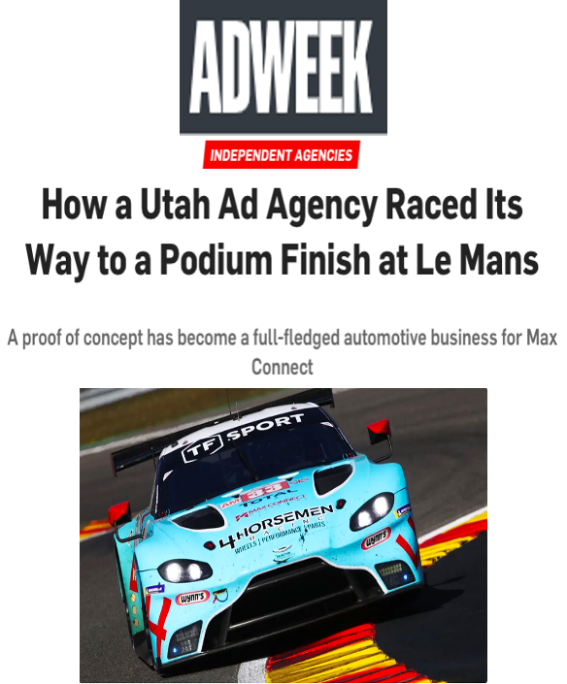
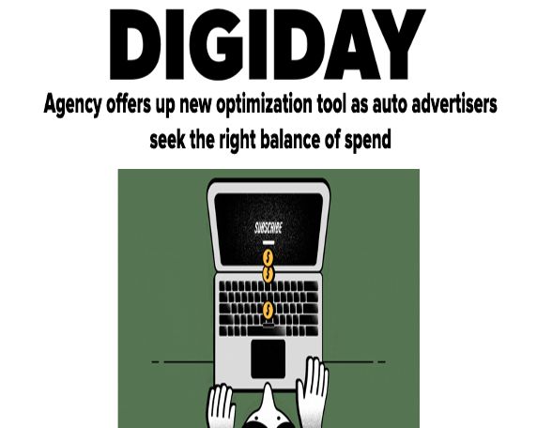
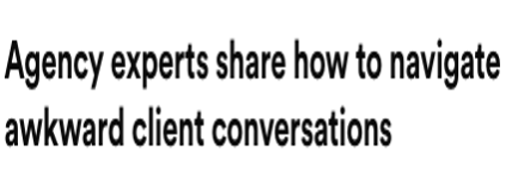
Earned media

Slide 71
Awards | recognitions

Slide 72
Definitions
Grassroots: The process of drumming up interest in a product, brand, or idea with the use of a targeted and highly niche audience.
In-Store: Marketing strategies that target customers while they are in a physical store or brick-and-mortar business and engaging and converting them once they have arrived.
Brand Activation: Making your brand known to people, increasing awareness and engagement through some kind of brand experience

Slide 73
Organic social
Overview
We dive into your brand to understand the demographics and tone of voice of the audience to create content that will resonate with your ideal audience. We are here to inject your followers' feeds with relevant and meaningful social posts that encourage engagement. We help you build an authentic community by adding value to conversations.
Strategy
Our brand management includes listening to your followers, engaging in industry-related topics and trends, and joining online discussions that relate to your brand. We aim to help your brand develop a greater audience appeal, differentiation, and higher customer retention.

Slide 74
Ford fan zone

Slide 75
Boosted social posts

Slide 78
Definitions
Conversion Rate Optimization: the process of increasing the percentage of conversions from a website or mobile app. CRO typically involves generating ideas for elements on your site or app that can be improved and then validating those hypotheses through A/B testing and multivariate testing.
Lead Nurturing: the process of cultivating leads that are not yet ready to buy. Successful lead nurturing anticipates the needs of the buyer based on who they are (using profile characteristics, such as title, role, industry, and so on) and where they are in the buying process.

Slide 79
Campaign optimization
Overview
By analyzing data from Google Analytics, we can identify where your marketing funnel is struggling and establish plans for improving website bounce rate, audience segmentation, and conversions.
A/B Split Testing: With two iterations of content being tested simultaneously, we can understand which content resonates the most with target audiences in real-time. This allows us to improve user engagement during the development of a digital campaign.
Strategy
We optimize campaigns that are underperforming and push even the best campaigns to do better. In the case that conversions are lower than expected, we examine other factors that may be affecting the customer journey. For example, design flaws on the business website can negatively impact the user experience. Creating a seamless landing page is our top priority to ensure that conversions are being maximized.

Slide 80
LANDING PAGES

Slide 81
Heat Maps

Slide 82
Email nurturing flows

Slide 83
Definitions
Influencer: a person with the ability to influence potential buyers of a product or service by promoting or recommending the items on social media.
Affiliate: an individual or a company that markets the seller's product in an appealing way to potential consumers.
Brand Collaboration: an excellent way for companies to cross-promote and reach new audiences. When two brands team up, they each bring their own customer base, social media community and resources to the table.

Slide 84
INFLUENCERS

Slide 85
Definitions
CAC | CPA: Customer Acquisition Cost and Cost per Acquisition.
CRM: Customer Relationship Management platform.

Slide 87
Our business intelligence platform: made for your growth acceleration
Kudos was built with the goal of giving you better customer insights and an easier and more effective way to analyze your digital marketing.
This platform was built with the business stakeholders in mind, not just the digital marketer.

Slide 88
DIGITAL FLOW – YEAR LOOK BACK
IMPRESSIONS
10,086,026
Over 10 million impressions were delivered to electricians/users in the market for buying a product
CLICKS
160,972
Over 150k clicks attributed from electricians/users from paid media campaigns with an avg. CTR of 1.6%
VISITORS
160,585
Over 150,000 visitors came to bigelectricsupply.com from all sources including organic and direct
TRANSACTIONS
2,384
Over 2,000 transactions from paid media and organic and direct
CONVERSION RATE
1.06%
Over 1% conversion rate for all transactions made

Slide 89
Definitions
CDP: software that combines data from multiple tools to create a single centralized customer database containing data on all touch points and interactions with your product or service: Customer Acquisition Cost and Cost per Acquisition.
Loyalty Program: sponsored by retailers and other businesses, offer rewards, discounts, and other special incentives as a way to attract and retain customers. They are designed to encourage repeat business, offering people a reward for store/brand loyalty

Slide 90
Access Pass Updates
Nike

Slide 91
Mobile apps

