Slide 1
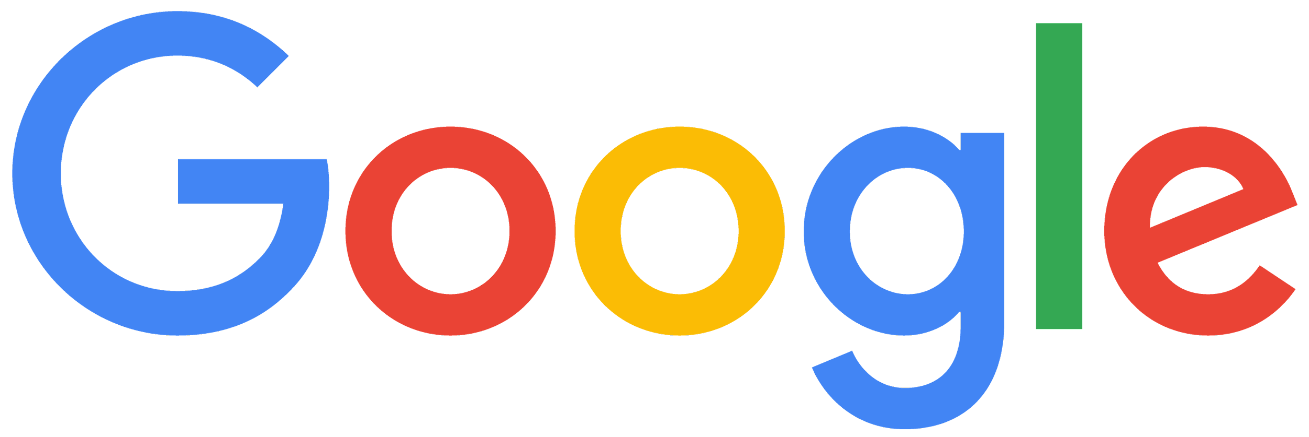
Modern Marketing

Slide 2
Table of contents
The 3 C’s of Growth with Google
Today’s Consumer
Customer-centric
Cutting-edge
Competitive
The world has changed; Consumers have more choice and control than ever before.
Optimize existing Search campaigns via Search Ads Automation, Privacy & Measurement
Be ready for new channels and formats
Your human expertise + your unique 1P data = your competitive edge

Slide 3
Please make a copy of the template before using.
Please input relevant names & dates into title slide.
Today’s Consumer

Slide 4
The world has changed.
Consumers have more choice and control than ever before.
Then
Now
Notes:
We can use this opportunity to say that marketing has changed. We can ask marketers tp shift their thinking from a 360-degree view of customers to a 360-degree view of their business. Most of what we're saying stays the same, but this subtle shift allows marketers to think more holistically about their data and business, instead of focusing on what is 'lost'

Slide 5
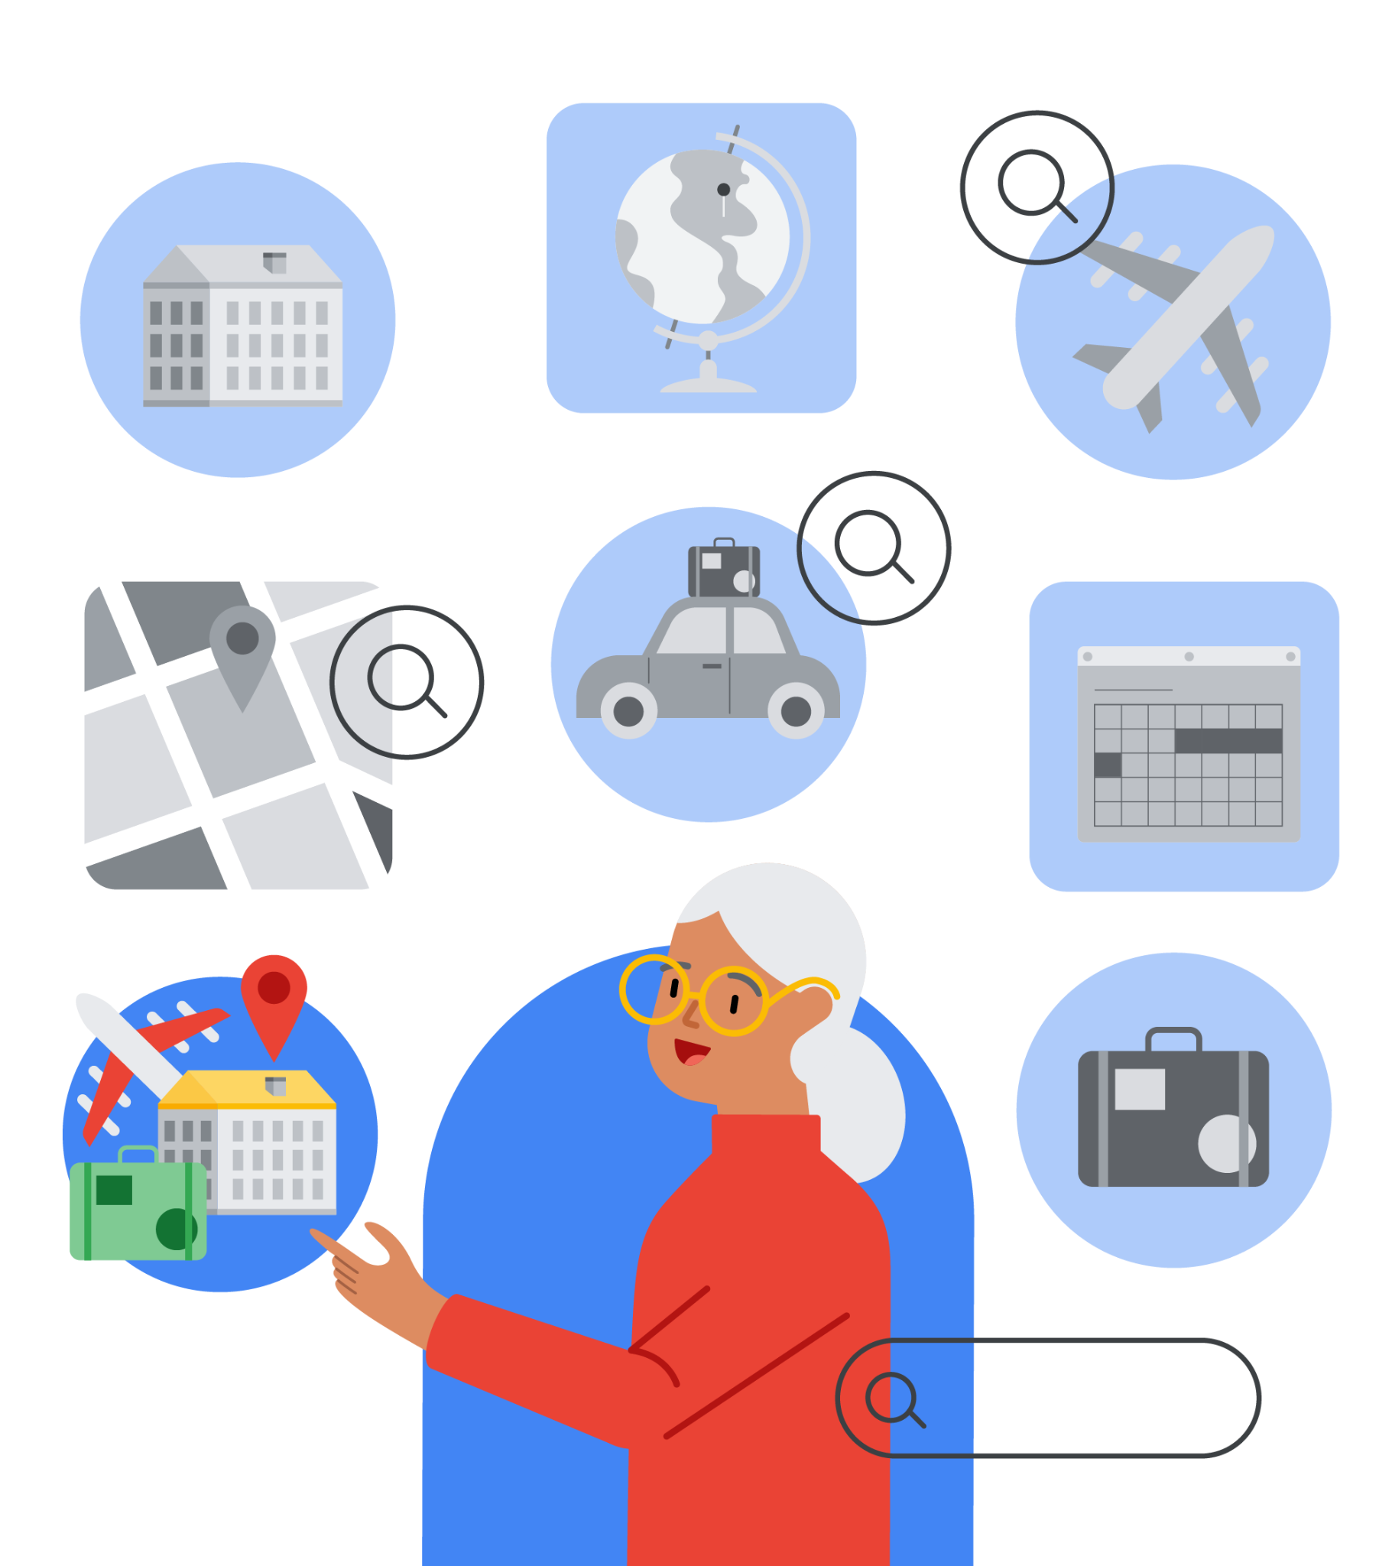
Did you know it takes people an average of 8 searches to complete complex tasks?
Search is the top tool used by consumers to research in-store purchases.
Source : ‘8 searches’ - Google Internal Data, 2021; ‘Top tool’ - Google commissioned Ipsos COVID-19 tracker, US, CA, UK, FR, DE, IT, AU, JP, RU, IN, CN, BR, MX, ES, ZA, KR n=1000 online consumers 18+ per market. Sept 10-13 2021
Notes:
In a recent survey Google conducted, search was the top resource consumers use to research their in-store purchases, in surveyed countries across the globe.
And it’s not just for straightforward purchases either: purchasing a family vacation was never a walk in the park - but with COVID in the mix, it’s got even more complex.
Source:
‘8 searches’ - Google Internal Data, 2021
Top tool - Google commissioned Ipsos COVID-19 tracker, US, CA, UK, FR, DE, IT, AU, JP, RU, IN, CN, BR, MX, ES, ZA, KR n=1000 online consumers 18+ per market. Sept 10-13 2021

Slide 6
Purchase journeys are more complex than ever, and span several channels over several days.
+150%
increase in searches containing ‘near me with outdoor seating’
YOY
COVID has only increased the complexity in everyday tasks.
Pockets of demand appear and disappear in response to changing regulations and mandates.
+600%
in searches for ‘travel rules’
YOY
in searches for ‘last minute hotel deals’
+70%
YOY
Source : ‘Outdoor seating’ - Google data, global English, Sep.1, 2019 - Aug.1 2021; ‘Travel rules’ - Google Data, Global English, Aug 31, 2021 - Oct 29, 2021 vs Aug 31, 2020 - Oct 29, 2020; ‘Hotel deals’ - Google Data, Global English, Aug 31, 2021 - Oct 29, 2021 vs Aug 31, 2020 - Oct 29, 2020
Notes:
Booking a family vacation or fixing a broken appliance are complex tasks that require several searches, as the consumer expands and contracts their consideration set, and eventually moves to a purchase.
COVID has complicated these sorts of tasks even further: with ever-changing regulations and requirements, the customer has to make several more searches to achieve the same objective.
For example, searches for "travel rules" have grown globally by over 600% YoY, as consumers vye to keep on top of rapidly changing COVID regulations.
Fluidity and flexibility are now the norm: searches for "last minute hotel deals" have grown globally by over 70% YoY.
Sources:
‘Outdoor seating’ - Google data, global English, Sep.1, 2019 - Aug.1 2021
‘Travel rules’ - Google Data, Global English, Aug 31, 2021 - Oct 29, 2021 vs Aug 31, 2020 - Oct 29, 2020
‘Hotel deals’ - Google Data, Global English, Aug 31, 2021 - Oct 29, 2021 vs Aug 31, 2020 - Oct 29, 2020

Slide 7
Experiences that were traditionally offline have moved online.
+200%
increase in searches containing ‘online doctor consultation’
YOY
This migration has created new opportunities
for business growth, across industries.
+200%
in searches for ‘online dating’
YOY
in searches for ‘multiplayer online games’
+100%
YOY
Source : ‘Doctor consultation’ - Google Data, Global English, Apr 27, 2021 - Jun 25, 2021 vs Apr 27, 2020 - Jun 25, 2020; ‘Dating’ - Google Data, Global English, Sep 2020 - Aug 2021 vs Sep 2019 - Aug 2020; ‘Multiplayer’ - Google Data, Global English, Sep 2020 - Aug 2021 vs Sep 2019 - Aug 2020
Notes:
Some of these new pockets of demand that have emerged as a result of the pandemic are here to stay.
Demand for traditionally in-person experiences has gone online: Searches for ‘online doctor consultation’ have grown globally by over 200% YOY. Searches for ‘online dating’ have also grown globally by over 200% YOY.
Trends have been accelerated: online gaming was already big, but searches for ‘multiplayer games online’ have grown by over 100% globally YOY.
We’re witnessing a moment in history on a similar scale to the shift to broadband, or the evolution from desktop to mobile.
This migration from offline to online can create either confusion and inconsistency for businesses, or a host of brand new opportunities for growth.
Google is here to help ensure your business is in the camp that harnesses the opportunity.
Sources:
‘Doctor consultation’ - Google Data, Global English, Apr 27, 2021 - Jun 25, 2021 vs Apr 27, 2020 - Jun 25, 2020
‘Dating’ - Google Data, Global English, Sep 2020 - Aug 2021 vs Sep 2019 - Aug 2020
‘Mulitplayer’ - Google Data, Global English, Sep 2020 - Aug 2021 vs Sep 2019 - Aug 2020

Slide 8
Consumers wanted personalization before the pandemic, now they demand it.
71%
of consumers now expect to receive personalized interactions.¹
76%
76% of consumers said receiving personalized communications was a key factor in prompting their consideration of a brand ²
Source 1 & 2: McKinsey
Notes:
For brands who are INVESTING and looking to build market share and share of voice during the current times, Discovery is a way to maintain share of voice while still supporting short term cash flow and driving on prospecting metrics / new customer acquisition.

Slide 9
Consumers see privacy as a basic human right that they expect to be respected.
9 out of 10
Adults believe companies should only have access to personal data with permission or not at all¹
85%
of internet users take some precautions to protect their online information ²
Source 1 & 2: McKinsey

Slide 10
The 3 C’s of Growth with Google
CONFIDENTIAL + PROPRIETARY
Here's how you can drive business growth through the 3 C's.

Slide 11
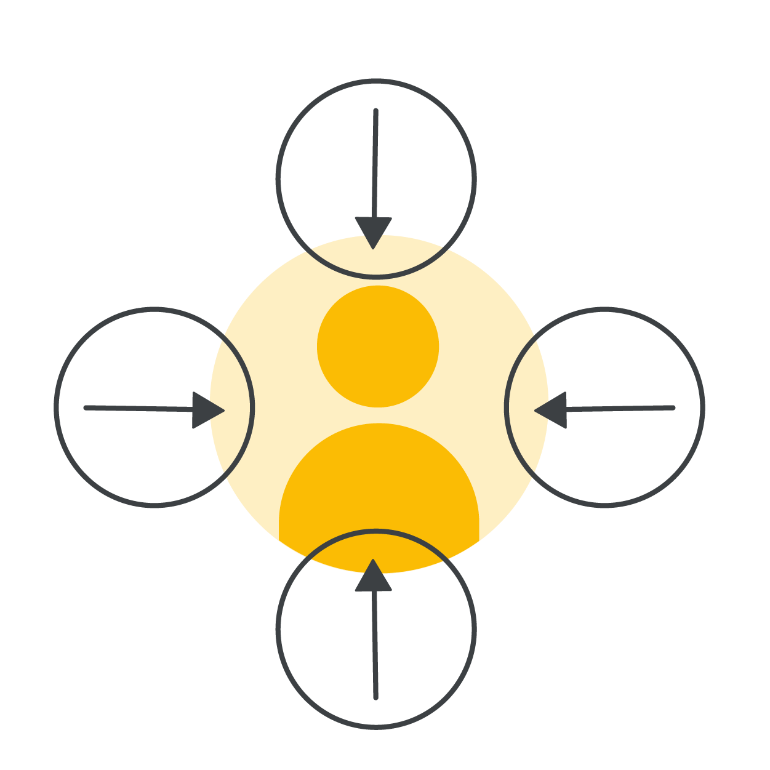
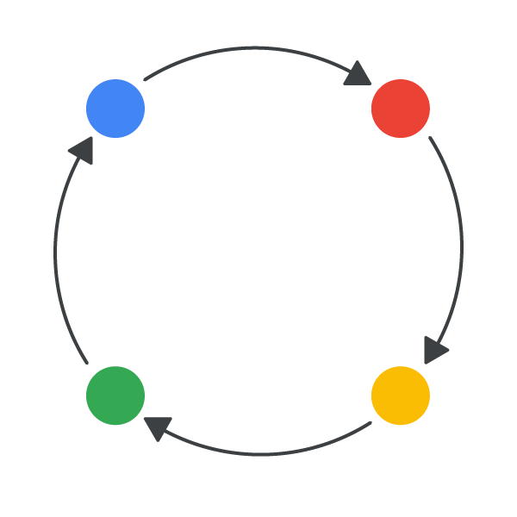
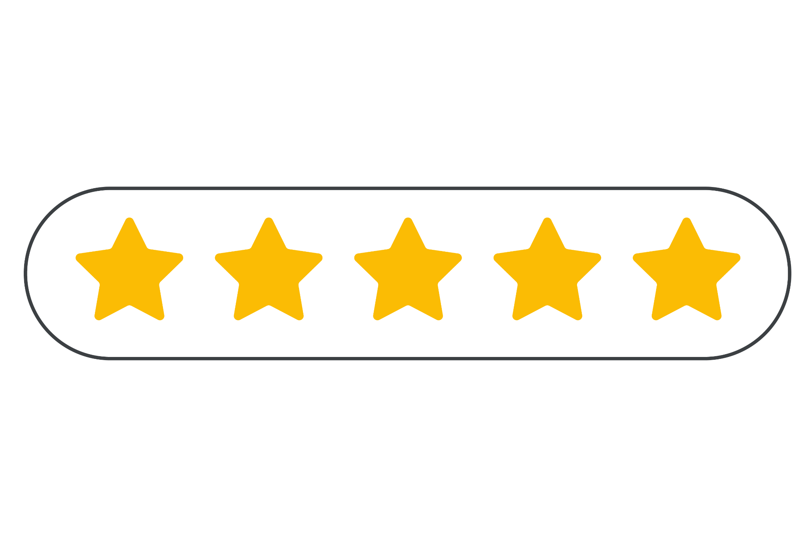
Be top of mind at unprecedented scale.
Be customer-centric
Be cutting-edge
Be competitive
Automate your marketing to ensure your customers continue to experience the best of your brand, in the best moment.
Ensure your online experience is ready for new channels and formats - show up the right way, every time.
Make your 1P data work for you. Scale your human expertise so that you can scale business results.
Notes:
Marketing has always been about having the right message top of mind in the right moment for the right customer.
But with this explosion of new multi-channel moments, complex decisions, competition, and environmental change, marketers need a way to be top of mind at unprecedented scale: from brand to demand.
With a customer-centric, cutting-edge and competitive partnership, Google’s automation can be your engine to drive sustained growth at scale.

Slide 12
Customer-centric
Remain customer-centric despite complexity by:
Automating your existing Search campaigns
Staying focused on privacy and uplevelling your measurement
Notes:
The first step to customer-centricity is to automate your existing Search campaigns, while staying focused on privacy standards.
Combined with uplevelled measurement, you can ensure your marketing is scaled, so your customers continue to experience the best of your brand, in the best moment.

Slide 13
Search Ads Automation
Search Ads Automation
Deliver business results at scale.

Slide 14
Machine learning, which powers our automated products, not only brings magic to consumers…
Search Ads Automation
mount evarest
About 1,530,000 results (0.70 seconds)
Did you mean: mount everest
Listening...
Notes:
Machine learning already brings magic to consumers.
Google Search helps you find that melody that’s stuck in your head with machine learning. Just play, sing or even hum it.
The introduction of machine learning into Google Search’s spelling algorithm improved it in one day more than the previous five years combined.

Slide 15
…it keeps advertisers ahead of the trends that matter.
Search Ads Automation
The same Machine Learning that powers natural language processing, helping Google understand Search intent, also powers broad match. ML helps broad match pair an advertiser's search ads with the most relevant searches.
Trends panel interface
Notes:
Automation powered by machine learning is already working for advertisers around the world - the Insights page, we’ve shown over 4.6M search trends to advertisers, helping them inform their marketing decisions and discover new opportunities.
Advertisers are applying automation to more aspects of their campaigns than ever before — from automatically assembling and selecting the best-performing creatives with responsive search ads, to finding more search queries that perform using broad match keywords, and setting the right bid for every auction by factoring in a wide range of signals that predict performance using Smart Bidding.

Slide 16
Boost the impact of your ads by combining automated
products to drive growth.
Search Ads Automation
Smart Bidding
+
Broad match
+
Responsive search ads
Delivers the right bid for each query at the right price
Finds new, high-performing queries and emerging trends
Assembles the most relevant creative from your assets — even helping you show for more queries
Notes:
When you establish a partnership with Search Automation, you can follow a simple formula for growth. It’s as straightforward as using broad match with Smart Bidding and responsive search ads.
Broad match helps you find new high-performing queries and emerging trends.
Smart Bidding optimizes bids in real time to hit your performance goals even as query volume and conversion value change. This means that you can deliver the right creative to each query at the right price.
Responsive search ads combine your creativity with the power of Google’s machine learning to help you deliver relevant, valuable ads. It automatically assembles your most relevant creative, even helping you to show for queries you didn’t before by creating new versions of the copy.

Slide 17
First, start with Smart Bidding.
Search Ads Automation
Smart Bidding
+
Broad match
+
Responsive search ads
Delivers the right bid for each query at the right price
Finds new, high-performing queries and emerging trends
Automatically assembles the most relevant creative — even helping you show for new queries
Notes:
We’ll start with broad match…

Slide 18
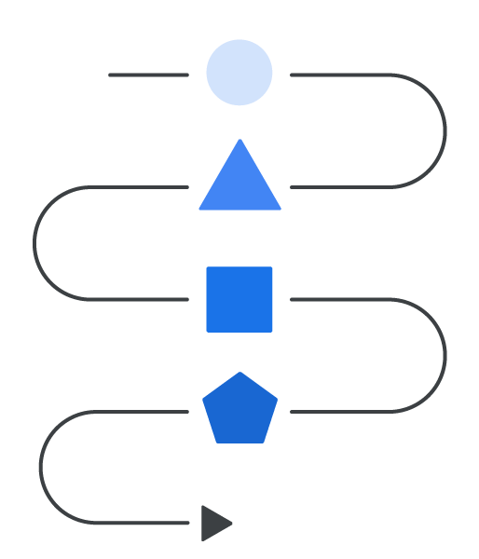
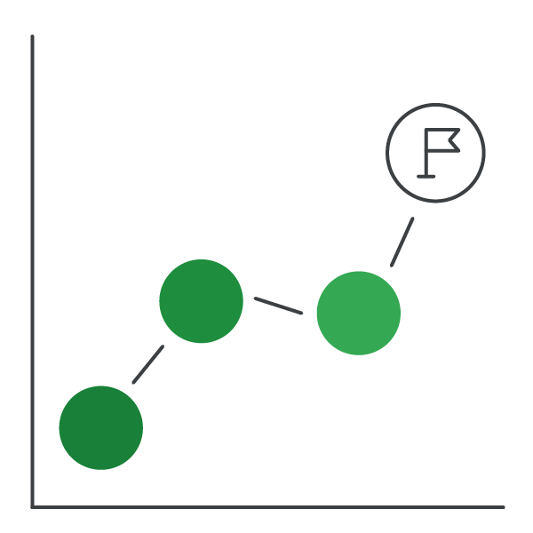
More than 80% of advertisers are already using automated bidding to...
Search Ads Automation
Adjust to a dynamic market
Utilize more signals
Reach performance goals
Source: ‘80%’ - Google Internal Data, Global, Mar. 16, 2021 to Apr. 12, 2021
Notes:
More than 80% of advertisers are already using Smart Bidding to:
Adjust to a dynamic market
By optimizing your bids in real-time, Smart Bidding can help you stay on top of market trends and rapidly-shifting demand.
Utilize more signals
Smart Bidding uses data beyond just what’s in your account to ensure that you’re making the right bid for every query.
Reach performance goals
Smart Bidding stays focused on the targets you provide — while giving you control and transparency in reporting.
Source:
‘80%’ - Google Internal Data, Global, Mar. 16, 2021 to Apr. 12, 2021

Slide 19
Smart Bidding uses billions of combinations of signals in each auction
Search Ads Automation
Location Intent
Browser
Interests
Language
Week day & time of day
App reviews
Time
Query
Device
Ad characteristics
Device type
Recency on list
Conversion path
Location
Audience segment
Search network partner
Notes:
To set the right bid, Smart Bidding predicts and sets millions of unique bids every second across campaigns using automated bidding–more than what any platform or individual practitioner can handle. And it incorporates all of the signals that you see here, and more.
This is true auction-time optimization that sets bids for each individual auction, not just a few times a day.
This means that it’s now possible for advertisers to set bids based on each user’ context in the moment. Automated bidding is the only way to account for all of these available signals and improve performance.

Slide 20
Add broad match to Smart Bidding, to drive growth.
Search Ads Automation
Smart Bidding
+
Broad match
+
Responsive search ads
Delivers the right bid for each query at the right price
Finds new, high-performing queries and emerging trends
Automatically assembles the most relevant creative — even helping you show for new queries
Notes:
The second tool in your box of automated products is Smart bidding. Smart bidding optimizes bids in real time to hit your performance goals even as query volume and conversion value change. This means that you can deliver the right creative to each query at the right price.

Slide 21
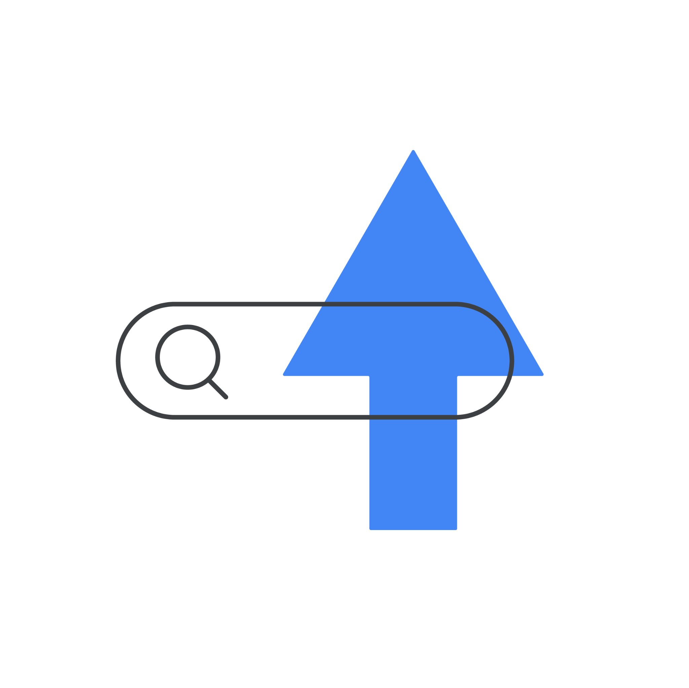
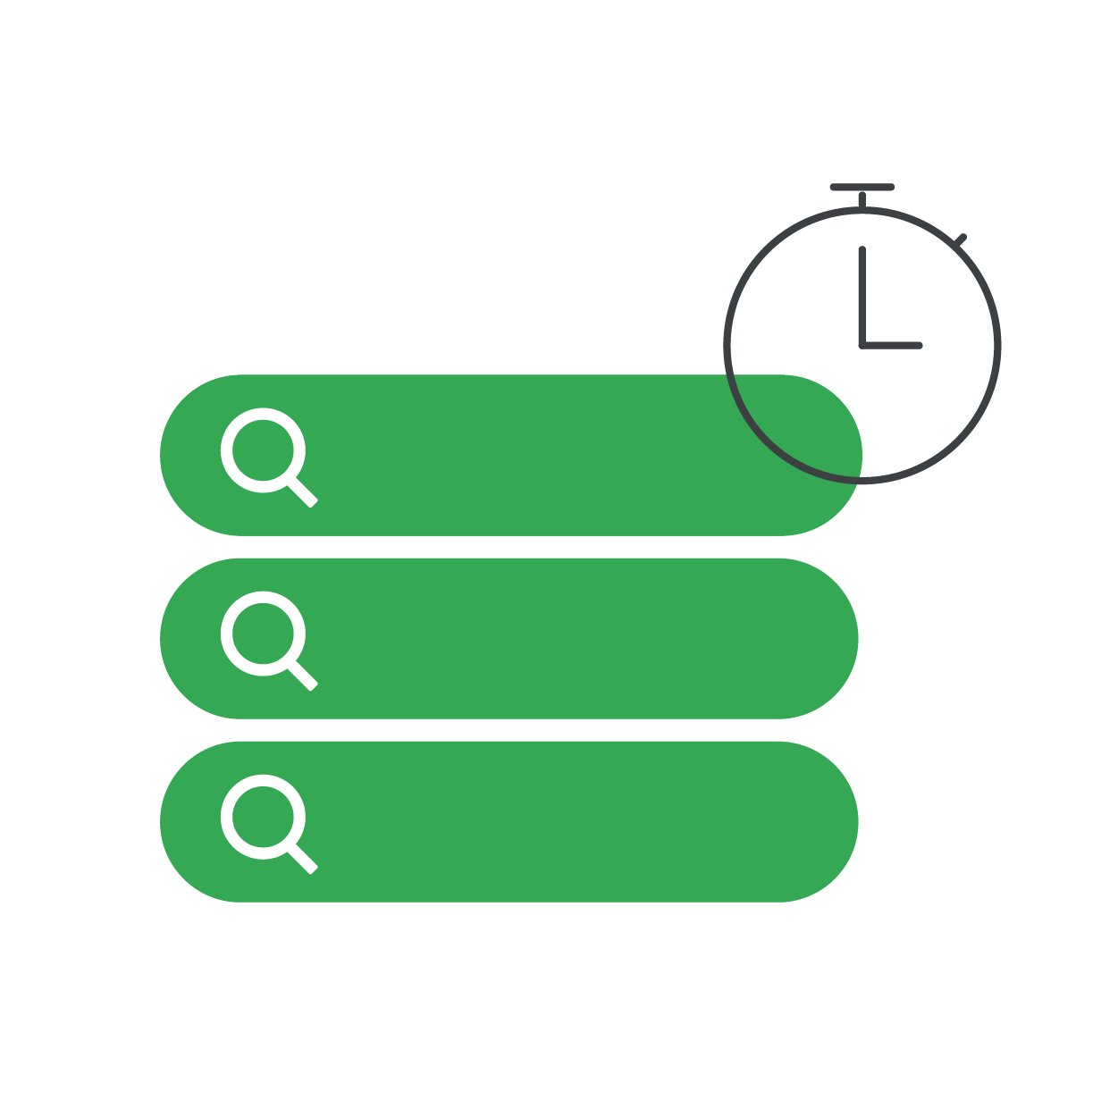
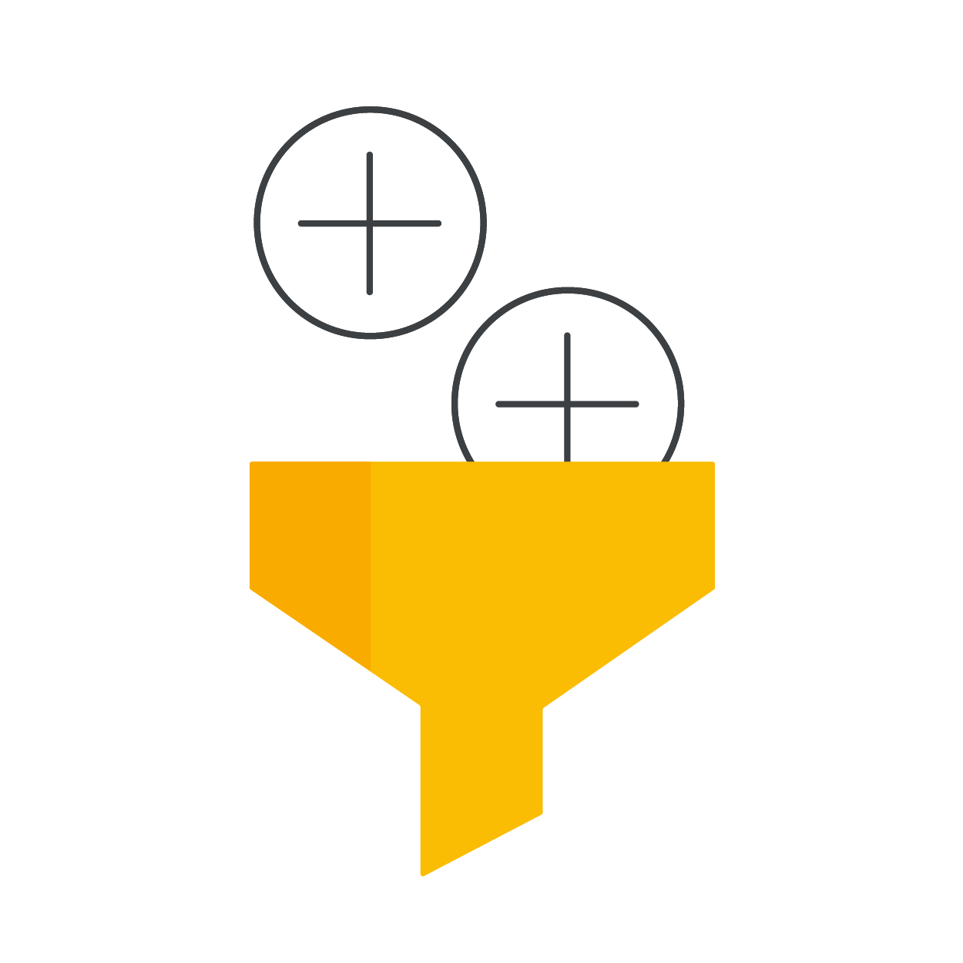
Reach more customers and drive better performance with broad match
Search Ads Automation
Expand
Identify and capture new, high-value queries relevant to your business.
Increase efficiency
Pay for the keywords that work, and avoid wasted spend on the ones that don’t.
Save time
Spend less time on creating and managing extensive keyword lists.
Be relevant
Pull in more relevant signals for a better match to the intent of each query.
Notes:
Broad match is a good example of machine learning working to ensure your automated campaigns are optimized.
It increases efficiency by ensuring you pay for the keywords that work. It saves you time on legacy tasks. It expands your campaign’s reach by identifying and capturing brand new, high-value queries.
Legacy tasks like creating and managing extensive keyword lists are no longer required: strategists can devote more time and attention to providing strategic value.
And broad match ensures your campaign stays relevant, by pulling in more relevant signals, for a better match to the intent of each query.

Slide 22
Broad match today is not the broad match you remember
Search Ads Automation
Broad match has improved relevance for keyword variations: it matches the same queries as exact and phrase match, along with many more related searches
Broad match now matches holistically with all of the keywords in your ad group, giving it an improved understanding of keyword intent
Broad match now considers additional signals like user location, recent search activity, and landing page to ensure searches are relevant to your business
Notes:
The Broad Match Journey
Improved relevance of variations of Keywords: Broad match matches the same queries as Exact and Phrase Match, and many additional related searches
Including relevance signals (like Landing Page and user signals such as location), ensuring queries match advertiser's business - works exceptionally well with Smart Bidding, feeding in all available signals, while driving efficiency
Matching holistically & improved understanding of the keyword intent, based on all the keywords in your ad group

Slide 23
Why broad match works so well with Smart Bidding
Uses Machine Learning to optimize bids for conversions/conversion values in each auction
Capture incremental high-value queries while meeting efficiency targets
Broad match queries
Auctions entered by Smart Bidding
Feeding in all relevant real time signals for context on each time of a particular query
Smart bidding only bids on relevant queries, ensuring relevance with broad match
Accurate predictions on how different bids might impact conversions/conversion values
Smart Bidding + broad match Keywords capture valuable traffic and simplify account management
Notes:
Instead of casting the widest net possible, Smart Bidding works with broad match to focus on new, high-performing queries.
By bidding at the query level, it shapes your traffic in a way that aligns with your performance goals.

Slide 24
Add responsive search ads, to complete the growth equation.
Search Ads Automation
Smart Bidding
+
Broad match
+
Responsive search ads
Delivers the right bid for each query at the right price
Finds new, high-performing queries and emerging trends
Automatically assembles the most relevant creative — even helping you show for new queries
Notes:
Finally, responsive search ads combine your creativity with the power of Google’s machine learning to help you deliver relevant, valuable ads. When added to broad match and smart bidding, you complete the growth equation.

Slide 25
Responsive search ads work with Smart Bidding and broad match…
Search Ads Automation
By entering up to 15 headlines and 4 descriptions, Google Ads will use machine learning to create and test different asset combinations, learning what performs best over time.
Notes:
By adding responsive search ads to the equation, you can create ads that adapt to show more relevant messages to more people.
By entering up to 15 headlines and 4 descriptions that you hypothesize will resonate with your customers, Google Ads will use machine learning to automatically create and test different asset combinations, learning what performs best over time.
It works with Smart Bidding and broad match to show the right ad for each query — including new queries that a static text ad may not be eligible for due to ad relevance.

Slide 26
… for an average of 20% more conversions at a similar cost per action.
Search Ads Automation
Advertisers who adopt responsive search ads in campaigns that also use broad match and Smart Bidding see an average of 20% more conversions at a similar cost per action.
Source: Google Internal Data, Apr. 1, 2021 to Apr. 7, 2021
Notes:
Advertisers who adopt responsive search ads in campaigns that also use broad match and Smart Bidding see an average of 20% more conversions at a similar cost per action.
Source: Google Internal Data, Apr. 1, 2021 to Apr. 7, 2021

Slide 27
This combination of automated products helps you deliver more relevant creative to more queries at the right price
Search Ads Automation
Query-level matching using a variety of signals
+
Bids that are tailored to each query in real-time
+
Unique, relevant creative built for each query
Buy
$3.00
Query
Responsive search ad
Smart Bidding
Buy New Couch Today
Couch
Trending couch colors
$1.00
Buy
Language
Shop Trending Couch Styles
LP Signal
Return couch
$0.00
Trending couch colors
Query: “buy couch”
Geo
Return couch
Keyword
Query
Bid
Notes:
This combination of automated products helps you deliver more relevant creative to more queries at the right price.
But how can advertisers ensure they’re implementing updates continuously, to drive incremental conversions? Optimization score is a simple tool to help you understand how your campaigns are benefiting from automated products.

Slide 28
Privacy &
Measurement
Privacy & Measurement
Why is getting privacy-safe measurement right imperative to being customer-centric?
Notes:
Privacy-safe measurement is the foundation of any successful automation or digital advertising effort. Being customer-centric means honoring expectations of privacy - and keeping up with evolving regulations.

Slide 29
The industry is entering a new world of measurement
Privacy is front-and-center
Privacy & Measurement
Expectations for privacy are changing
Change is the norm
Multiple solutions will
be necessary
Notes:
The industry has entered a new world of measurement where privacy is front and center.
Expectations for privacy are changing: People want to be sure their identity and personal information are safe and protected.
Change is the norm: 3P cookies and other shared identifiers will continue to degrade, impacting how the ecosystem measures conversions.
Multiple solutions will be necessary: 1P data and more modeling will help to preserve accurate measurement and drive better performance.

Slide 30
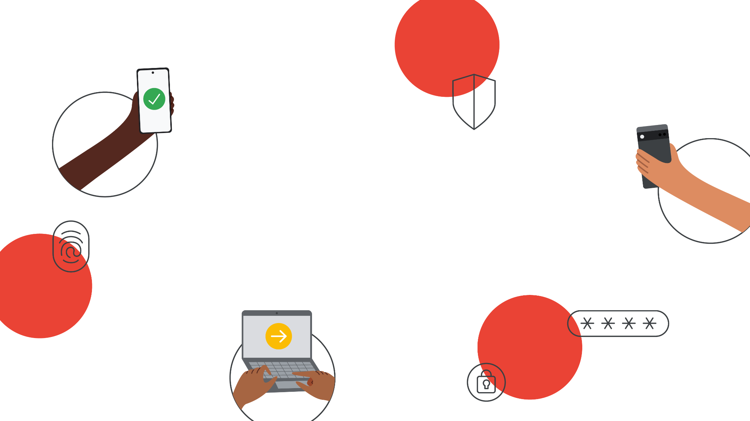
Privacy & Measurement
48% of people worldwide have stopped buying or using a service from a company due to privacy concerns.
Source: ‘48%’ - ‘How to put privacy first and accelerate your business’s economic recovery’, Think with Google, 2020
Notes:
48% of people worldwide have stopped buying or using a service from a company due to privacy concerns.
Source:
‘48%’ - How to put privacy first and accelerate your business’s economic recovery. Think with Google. 2020.

Slide 31
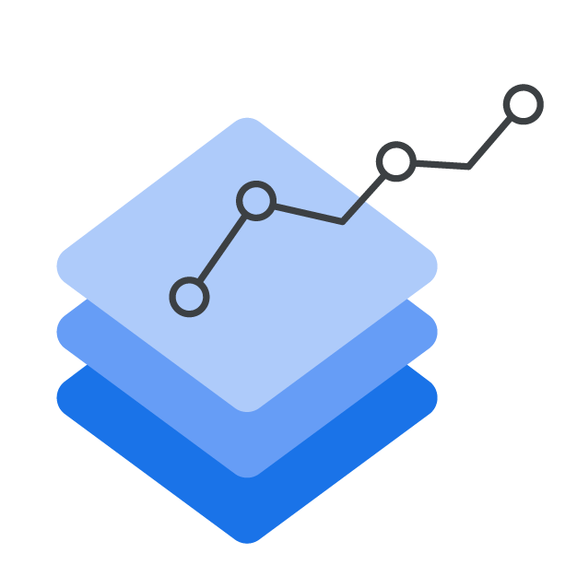
Businesses can protect user privacy and deliver business results
Privacy & Measurement
Preserve existing measurement using durable conversion tracking methods
Enrich the comprehensiveness of your conversion tracking by assigning values to your conversions
Strengthen your conversion setup with privacy safe features to future-proof your measurement
Notes:
It’s possible for your business to protect user privacy and deliver business results. There are three main steps to doing this:
Preserve existing measurement using durable conversion tracking methods
Enrich the comprehensiveness of your conversion tracking by assigning values to your conversions
Strengthen your conversion setup with privacy safe features to future-proof your measurement
Customers are often willing to exchange data for a valuable offering.

Slide 32
For marketers lacking in first-party data, they should look for opportunities to create a fair value exchange with customers
Privacy & Measurement
1
Make it memorable
Make it meaningful
2
Make it manageable
3
Sources: Data Ethics Study - ‘Data Ethics and Effectiveness, Part 1 — Ethics’. Ipsos, 2021; ‘Global Trends 2020’, Ipsos, 2020.
Notes:
1. Make it memorable. Create clear privacy policies and find ways to help users easily understand and remember what’s happening.
Why: People who consciously agree to share their data are more positive about ads presented to them and find them more relevant.
2. Make it meaningful. When people see value in an exchange, they’re more likely to engage and share the data that brands need to make future exchanges more valuable.
Why: Globally, nine in ten adults say they’re more likely to shop with brands that provide offers and recommendations that are relevant to them.
3. Make it manageable. Users should be given full control of settings and features so they can decide how their information is used and when it’s deleted. And once a user has made a choice, it absolutely must be honored.
Why: People are three times more likely to react positively to advertising when they feel in control of their data.
Sources:
Data Ethics Study: Data Ethics and Effectiveness, Part 1 — Ethics. Ipsos, U.K., Germany, France, the Netherlands. 2021.
Global Trends 2020. Ipsos, Global. 2020.

Slide 33
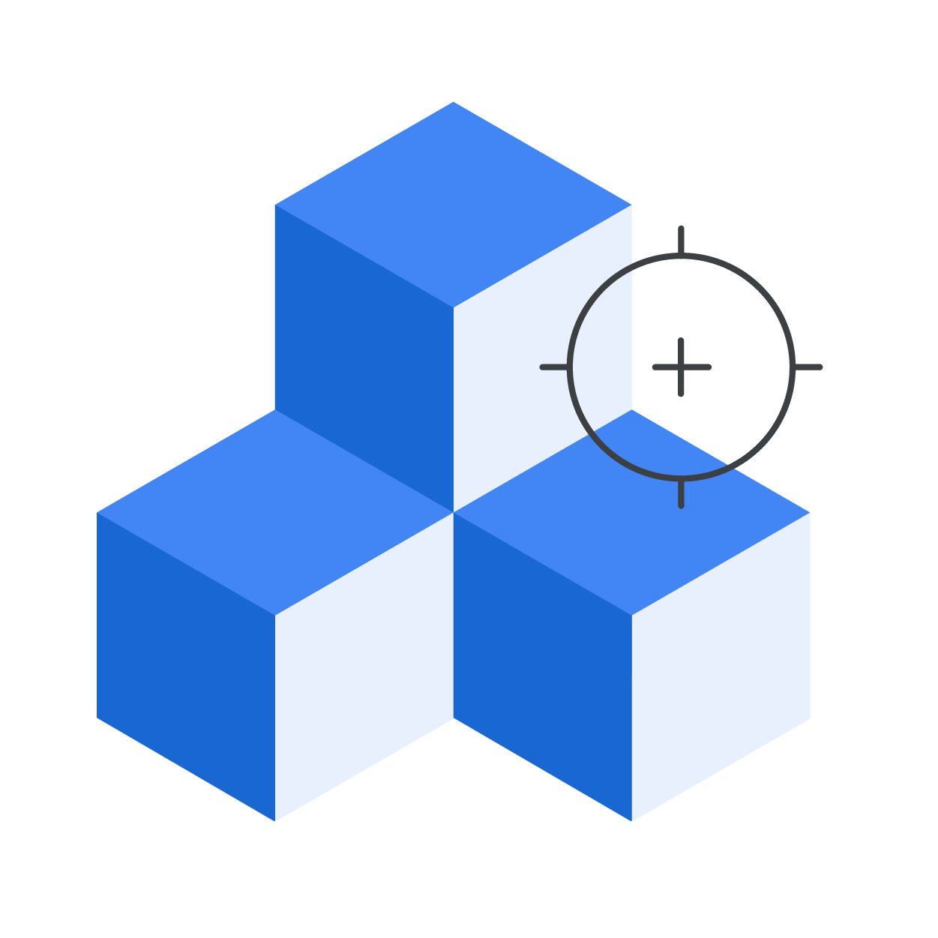
Quality inputs lead to quality outputs.
Search Ads Automation
Modeling is not just about accurate measurement.
With quality, consented and privacy-safe 1P data, Google can find gaps in observed data and automatically correct them in reporting.
This ensures that automated bidding can access the most accurate performance data and optimize for better performance.
Notes:
With a fair value exchange, advertisers can build a foundation of quality 1P data: and quality inputs lead to quality outputs.
The industry is operating in a landscape where privacy regulations and technology limitations have led to marketers losing the ability to observe certain cohorts of users. At times, this can lead to automated bidding algorithms needing to make optimization decisions based on incomplete data, which can result in biased learning. As a result, automated bidding could be at risk of deprioritizing those cohorts since they have a lower reported performance, leading to overall poorer performance.
Modeling, powered by machine learning, solves for these biases and corrects them in reporting to ensure automated bidding has access to the most representative performance data.
And modeling doesn’t just help with accurate measurement alone: modeling also enables more effective campaign optimization, despite a sometimes incomplete picture.

Slide 34
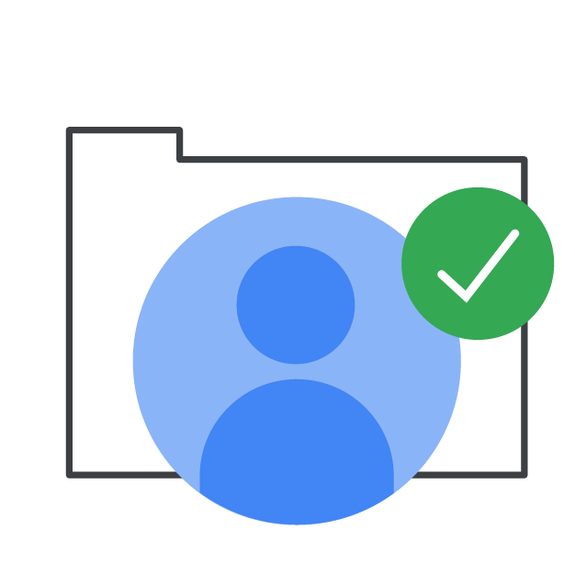
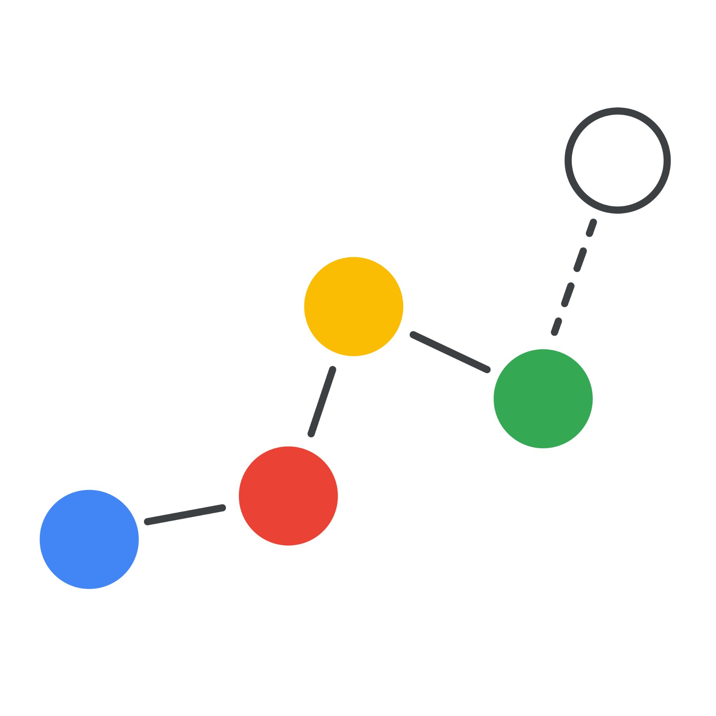
Capturing new growth opportunities requires a renewed focus on privacy
Privacy & Measurement
Preserve existing measurement with a robust tagging infrastructure, a foundation of 1P data, and new ways to respect user consent.
Businesses should invest in these solutions now to build a measurement foundation for the future.
Inform modeling by creating privacy-safe exchanges of consented user data to accurately solve for unknowns and improve your marketing.
Evaluate the need for additional security and control, and embrace new privacy-preserving technology, like the Privacy Sandbox.
Notes:
Building a foundation of quality 1P data, and therefore capturing new growth opportunities, requires a renewed focus on privacy. On our side, Google is investing in measurement to improve privacy for users while preserving the ad-supported web.
Businesses can invest in these solutions now to build a measurement foundation for the future.
Preserve existing measurement with a robust tagging infrastructure, a foundation of 1P data, and new ways to respect user consent.
Inform modeling by creating privacy-safe exchanges of consented user data to accurately fill gaps and improve your marketing.
Evaluate the need for additional security and control, and embrace new privacy-preserving technology, like the Privacy Sandbox.

Slide 35
Cutting-edge
Add Performance Max campaigns to ensure your brand shows up across new formats, channels and in every marketing moment.
Notes:
Secondly, in order to have a holistic and effective partnership with Google Ads Automation, you have to be on the cutting edge of the industry. Your brand should show up consistently across the newest formats, channels, and in every marketing moment.

Slide 36
Performance Max
Performance Max
The best of Google, in every marketing moment.
Notes:
Adding Performance Max to already automated Search campaigns is the secret to getting the best of Google in every moment.

Slide 37
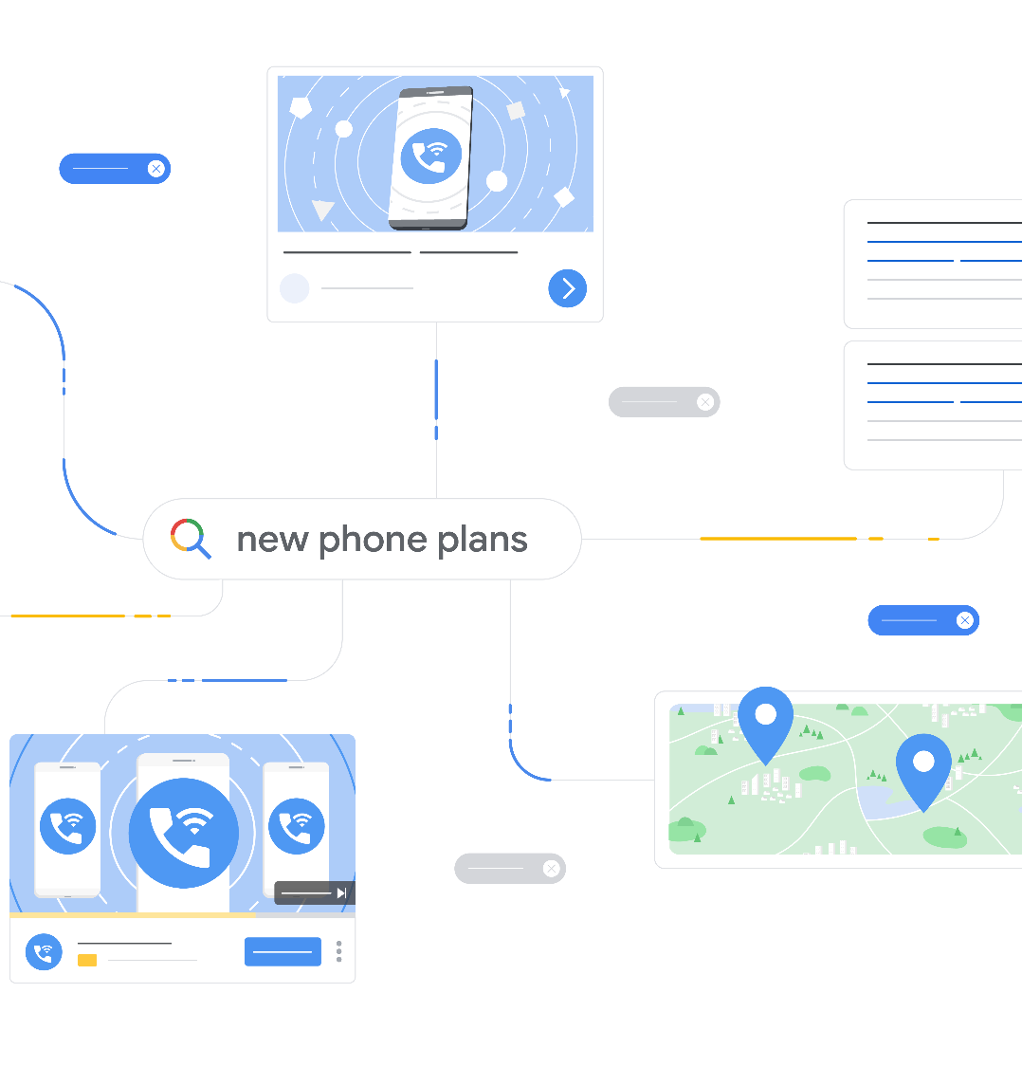
Performance Max helps maximize your performance
Performance Max
across Google Ads inventory using automation. This can help drive towards your goals, but it can also save you time to reinvest in other important areas).
Notes:
Performance Max helps maximize what matters - your performance - across all Google Ads inventory. It is powered by Machine Learning technology, using automation to save you time and drive toward your goals.

Slide 38
Why Performance Max?
Performance Max
Use the best of Google Ads automation
1
2
3
4
Find more converting
customers for your goals
Drive more value from your budget
Get rich and
transparent insights
Steer automation with your inputs and expertise
Notes:
A few of the key value props for Performance Max:
Find more converting customers for your goals
Access the full breadth of Google Ads inventory from a single campaign to engage customers for your specific goals - and use Google’s real-time understanding of consumers to show up in the right moments.
Drive more value from your budget
Your budget is optimized across channels to reach the highest value opportunities with the best of Google Ads automation and attribution technology, customized to your business’s marketing objectives.
Get rich and transparent insights
Understand how automation is working and how you can improve your campaign. See which audiences, creatives and other drivers (incl. consumer insights and trends) are impacting performance.
Steer automation with your inputs and expertise
Steer automation with user inputs to get better results and get them faster to accelerate the campaign ramp-up period and deliver better results faster. Guide automation using exclusive features like Audience Signals and combine with Conversion Value Rules.

Slide 39
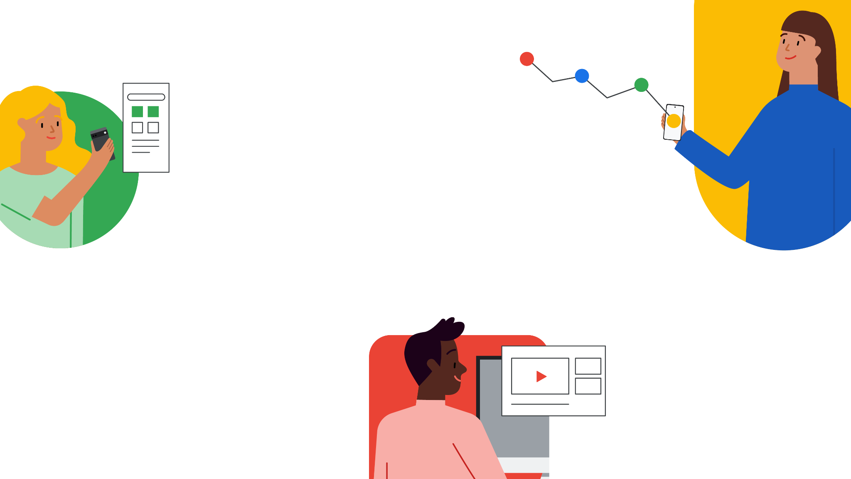
Performance Max
Advertisers who use Performance Max campaigns in their account see an average increase of 13% in total incremental conversions at a similar Cost Per Action.
Source: Average uplift in performance based on Google Internal Study - Q4, 2021; Individual results may vary according to campaign details.
Notes:
Advertisers who use Performance Max campaigns in their account see an average increase of 13% total incremental conversions at a similar cost per action.
Source:
‘13%’ - Average uplift in performance based on Google Internal Study - Q4, 2021; Individual results may vary according to campaign details. Claims council dash.

Slide 40
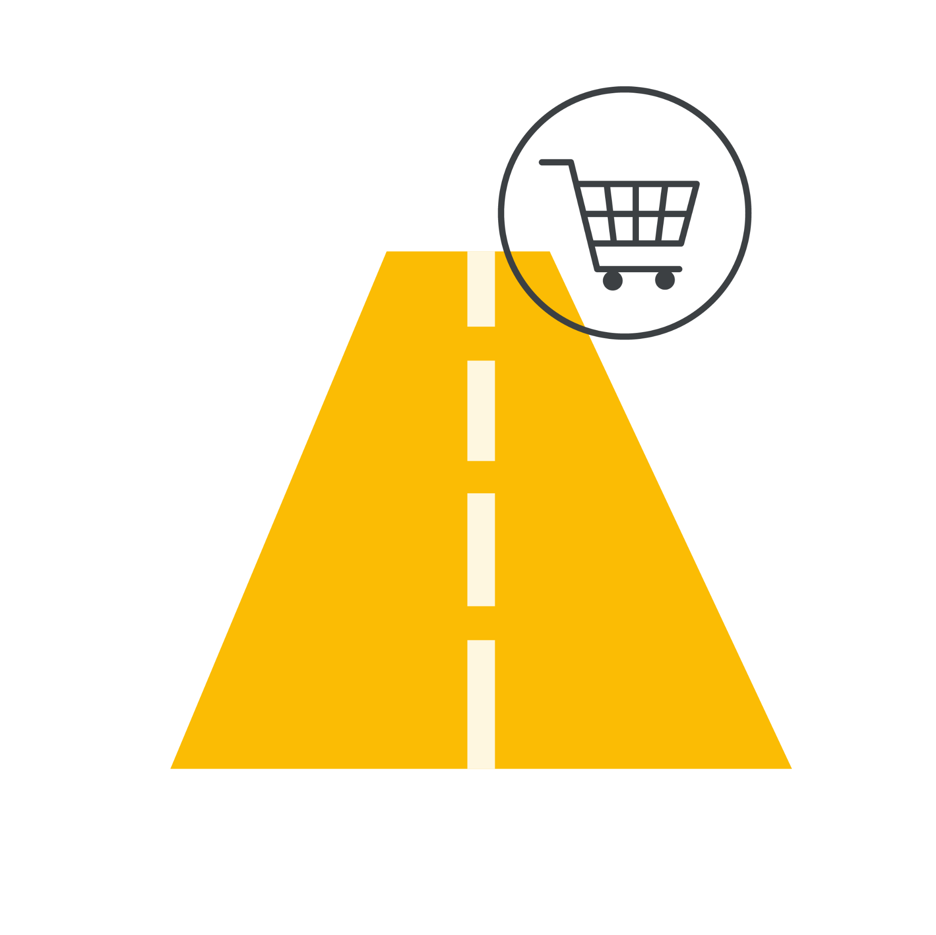
What’s different About Performance Max?
Performance Max
Single goal-based campaign that focuses on achieving the performance goals with automation and machine learning
Path-to-purchase-aware using data-driven attribution, so the right ad can be served at the right time according to your marketing objective
Always serve on the best inventory across all Google channels to automatically target customers where you can efficiently scale
Notes:
Here you can see how Performance Max is unique compared to existing channel-based campaigns. While during early stages beta testing we do recommend running PMax alongside existing campaigns, here you can see the unique value prop from both.
Because Performance Max is goals-based, it unlocks maximum performance in 3 particular ways: alignment to marketing objectives goals, path-to-purchase aware with data driven attribution, and serves across inventory (and the best inventory opportunities) which achieves performance, efficiency, and scale.

Slide 41
Drive more conversions across channels
Performance Max
Notes:
Fully automated Search campaigns, partnered with Performance Max, will take most organizations to the next level of modern marketing. Of course, there are occasional moments where you need to target very specific audiences, and our recommendation on this would be to speak to your Google Ads representative about unique Discovery, Display or Video campaigns to fit your objectives.

Slide 42
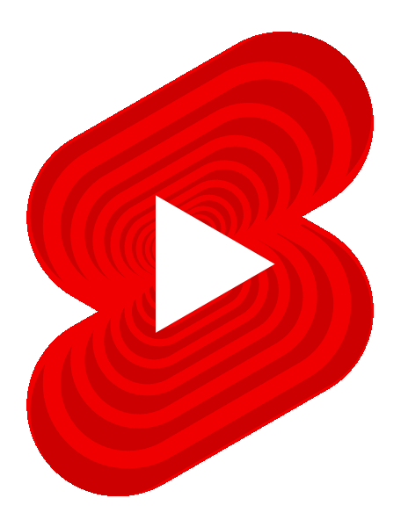
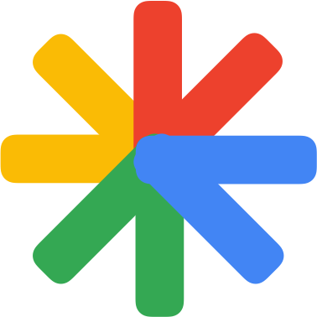
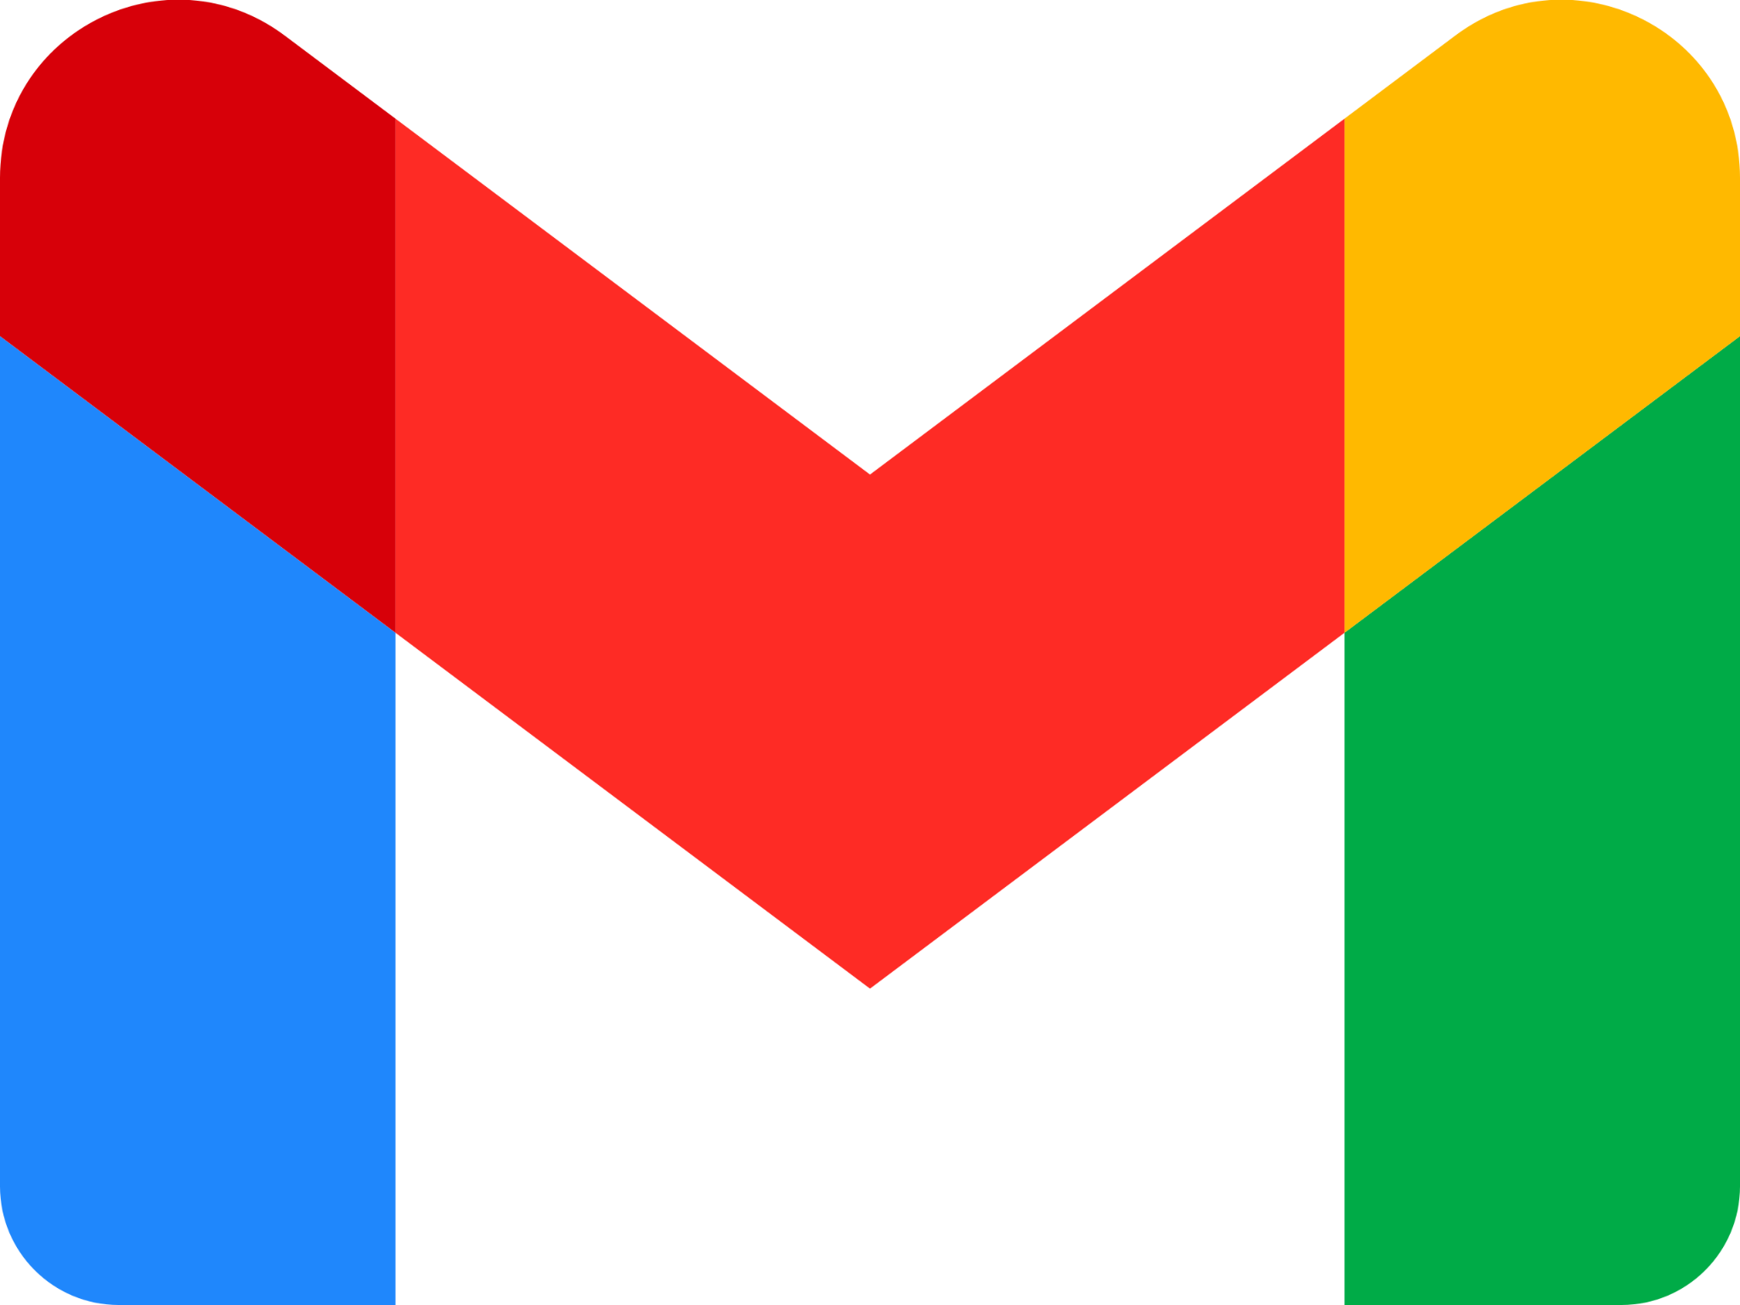
INTRODUCING
Demand Gen
campaigns
Notes:
Cue, Demand Gen campaigns…
Demand Gen is a new ad solution that helps advertisers find and convert consumers with immersive, relevant and visual creatives that grab attention and spur action in the right moment.
Power up your social marketing performance by tapping into the combined powerhouses of YouTube and Google, to boost your impact beyond social.
With over three billion monthly users across YouTube, Shorts, Discover, and Gmail, Demand Gen serves tailored, audience-first creatives via Google AI to your target audiences, save time while maximizing creativity and impact. Demand Gen literally takes your creative to new places so you can reach your consumers as they stream, scroll and connect across surfaces that offer the perfect blend of information and entertainment.

Slide 43
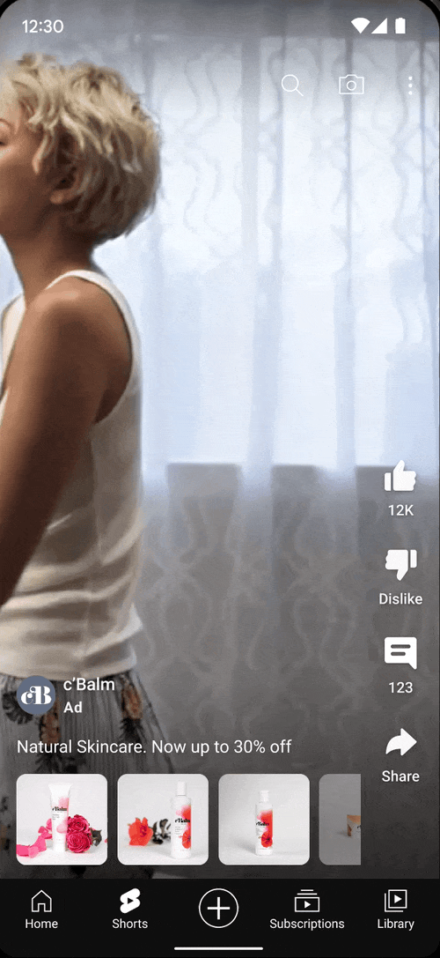
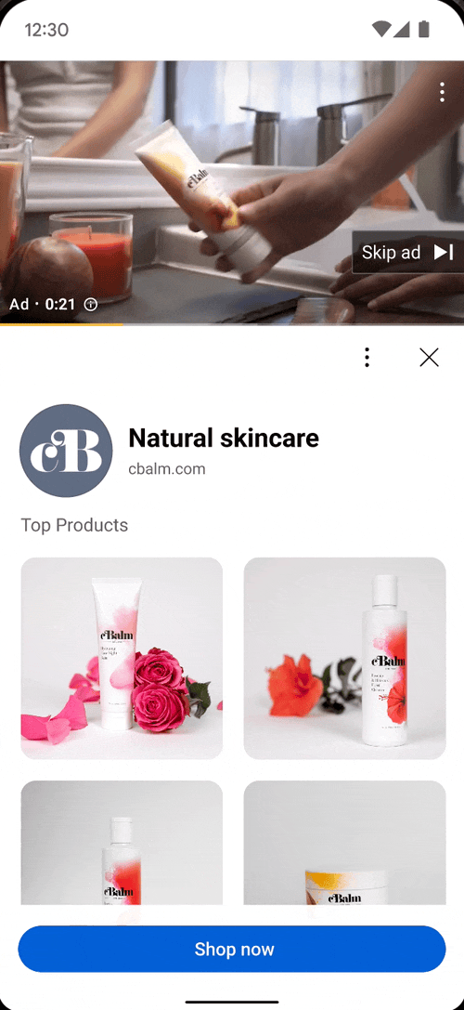
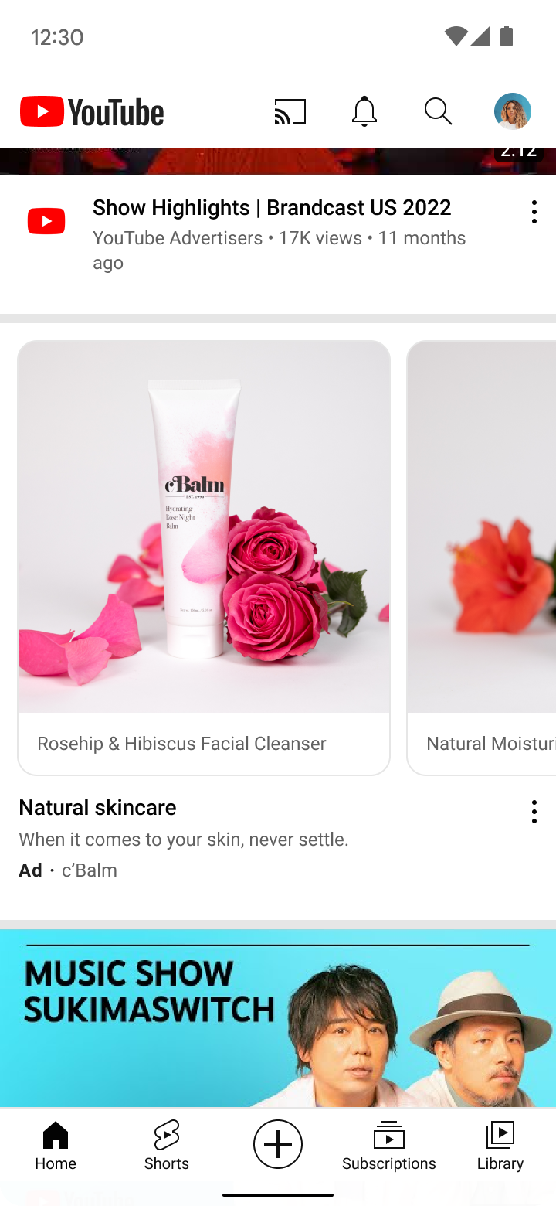
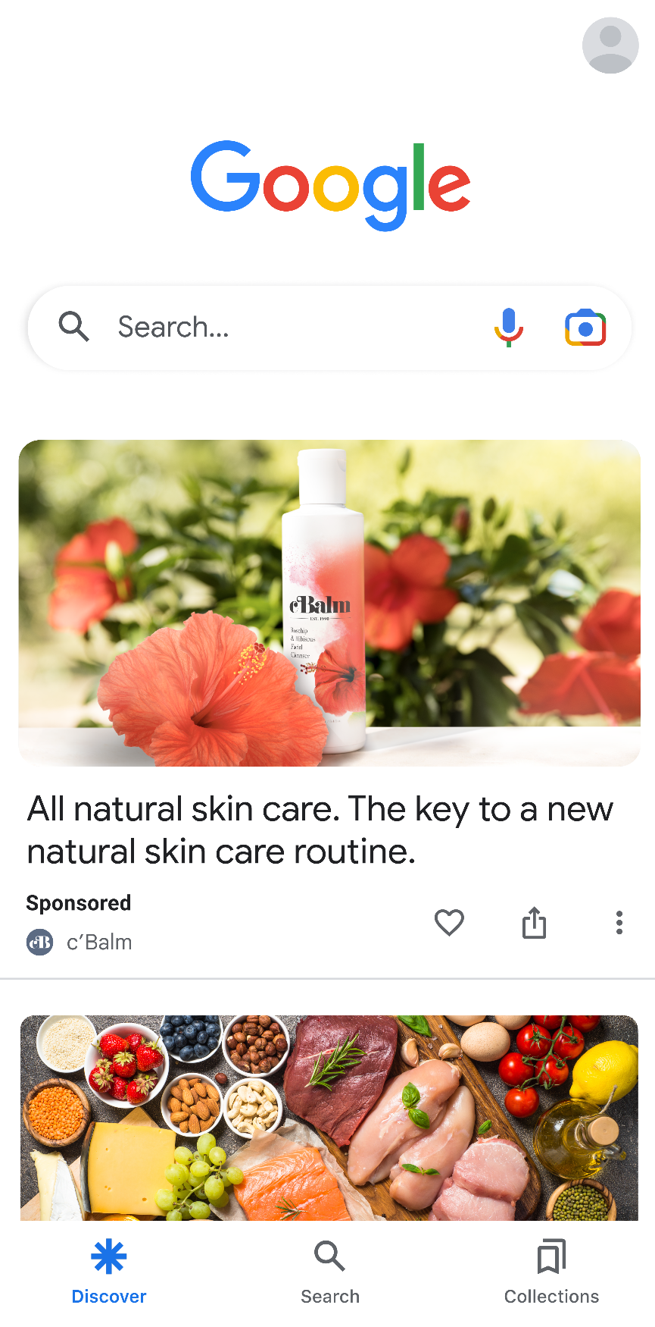
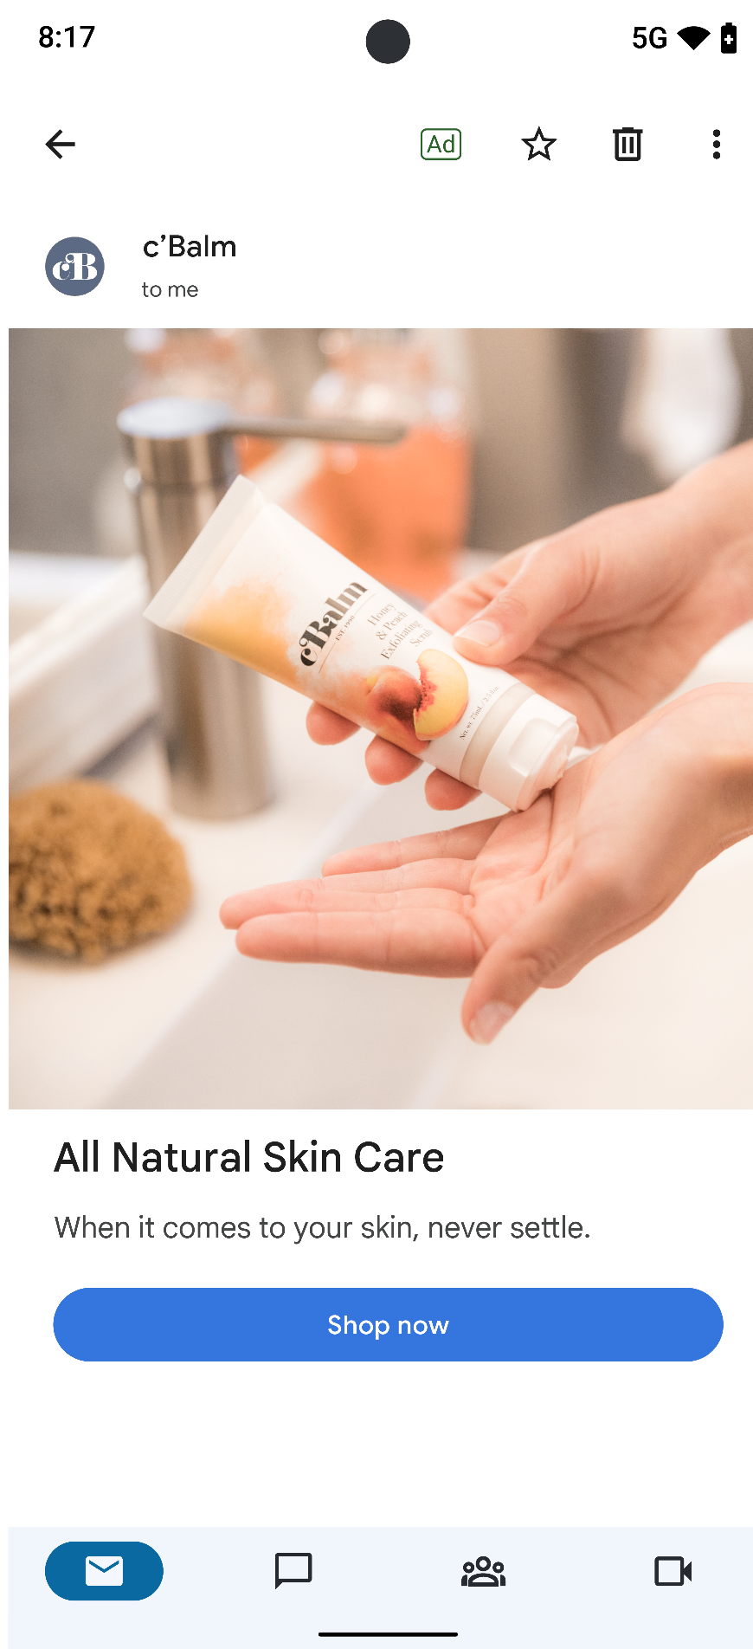
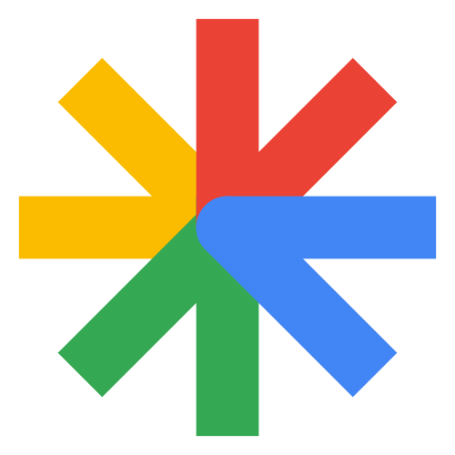
Find and convert consumers with immersive, relevant, and visual creatives that grab attention and drive conversions in the right moment
YouTube Shorts
YouTube in-stream
YouTube Feeds
Discover
Gmail
Notes:
Demand Gen builds upon the strengths of our existing Discovery and Video action campaigns today, – the reach of YouTube and Google’s most engaging surfaces,
the power of video and image creative served to tailored audiences, and the ability to fuel the funnel by driving site traffic and actions across the customer journey
with proven measurement.
There are multiple creative formats available in Demand Gen across YouTube, Discover, and Gmail -- including various aspect ratios, single image, carousel, and product-specific formats,
And with the combination of video and image ads now in one single campaign, Demand Gen offers a more immersive ad experience and helps you spark action in moments when customers are ready to engage.
—-- FOR REFERENCE ONLY —--—--
Back up claim:
Nearly half of consumers say they are more likely to purchase a new product or brand they see in a video ad in their personalized feed.
Source: Google/Ipsos, Consumer Feed Behavior Research, August 2022, Online survey, US consumers aged 18+ who browse feeds (feeds defined as: Google, Chrome, YouTube, Gmail, Facebook, Instagram, TikTok, Twitter, and Pinterest) monthly or more often. Base: Consumers n=2,000

Slide 44
Demand Gen combines Google & YouTube touchpoints to grab attention and spur action
Expanded Impact
Tailored Ad-Experiences
AI-Powered Bidding & Measurement
Access to YouTube & Google’s most immersive, personalized touchpoints
Multi-format on YouTube including Shorts, Discover and Gmail
Reach 3B+ users
50B+ global daily views on Shorts
Audience-first creatives that drive demand
New! Lookalike audiences
Creative A/B Experiments
New campaign setup
Product feeds
Video & image ads in one campaign
Future-proof tools to measure the full value of campaigns
Conversion, Value-based, Max Clicks bidding
Search Lift, Brand Lift, Conversion Lift
Data-Driven Attribution
Notes:
Further, Demand Gen combines Google & YouTube touchpoints to grab attention and spur action:
First, they allow advertisers to connect with consumers exclusively on YouTube and Google’s most immersive, personalized touchpoints and feeds- YouTube, including, in-stream, home page, shorts, as well as Discover and Gmail, and run video and image assets within a single campaign.That means seamlessly reaching more than 3 billion monthly users as they stream, scroll and connect – and make decisions. Research shows that 91% of consumers took action immediately after discovering new products or brands on Google feeds, like Discover or Gmail.
Even better, advertisers can run audience-first campaigns to specific segments and tailor creatives based on their campaign goals. For social or creative first marketers who care deeply about how their ads look when rendered across different channels and formats, they can preview the experiences in real time, right in Google ads before they run.
We’re also introducing lookalike segments - unique to demand gen- which allows advertisers to bring their own customers lists (via feeds, youtube subscribers, retargeting lists and more), and find lookalike audiences across YouTube and Google.
And finally, advertisers can optimize and measure across the funnel. In addition to optimizing for conversions, advertisers can choose to bid for clicks to drive consideration goals like site visits, or fuel their marketing funnel by building retargeting lists or optimizing for consumers to take specific actions on their site to drive more engagement and ultimately, consideration. Advertisers have long benefited from full-funnel measurement tools like data driven attribution, brand and search lift and conversion lift on YouTube. All of these tools will be available for Demand Gen and -- for the first time -- we're bringing brand lift and search lift to measure the impact of image assets and other inventory in Demand Gen, such as Discover feed and Gmail.
--------------------
ADDITIONAL TALKING POINTS:
Pillar 1: Access to YouTube & Google’s most immersive, visual touchpoints.
Access to more than 3 billion users with video and image ads in one campaign so your most immersive and creative ads show up in front of the right audiences. Think: Your best and buzziest social creative on our most immersive, visual platforms, YouTube, Discover, and Gmail. That means you’re tapping into Shorts, with over 50B global daily views.
Make your social creatives and strategy go further and work harder—while you take it easy. With Demand Gen, you can bring your best, existing creative in just a few clicks, and we’ll unleash it across YouTube including Shorts, Gmail, and Discover. The new campaign setup makes it easier than ever to bring top performing video and image creatives and preview them across these experiences, right in Google Ads.
Demand Gen is a new ad solution that combines Google and YouTube touchpoints to move audiences towards a purchase mindset. Use Google AI to discover the perfect combination of high impact visuals, messages, and placements, so you can drive more consumers to press ‘pay now.’ Preview your top performing social video and image creatives across Google and Youtube placements to ensure they tell the right story
Pillar 2: Audience-first creatives that drive demand.
From YouTube to Discover, you’ll break out your most immersive, visual creative with the most relevant consumers in just a few clicks. With Google AI serving tailored assets to specific audiences, save time while maximizing creativity and impact. Demand Gen literally takes your creative to new places
Bring your audience data and we’ll match it with Google AI-powered lookalike audiences—created with inputs like past purchases, website and app activity, or YouTube engagement. Combine your inputs with our powerful audience insights to tap into what really moves consumers. You have all the control: you decide the goal and the creative; we’ll custom-match the right audience and serve an ad to them for maximum relevance and impact.
Demand Gen’s A/B experimentation allows advertisers to fine-tune their creative approach. Learn which creative had the most impact and adjust your strategy accordingly to increase performance. Use reporting insights to curate your assets and optimize for demand.
Pillar 3: Fuel the funnel and measure the impact.
Crucially, in addition to conversions, you’ll be able to optimize and measure across the funnel, with max clicks bidding to drive consideration goals like site visits. Full funnel measurement tools including brand lift and search lift studies to demonstrate the incremental impact of your campaigns.
Demand Gen optimizes for website traffic, converts high value users, and bids against efficient metrics while using data driven attribution to show the full value of a campaign in the Google ecosystem.
Dive deeper into your campaign results using search, brand and conversion lift data to see how your ad spend is paying off and understand the incremental impact of your campaigns. Be informed about what works and what doesn’t with proven measurement capabilities powered by Google AI.

Slide 45
Euro
Cup
Scores
Tailored Ad Experiences
Yoga
for new
moms
Meditation guides
Drive audience & creative customization with Demand Gen
Local
Coffee
Shops
Cooking tutorials
Google and YouTube audience solutions powered by interest and intent to meet your goals.
Our users express interest and intent, powering our audience solutions to meet your goals.
Notes:
One of the unique benefits of Demand Gen is access to Google’s audiences.
Our audiences are generated from signals across 8 of our properties ranging from searching on Google maps for a local coffee shop, to watching Cooking tutorials, to checking in on the latest Euro cup scores.
These users are expressing interest and intent, powering our audience solutions to meet your goals.
And this is done at scale. Each day, there are billions of touch points that give insight into audience mindsets.
We’ve built a brand new solution unique to only Demand Gen campaigns at Google -- Lookalike audiences -- where you can leverage your own customer data, and then use our data to find potential customers that share similar characteristics.
Your best creatives, served to tailored audiences -- Quickly adapt your top-performing creative and Google AI will serve it to your specific audiences
------------------
Access to short and long form video and images in a single campaign
A new construction flow that makes it easier than ever to bring your existing image and video ad experiences to Google, and preview them in real time.
AI-powered lookalike segments that enable you to reach people outside of your known customer set.
The ability to pair your tailored creative with specific audience segments to deliver the most relevant message (at the right moment)
----------------------
ADDITIONAL TALKING POINTS:
Daily, there are 5B YouTube videos watched, 5.6B searches daily, 1B active users on chrome. The scale of these signals continues to grow and as a result we are able to understand what truly matters to audiences - and personalize their experience across our privacy-safe feeds.

Slide 46
Find more high value audiences with Lookalike segments
Tailored Ad Experiences
Notes:
Maximize relevance, results & creativity with AI-powered lookalike audiences
AI-powered lookalike audiences help you reach new, qualified consumers outside of your existing customer base. Pair tailored creatives with specific audience segments or dynamic product feeds to deliver the most relevant message (at the right moment). A beauty brand can tailor creatives to new, lookalike audiences based on customer preferences like organic ingredients or sunscreen.
-----------------------
ALTERNATIVE TALKING POINT:
Bring your audience data and we’ll match it with Google AI-powered lookalike audiences—created with inputs like past purchases, website and app activity, or YouTube engagement. Combine your inputs with our powerful audience insights to tap into what really moves consumers. You have all the control: you decide the goal and the creative; we’ll custom-match the right audience and serve an ad to them for maximum relevance and impact.

Slide 47
Prove impact across the entire customer journey to drive consistent demand
AI-Powered Bidding & Measurement
Data Driven
Attribution
Brand Lift & Search Lift*
Conversion Lift based on users
Understand your campaign value in the Google ecosystem
Measure how your ads drive consideration
Prove out the true impact & incrementality
*Brand Lift and Search Lift only available for YouTube inventory in beta.
Notes:
Driving demand isn't just measured by conversions and CPAs, it's the incremental value your campaigns generate, like impact on Search, PMax and other campaigns with assistive conversions (DDA) and the halo effect it has on customers who are exposed to your brand:
Data Driven Attribution uses your account data to assign credit to different conversions based on how people engage with your ads, and determines which campaigns have the greatest impact on your goals.
Assign credit to conversions based on how people engage with your ads, and determine which campaigns have the greatest impact on your goals.
Prioritize your bidding for the most impactful strategies.
We also have various solutions to help you measure your campaign performance at different levels of the funnel, including brand lift and search lift.
Discover how many people saw your ads, and how those ads impacted their perception of your brand
Measure incremental results in Awareness, Brand Consideration, Purchase Intent, Ad Recall, and more.
And to prove the true impact of your campaign, Conversion Lift measures the change in consumer behavior directly caused by the exposure of an ad.
Observe changing consumer behavior impacted by the exposure of an ad
Measure the lift in a randomly selected, controlled / treatment testing environment.
-----------FOR REFERENCE ONLY —---------
Data Driven Attribution creates an attribution model unique to your business that values all Google clicks and engaged views on the conversion path based on the contributions made in driving the conversion.
This form of measurement is important to accurately account for actions that were taken beyond last click that helped contribute to the end conversion.
Brand Lift is a survey-based measurement of brand impact. The target audience is split into a control group (who will not see your ad) and an exposed group (who will see your ad). Both groups will then receive the same survey in the YT interface that will determine if the ad exposure had an effect on the metric you are measuring.
Search Lift analyzes the increased likelihood a user has to search for a brand/product on Google.com and YouTube.com for your campaign in order to drive advertisers to optimize and understand the consideration of their brand.

Slide 48
Advertisers are saying Demand Gen…
Alpha Customer Feedback
Compares to social
Captures untapped audiences
"We’re excited to be among the first Demand Gen advertisers and have found the campaign set up to be seamless, efficient and effective as it opens up more inventory. Demand Gen has given us an entirely new perspective on Google campaigns as we're now looking beyond performance from format to format and instead comparing it to all social players."
"Modern advertisers are confronted with the ever-expanding landscape of consumer attention and as a leader in the social space for over a decade, we recognize the importance of meeting customers where they are and they are scattered across numerous platforms. We believe that Demand Gen presents an exceptional chance for our clients to allocate their advertising budget across a broader spectrum, capturing the attention of previously untapped audiences and bringing new customers into their sphere of influence”.
-Anselme Langle, Consultant Social Média & Display at Arcane
-Jeremy Frick, Chief Technology Officer, Brand Networks, an Augeo Company
Notes:
We’re also seeing early success from our alpha testers…
"We’re excited to be among the first Demand Gen advertisers and have found the campaign set up to be seamless, efficient and effective as it opens up more inventory. Demand Gen has given us an entirely new perspective on Google campaigns as we're now looking beyond performance from format to format and instead comparing it to all social players."
Anselme Langle, Consultant Social Média & Display at Arcane
"Modern advertisers are confronted with the ever-expanding landscape of consumer attention and as a leader in the social space for over a decade, we recognize the importance of meeting customers where they are and they are scattered across numerous platforms. We believe that Demand Gen presents an exceptional chance for our clients to allocate their advertising budget across a broader spectrum, capturing the attention of previously untapped audiences and bringing new customers into their sphere of influence”.
Jeremy Frick, Chief Technology Officer, Brand Networks, an Augeo Company.
----------------------
ADDITIONAL CUSTOMER QUOTE:
“Google's Demand Gen is the solution that performance-minded marketers have been looking for. At Smartly.io, we know that now, more than ever, marketers of all sizes are facing downstream pressures from fragmentation to the deprecation of third-party identifiers.As one of the first partners to offer Demand Gen to marketers on our platform, we’re confident in Google’s move to bring the best of Discovery Ads and Video action campaigns together as it gives marketers the solution to deliver incremental conversions to complement their social investments.”
Jessie Cooper, Vice President, Partnerships at Smartly.io.

Slide 49
Competitive
In a world where access to automated marketing tools is universal – maintain your competitive edge.
Notes:
But we live in a world where all businesses - including your competitors - stand to gain from automation solutions. So let’s address the elephant in the room: how can you maintain a competitive edge?

Slide 50
Integrate 1P data
Integrate 1P data
Your competitors do not have your 1P data, and your human expertise. Combined, these are your competitive edge.
Notes:
Your competitive edge is your 1P data, combined with your human expertise.

Slide 51
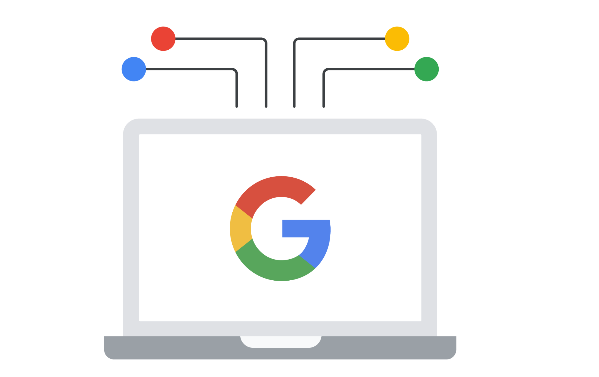
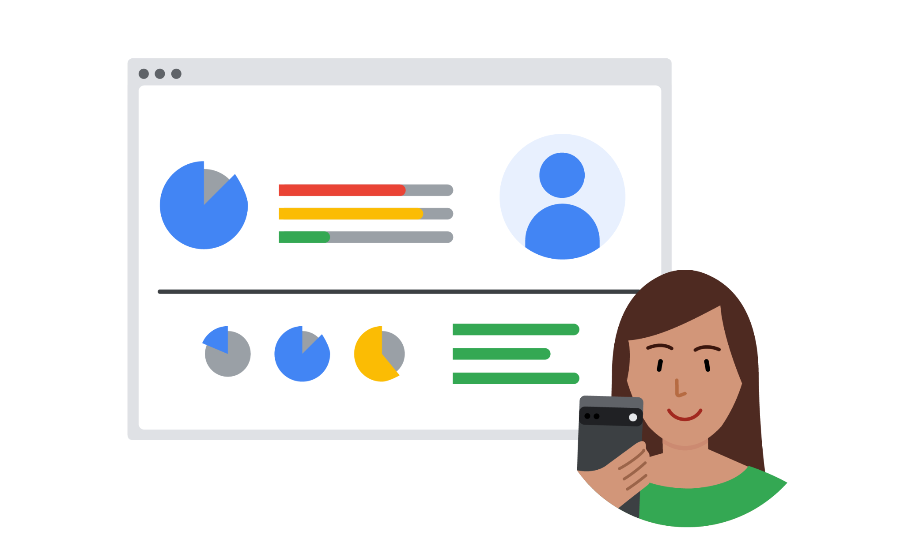
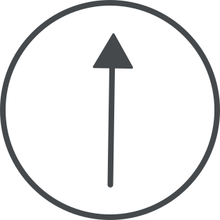
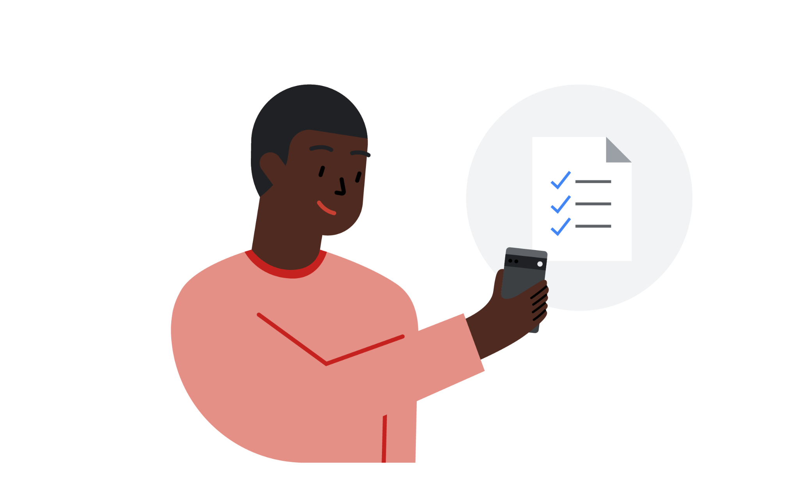
Automation + 1P data + human expertise = results
Integrate 1P data
Automation
2.9x
1.5x
=
=
+
Human Expertise
+
Revenue uplift
Increase in cost savings
First-party Data
Sources: ‘1.5x’ - BCG/Google, The Fast Track to Digital Marketing Maturity, 2021; ‘2.9x’ - BCG/Google, Responsible Marketing with First-party Data in Asia Pacific, 2020
Notes:
The combination of privacy-safe measurement and automation with human expertise and automation, drives results. In research we conducted in 2021 with BCG, we found that ‘digital marketing maturity’ significantly improves business performance and drives revenue.
Those using first-party data for key marketing functions achieved up to a 2.9X revenue uplift and a 1.5X increase in cost savings.
Sources:
BCG/Google, The Fast Track to Digital Marketing Maturity, 2021: https://www.thinkwithgoogle.com/_qs/documents/11989/BCG-The-Fast-Track-to-Digital-Marketing-Maturity-Aug-2021.pdf
BCG/Google, Responsible Marketing with First-party Data in Asia Pacific, 2020: https://www.bcg.com/publications/2020/responsible-marketing-with-first-party-data

Slide 52
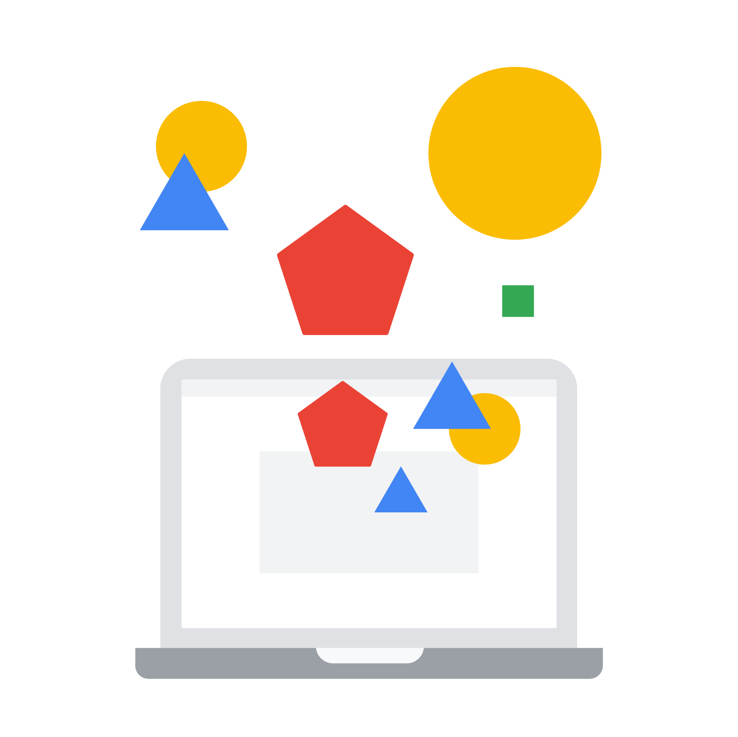
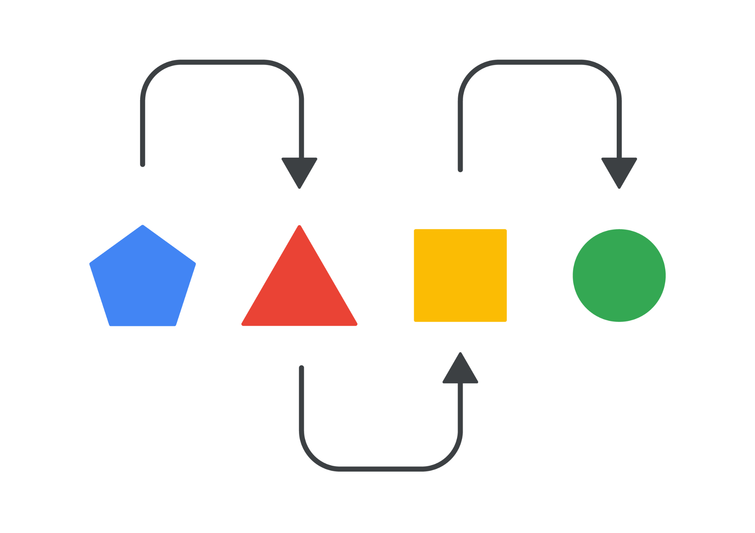
Google recommends a 3-step approach for building a robust database and connecting it to relevant platforms
Integrate 1P data
Step 1
Step 2
Step 3
Build a 1PD database
Create a customer-oriented strategy
Target business goals through automation
Notes:
There’s a three-step framework for privacy-safe growth: Build, Create, Activate
We like to structure our thinking about what marketers should do to enable privacy-safe growth around three key pillars:
Build a first-party data database
Create a customer-oriented strategy
Activate across platforms

Slide 53
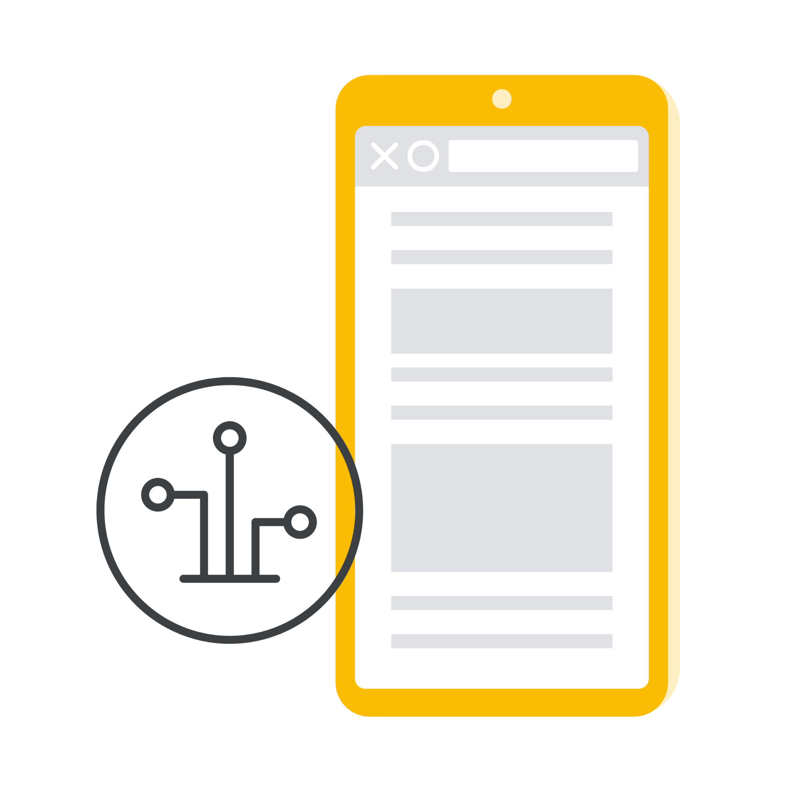
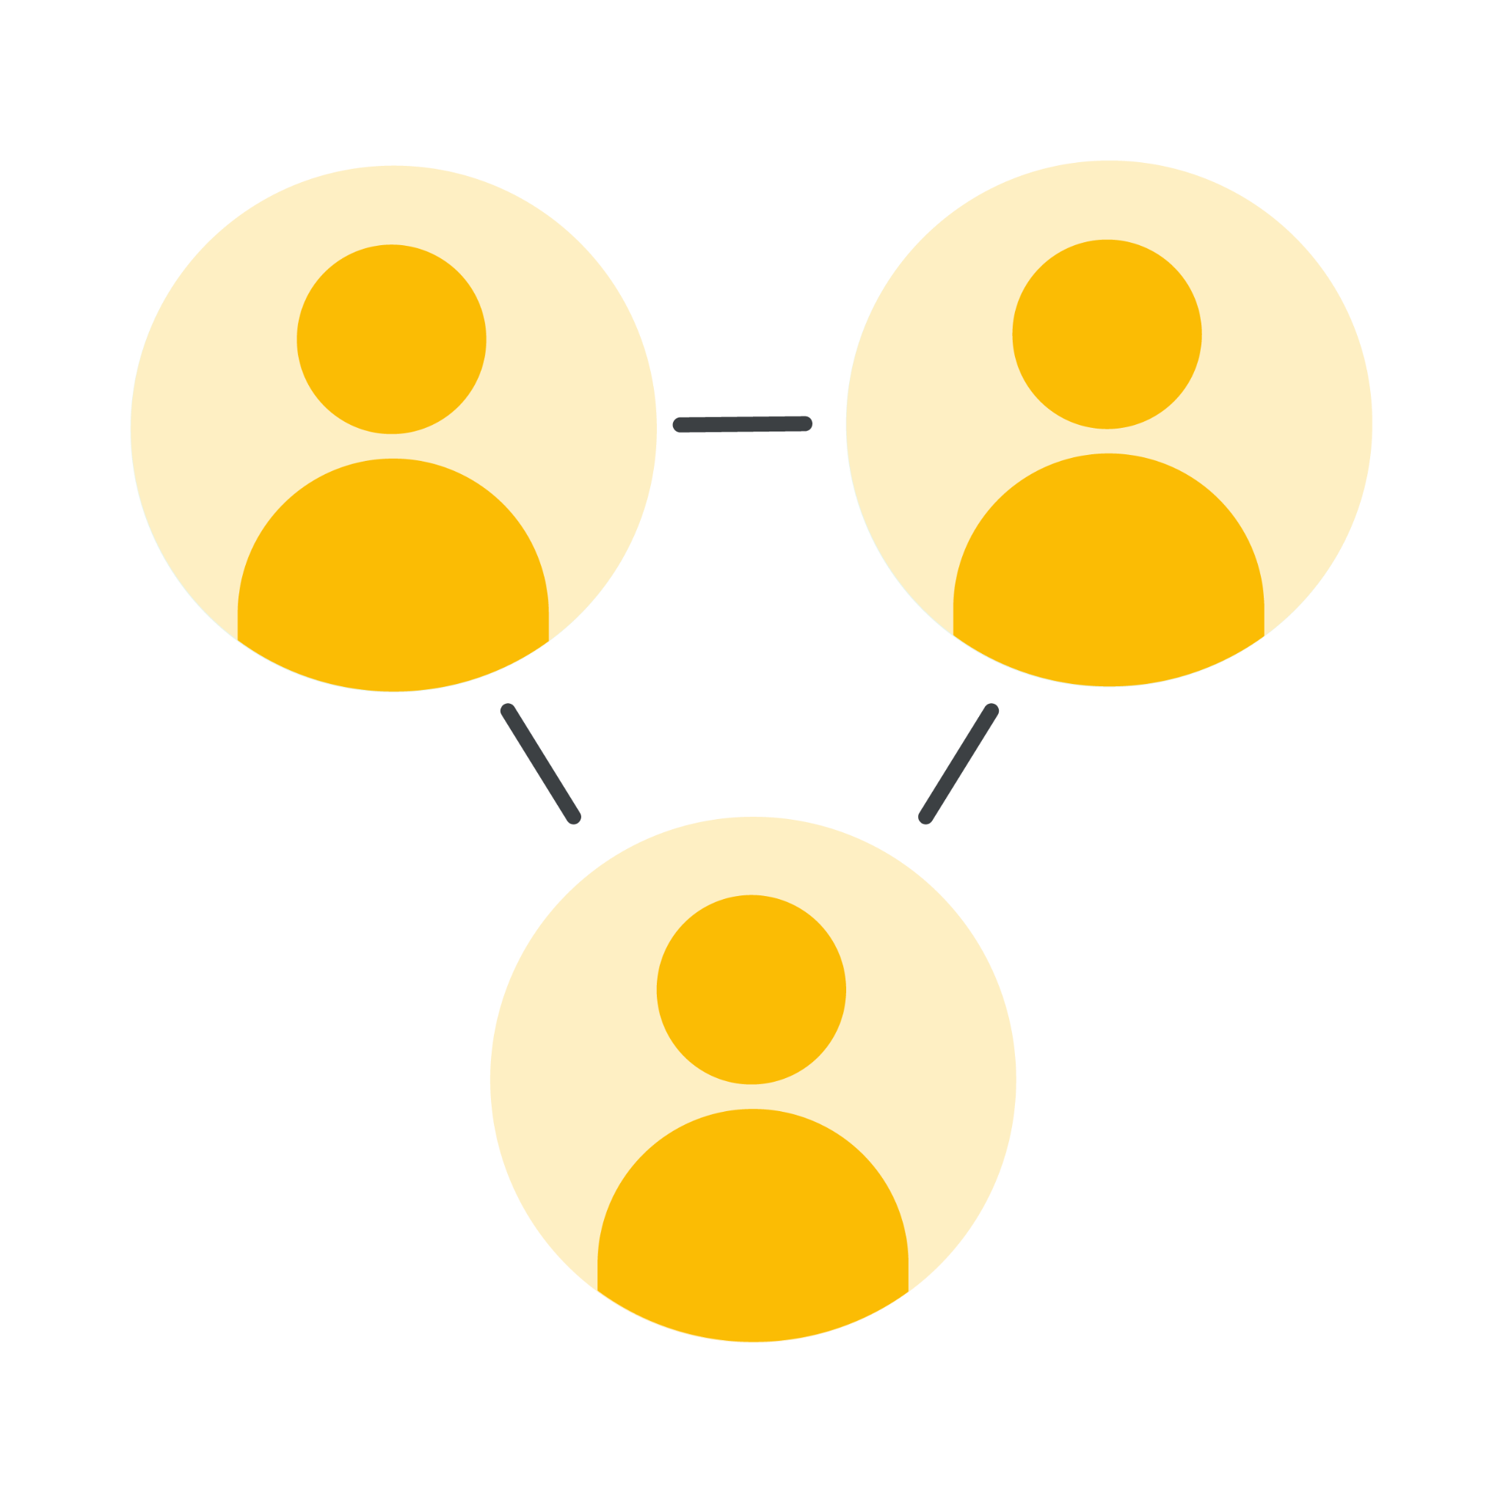
Build a robust 1PD database to inform your business objective-oriented marketing strategy
Integrate 1P data
Step 1
Technology
Integrate your marketing and data/customer management platforms to enable an automated flow of data.
Google’s Ad + Cloud products can help to make faster, better decisions by combining previously siloed data to unlock insights that then lead to timely and relevant customer messaging, surfacing behavioral predictions to help you invest more effectively in marketing
People
In many organizations, data is spread out across campaigns, CRM systems, websites, apps, etc. and is managed by a myriad of teams. The key is to create infrastructure that breaks down the organizational silos and connects the dots between data within your organization.
Process
Establish automated processes that allow for the seamless ingestion and connection of that data
Where possible, own your data: the more processes and tech that are done in-house, the more control you have within your ecosystem.
Notes:
Talk Track
Step 1: Build a robust 1PD database to inform your business objective-oriented marketing strategy
Getting the most out of 1PD is not just about having the right data, technology, or processes/people in place – it’s about developing open and technical solutions that support innovation, not hinder it
Integrate your marketing & data/customer management platforms to enable an automated flow of data. Google’s Ad + Cloud products can help to make faster, better decisions by combining previously siloed data to unlock insights that then lead to timely and relevant customer messaging, surfacing behavioral predictions to help you invest more effectively in marketing
In many orgs, data is spread out across campaigns, CRM systems, websites, apps, etc. and is also managed by a myriad of teams. The key is to create infrastructure that breaks down the organizational silos and connect the dots between data within your org, and also stand up automated processes that allow for the seamless ingestion & connection of that data
Where possible, own your data: the more processes & tech that are done in-house, the more you can control within your own ecosystem.

Slide 54
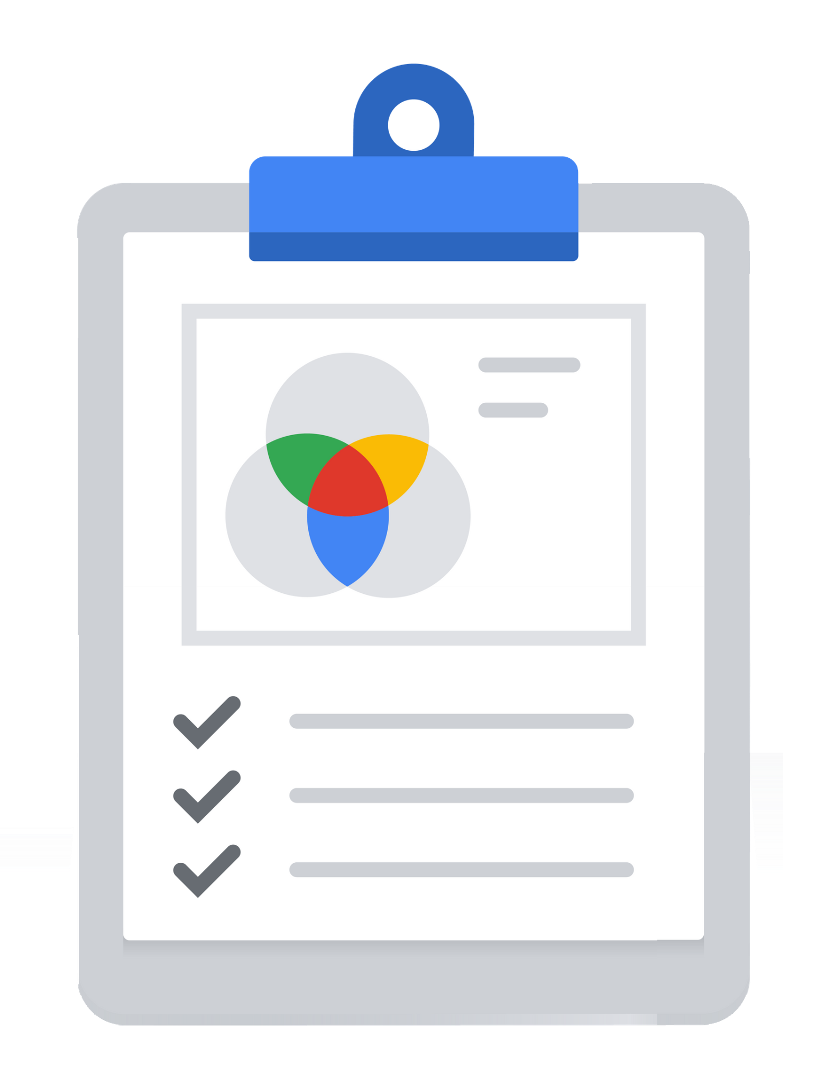
Ensure that your strategy is built to cultivate customer trust, and use that to build relationships with your customers
Integrate 1P data
Step 2
In terms of what to communicate, it’s important to be transparent about:
What data is collected
How it will be used
How its use will benefit customers
Source: Google/BCG ‘Consumer Privacy and Preferences Study; Senior marketing executives and expert interviews’, August 2021
Notes:
Talk Track
Step 2: Ensure that your strategy is built to cultivate customer trust and use that to build relationships with your customers
Tying your data assets to business goals is one piece of the puzzle; the other piece is ensuring that your first-party data strategy is rooted in consumer trust and transparency
This can be accomplished by over-communicating what you’re doing with data and why during the collection process
In terms of what to communicate, it’s important to be transparent about:
What data is collected
How it will be used
How its use will benefit customers
Source: Google/BCG ‘Consumer Privacy and Preferences Study; Senior marketing executives and expert interviews’, August 2021

Slide 55
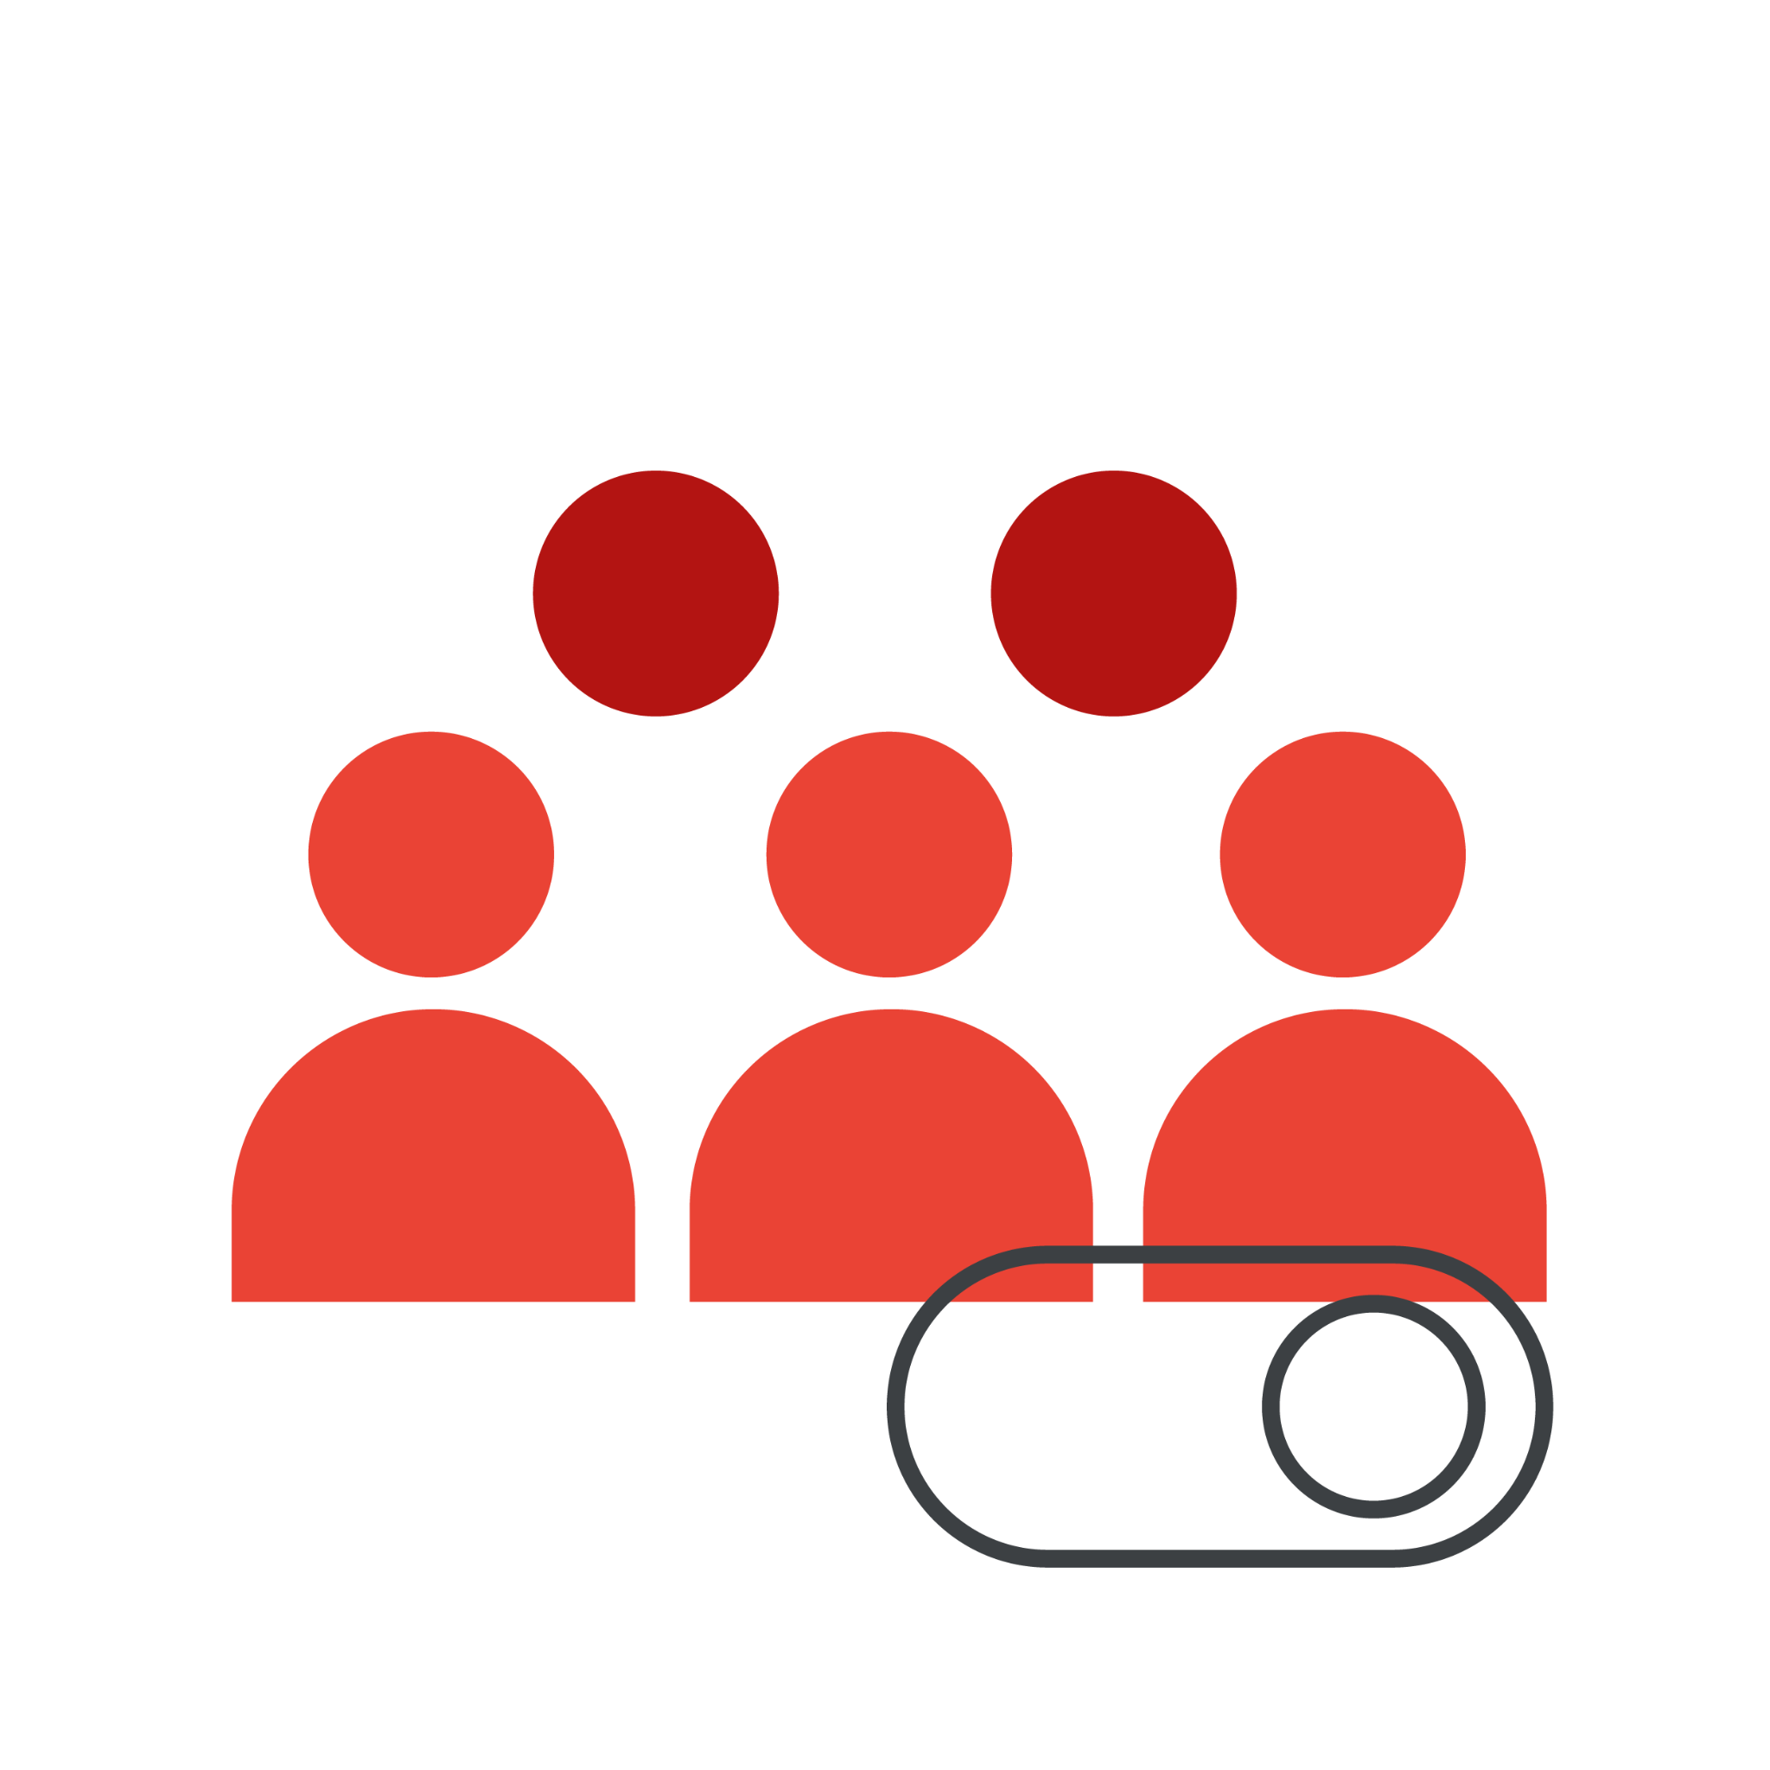
Optimize towards business goals through automation
Integrate 1P data
Step 3
Drive business objectives:
Combining your 1P data and automation will help you drive the most common business objectives:
Market share
Volume
Revenue
Profit
Human expertise + Automation + 1P data = competitive edge:
Activate custom and automated bidding strategies that aim to bid to more advanced value KPIs over time. Automation will help you drive value and performance; make the most of your 1PD and tailor messages to your most valuable customers.
Notes:
Combining your 1P data and automation will help you find the most valuable audiences for your brand, and therefore can help you drive the most common business objectives: market share, volume, revenue, and profit.
Activate custom and automated bidding strategies that aim to bid to more advanced value KPIs over time. Automation will help you drive value and performance; make the most of your 1PD and tailor messages to your most valuable customers.
Combining your human expertise with automation and a privacy safe 1P database is your competitive advantage.

Slide 56
3 Takeaways
Consumers Expect More
Lean into Technology
Your Data is the Best Data
Not legally binding. Intended solely for purposes of facilitating discussion about potential future collaborations. Google Confidential

Slide 57
Thank you

