Slide 1
Future-proof, drive performance, and reach quality leads with Google.
Notes:
Speaker Notes:
Welcome! Today, we’re going to share the latest macro information relating to global uncertainty and consumer confidence, review verticalized demand trend data, breakdown the increasingly complex modern lead generation customer, and and walk through how Google’s solutions can help you navigate this environment to future-proof your business, drive performance, and reach quality leads.

Slide 2
Hello!
Shenise Wigfall
Head of Agency

Slide 3
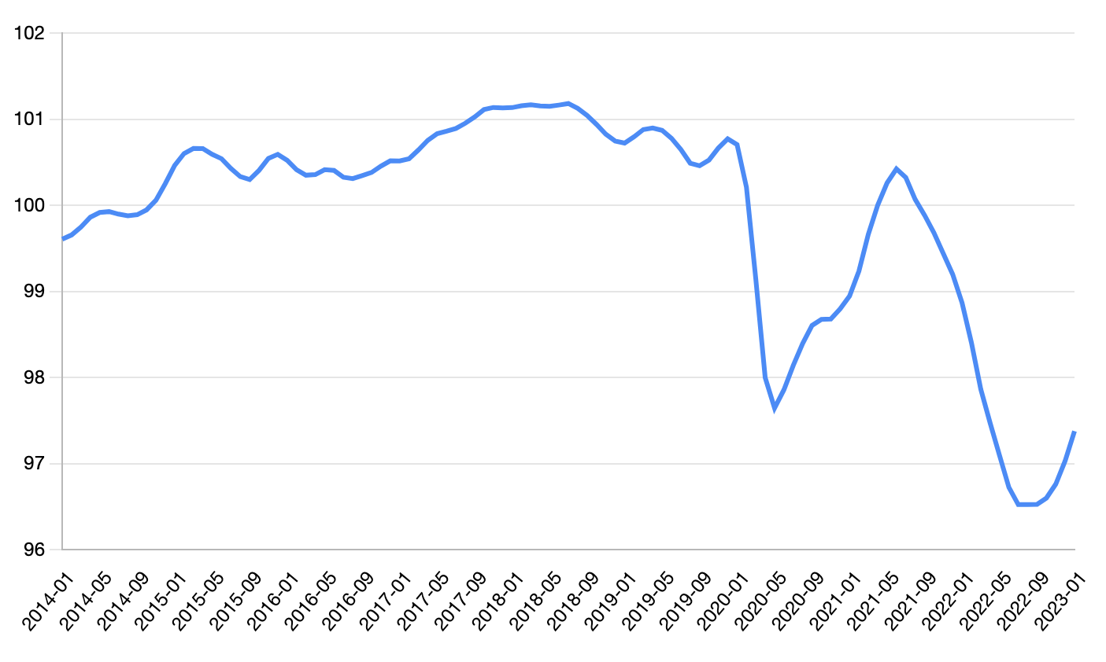
Ongoing global uncertainty presents unique challenges
Consumer Confidence Index
CCI
*OECD
Q1’14 - Q1’23
Source: OECD.org, Consumer confidence index (CCI) 2014-2023
Notes:
Speaker Notes:
The recent uncertainty has been challenging for everyone - for businesses, and for consumers.
If you look at this chart, it unfortunately does not show a good story on customer confidence.
Consumer confidence index provides an indication of future developments of households’ consumption and saving, based on their expected financial situation, their sentiment about the general economic situation, unemployment, and capability of savings.
An indicator above 100 signals a boost in the consumers’ confidence towards the future economic situation, as a consequence of which they are less prone to save, and more inclined to spend money on major purchases in the next 12 months.
Values below 100 indicate a pessimistic attitude towards future developments in the economy, possibly resulting in a tendency to save more and consume less.
As a summary, we can undoubtedly say that this chart is telling us customers are worried.
*OECD: Stands for “Organisation for Economic Co-operation and Development” see below for details on member countries, or update the graphic on this slide with country/market specific information from the internal appendix.
Additional Info:
Source (internal) via oecd.org (external)
What is OECD?
The Organisation for Economic Co-operation and Development
A unique forum where the governments of 37 democracies with market-based economies collaborate to develop policy standards to promote sustainable economic growth. Member countries of the OECD represent about 80% of world trade and investment.
Member countries are:
Australia, Austria, Belgium, Canada, Chile, Colombia, Costa Rica, Czech Republic, Denmark, Estonia, Finland, France, Germany, Greece, Hungary, Iceland, Ireland, Israel, Italy, Japan, Korea, Latvia, Lithuania, Luxembourg, Mexico, Netherlands, New Zealand, Norway, Poland, Portugal, Slovak Republic, Slovenia, Spain, Sweden, Switzerland, Türkiye, United Kingdom, United States
What is CCI?
This consumer confidence indicator provides an indication of future developments of households’ consumption and saving, based upon answers regarding their expected financial situation, their sentiment about the general economic situation, unemployment and capability of savings. An indicator above 100 signals a boost in the consumers’ confidence towards the future economic situation, as a consequence of which they are less prone to save, and more inclined to spend money on major purchases in the next 12 months. Values below 100 indicate a pessimistic attitude towards future developments in the economy, possibly resulting in a tendency to save more and consume less.

Slide 4
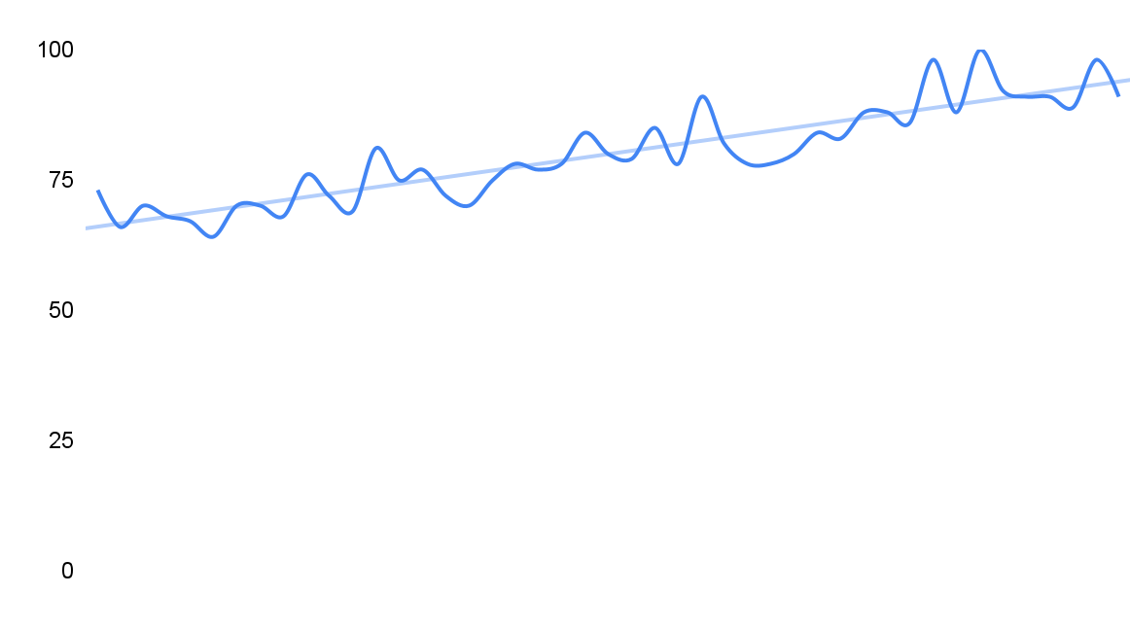
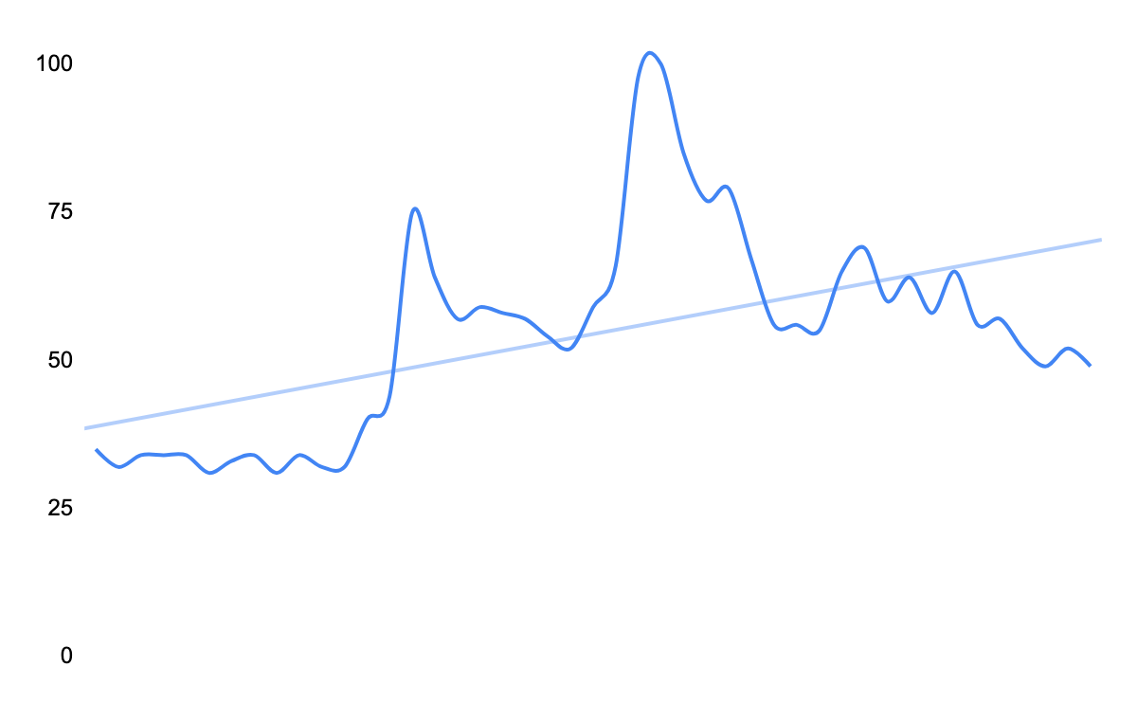
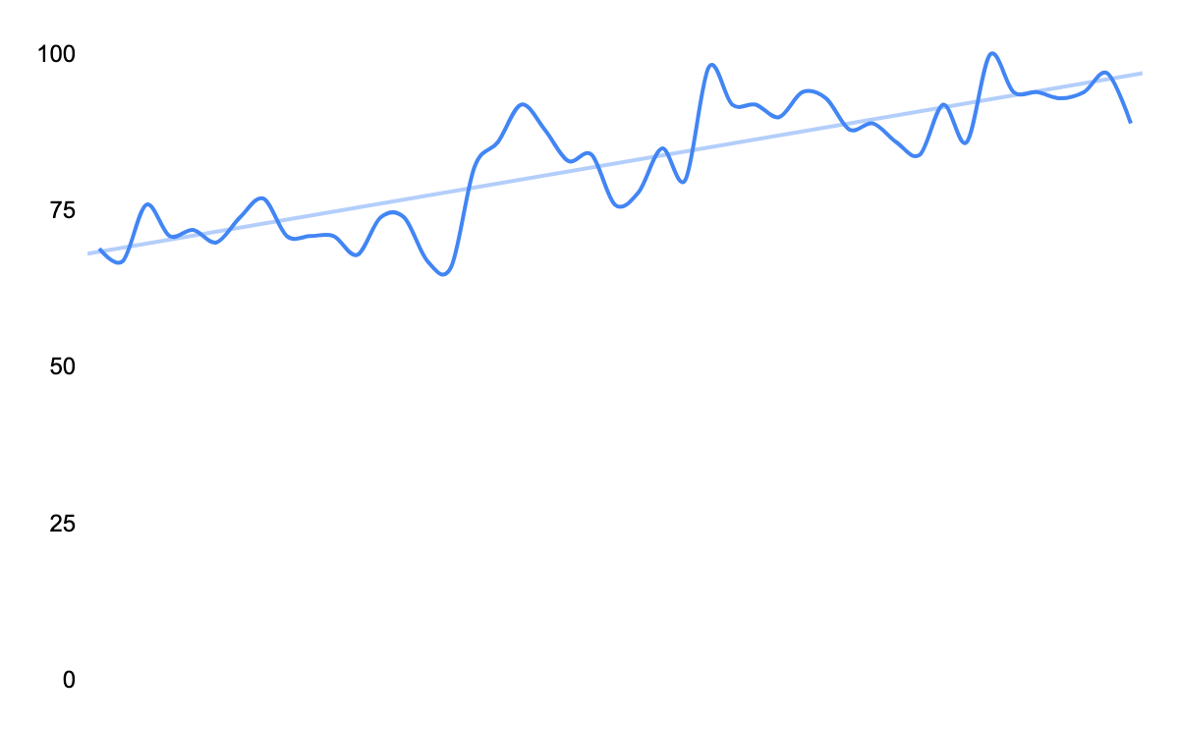
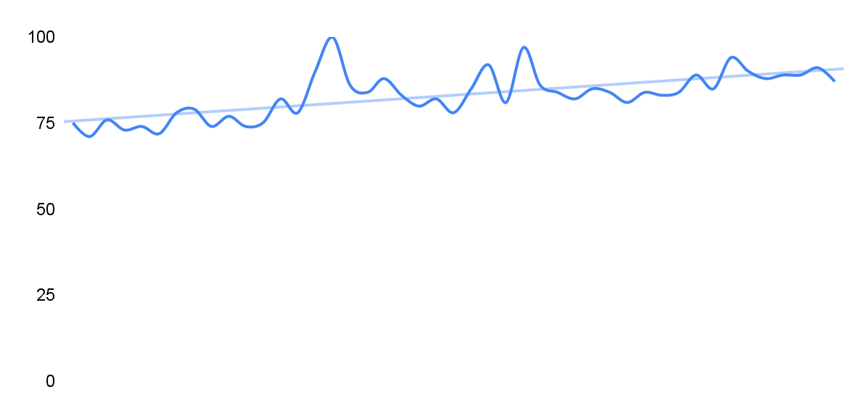
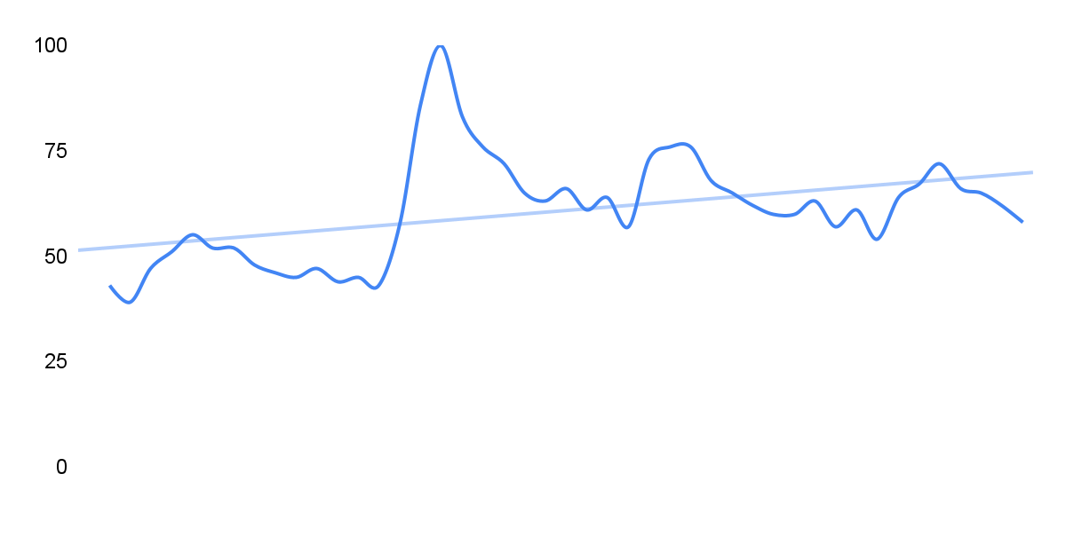
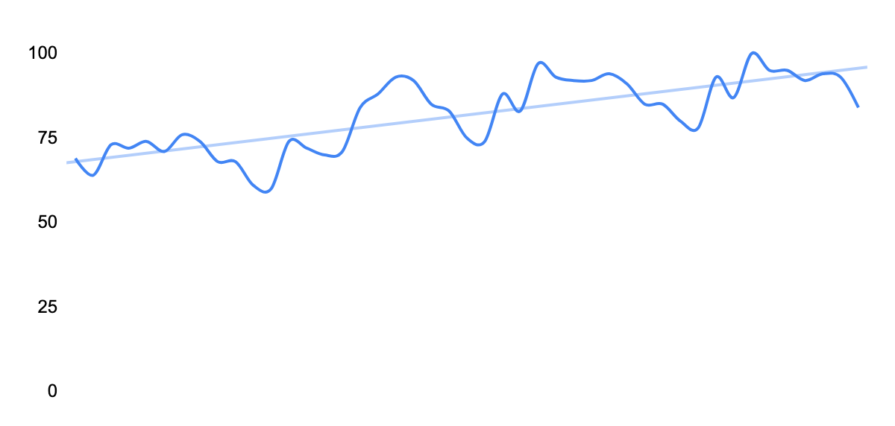
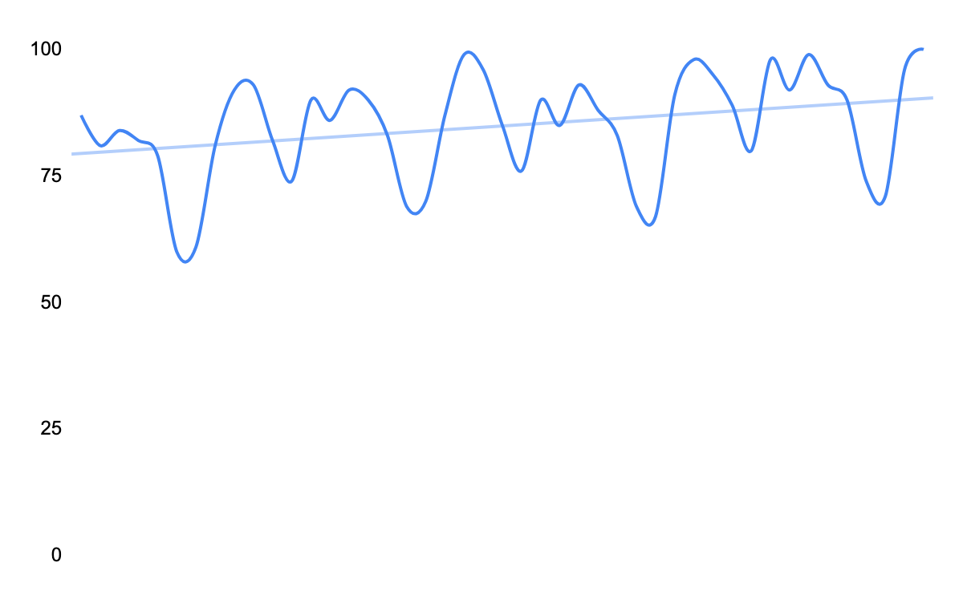
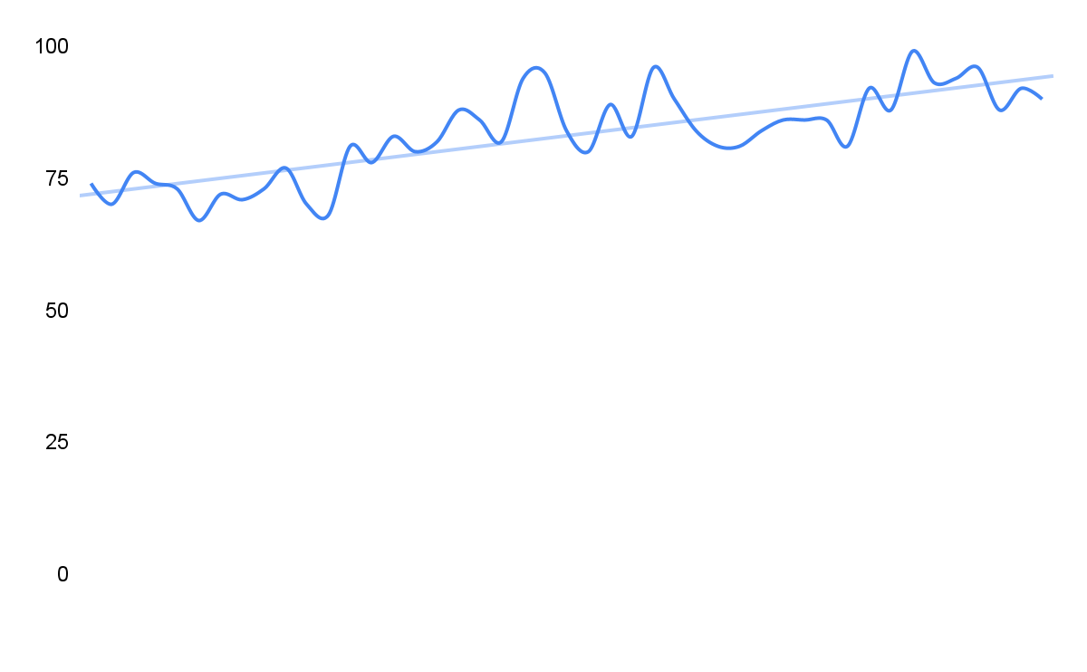
Despite rising uncertainty, top industries see steady interest and positive trend lines
Insurance
Investment Services
Cars / automotives
$
Financial Services
Indexed Search Volume, Q1’19 - Q4’22
Home Improvement Services
Real Estate (incl home security Moving & storage services)
Education Services
Legal services
Source: Google Internal Data Jan 2019 - Oct 2022 (Home Improvement & Maintenance, Insurance, Real Estate, Legal, Banking, Credit & Lending, Investing, Relocation & Household Moving, Alarm Systems & Equipment, Education & Training, Cars & Trucks, Used Motor Vehicles, Cable Services,Internet Service Plans,Phone Plans)
Notes:
Speaker Notes:
Although consumer confidence data converys that customers are worried about tomorrow, we’re continuing to see steady and increasing demand across top Lead Generation verticals like the ones shown above.
With these interest trend lines remaining positive, where we are observing a change is in the way consumers deliberate, and ultimately progress, on their path to purchase.
So, while consumers are searching, they are searching with a cautionary lens - ultimately, their needs are greater and their expectations are higher.

Slide 5
Customer journeys are becoming increasingly complex
93%
238M
of customer journeys
are unique…
… creating millions of different paths every 30 minutes
Source: Google and Greenberg mWeb and App Study, US Only, Q2 2021. 5 Switches in 30 minutes derived from average across 7 verticals analyzed | n=10,62. 93% of Path is any path that is more than one step and based off of Total Population in US Analyzed. 238M derived from US population*93% of population using both*93% not replicable
Notes:
Speaker Notes:
These higher consumer expectations result in longer and more complex consideration cycles, where virtually no two consumer journeys are likely to be same.
When nearly all paths to purchase are unique, this leads to increased pressure on marketings teams to predict, plan, and react.
However, no one human, or one marketing team, can understand every single one of these unique 230M + journeys and manually strategize and optimize towards them. To truly capitalize on these opportunities, you need a sophisticated and modernized marketing strategy.

Slide 6
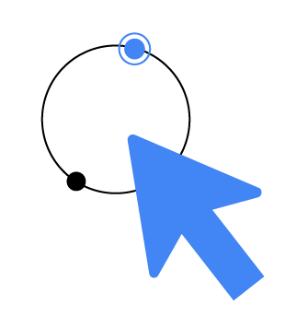
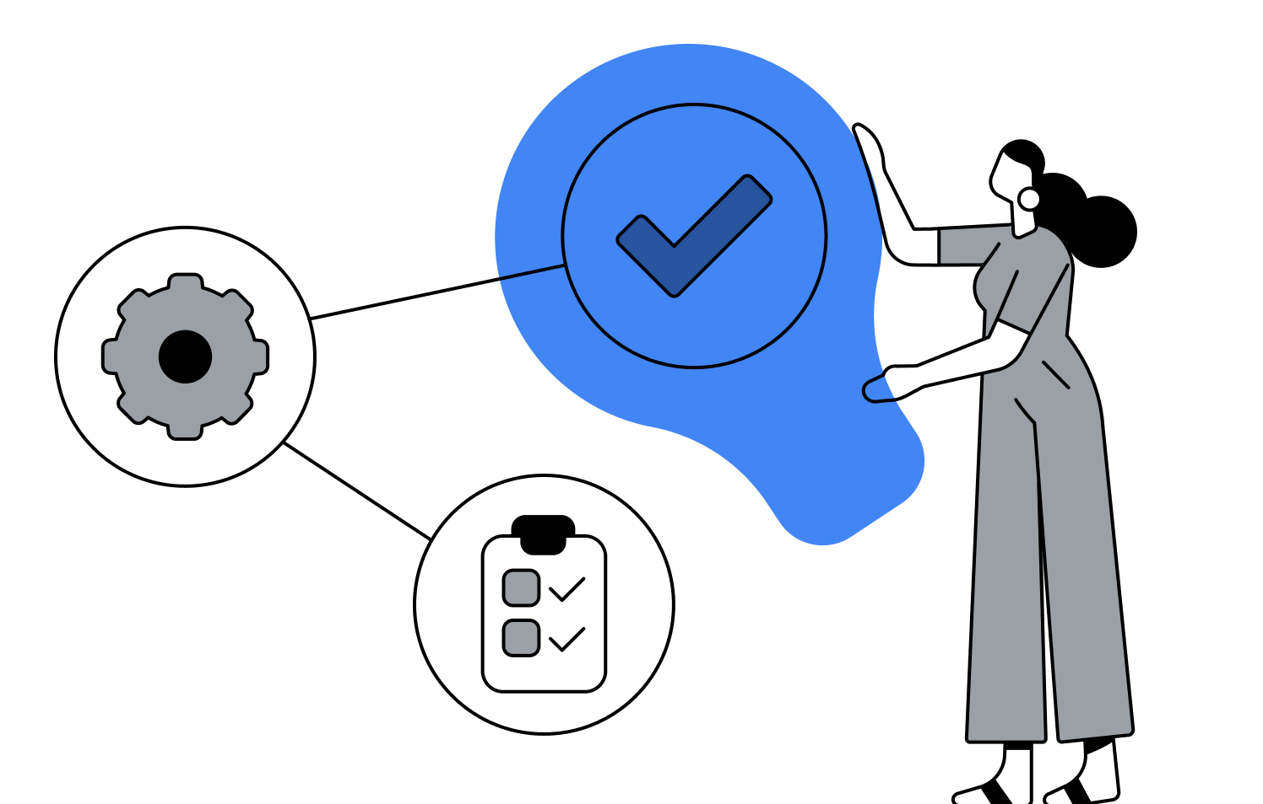
Given the changing global landscape, how can we help accelerate your business?
Notes:
Speaker Notes:
So, given the changing global landscape and increasingly complex consumer journeys, how can we help accelerate your business design a sophisticated and modernized marketing strategy to ensure you’re efficiently meeting revenue goals?

Slide 7
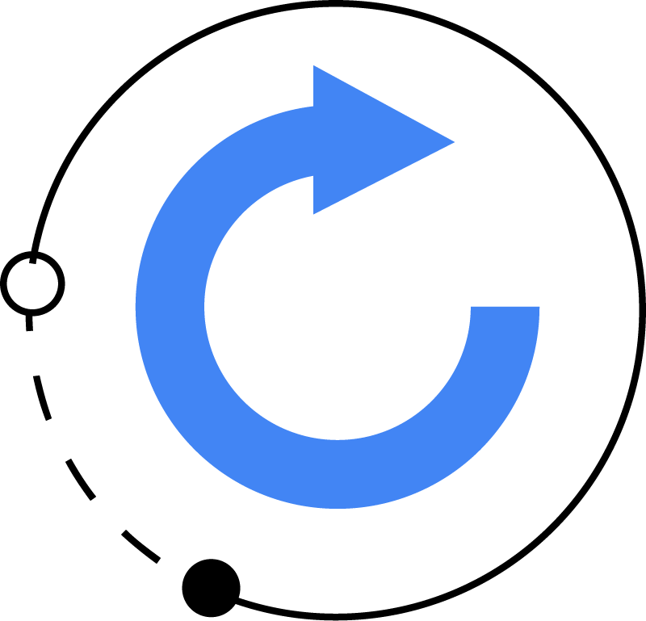
Accelerate your lead generation efforts in three steps
1.
2.
3.
3.
Leverage your
data so it works
for you.
Transform demand into revenue.
Drive higher value from your budget, today and tomorrow.
Notes:
Speaker Notes:
You can accelerate your business in 3 steps:
Leverage your data so it works for you, both online and offline, in order to
Transform demand into revenue and
Drive higher value from your budget, both today and tomorrow
Today we want to talk about product innovations that will make this easier and more effective than ever

Slide 8
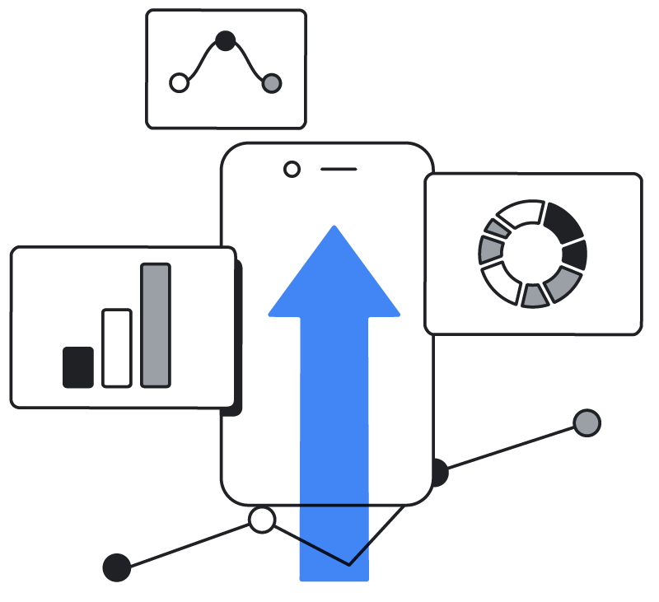
Leverage your data so it works for you.
1.

Slide 9
Understand the lead-to-sale journey
of your customer’s unique path to purchase
1. Leverage your data so it works for you.
Lifetime Value
ROI and total profit optimized
Examples: upsold and cross-sold leads, customer evangelists, repeat purchasers
Integrating your lead-to-sale journey drives +20% incremental revenue and +30%
cost efficiency.
Offline Actions
Revenue value optimized
Examples: marketing or sales qualified leads, vetted opportunity, converted leads
From Cost Center to Profit Center
Online Actions
Conversion cost optimized
Examples: new leads, form submissions, online chats, newsletter subscriber, brochure downloads
Source: BCG, Responsible Marketing with First Party Data, May 2020
Notes:
Speaker Notes:
In order to leverage your data so it works for you, step #1 requires an understanding of the average lead-to-sale journey of your customers.
As mentioned earlier, consumer journeys are becoming increasingly complex. We have tools available to help you breakdown these averages and map out the typical path to purchase - from an online, low value action with zero revenue to your business, to a high value profitable offline and lifetime action.
In doing so, you’ll be able to drive better business outcomes by focusing and optimizing towards qualified and converted leads. In fact, leveraging this data, as we’ll review how to do in the following slides, can lead to a 20% increase in incremental revenue and a 30% increase in cost efficiency.
Additional Info:
[New] Via Looker: Go/LeadtoSalesTool

Slide 10
Increase revenue
by understanding your customer’s healthcare lead-to-sale journey
1. Leverage your data so it works for you.
Online
Offline
Offline
Offline
Offline
Sign up
Consultation requested
Sales qualified call
Scheduled appointment
Initial consultation
5,000 Sign-ups per month
$27 per sign-up
2,500 Requests per month
$54 per request
125 SQLs per month
$1,080 per SQL
100 Appointments per month
$1,350 per appointment
90 consultations per month
$1,500 per consultation
50% conversion rate
5% conversion rate
80% conversion rate
90% conversion rate
<1 day
<1 day
<1 day
7 days
Increase revenue and profit by driving lifetime value, profitability and efficiency.
Notes:
Speaker Notes:
As an example of what understanding your customer’s lead-to-sale journey might look like, here’s a sample journey for a healthcare client.
The key to increasing revenue is to focus marketing efforts on the high quality offline actions that drive profit for your business.

Slide 11
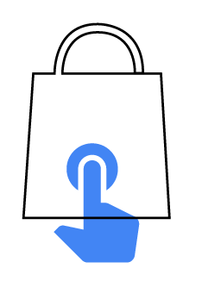
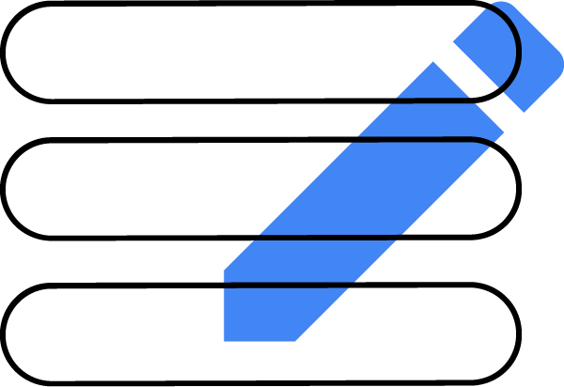
Put your 1P data to work
durable customer data is key to drive lead quality and growth
1. Leverage your data so it works for you.
Enhanced Conversions for Leads
Future-proof your measurement and recover conversions that may not be observable in certain browsers today.
Privacy safe and enduring, with hashing of first-party customer data.
No custom coding on your website
and no CRM modifications.
Notes:
Speaker Notes:
Step #2 of “Leverage your data so it works for you” is putting all of that data to work.
Enhanced Conversions for Leads was opened to *all accounts late last year as a privacy-safe solution for improving the accuracy of your high-value, offline conversion measurement.
What different about Enhanced Conversions for Leads, as opposed to other offline measurement solutions, is its durability:
Your first-party customer data remains confidential and secure using the same industry-leading standards that Google uses to protect its own users' data!
Additionally:
It’s easy to set up, with no custom coding and no required CRM modifications
It enables better performance, allowing you to optimize your campaigns to sales and transactions that happen offline.
Additional Info:
Note:
*August ‘22 Sensitive Vertical Restriction was removed for ECL and it should be available to all global CIDs.
Advertisers should ensure that any imported conversions, are properly categorized with either a “Qualified Leads” or “Converted Leads” Conversion Label whenever relevant. This allows the Google AI to deliver optimal performance.

Slide 12
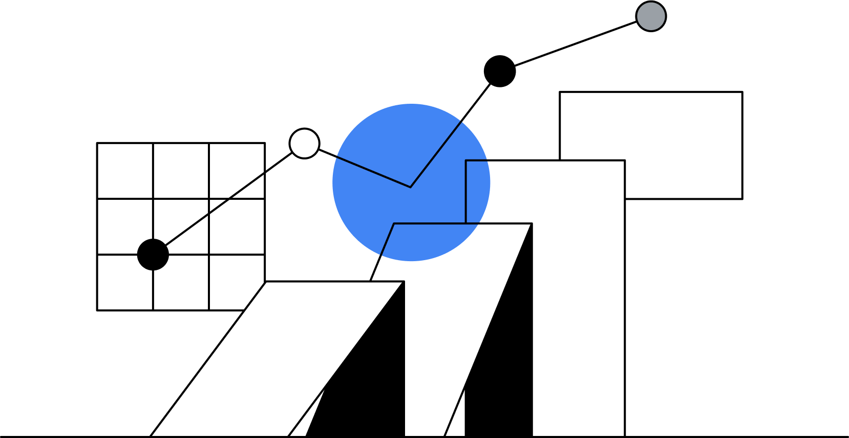
Transform demand into revenue
2.

Slide 13
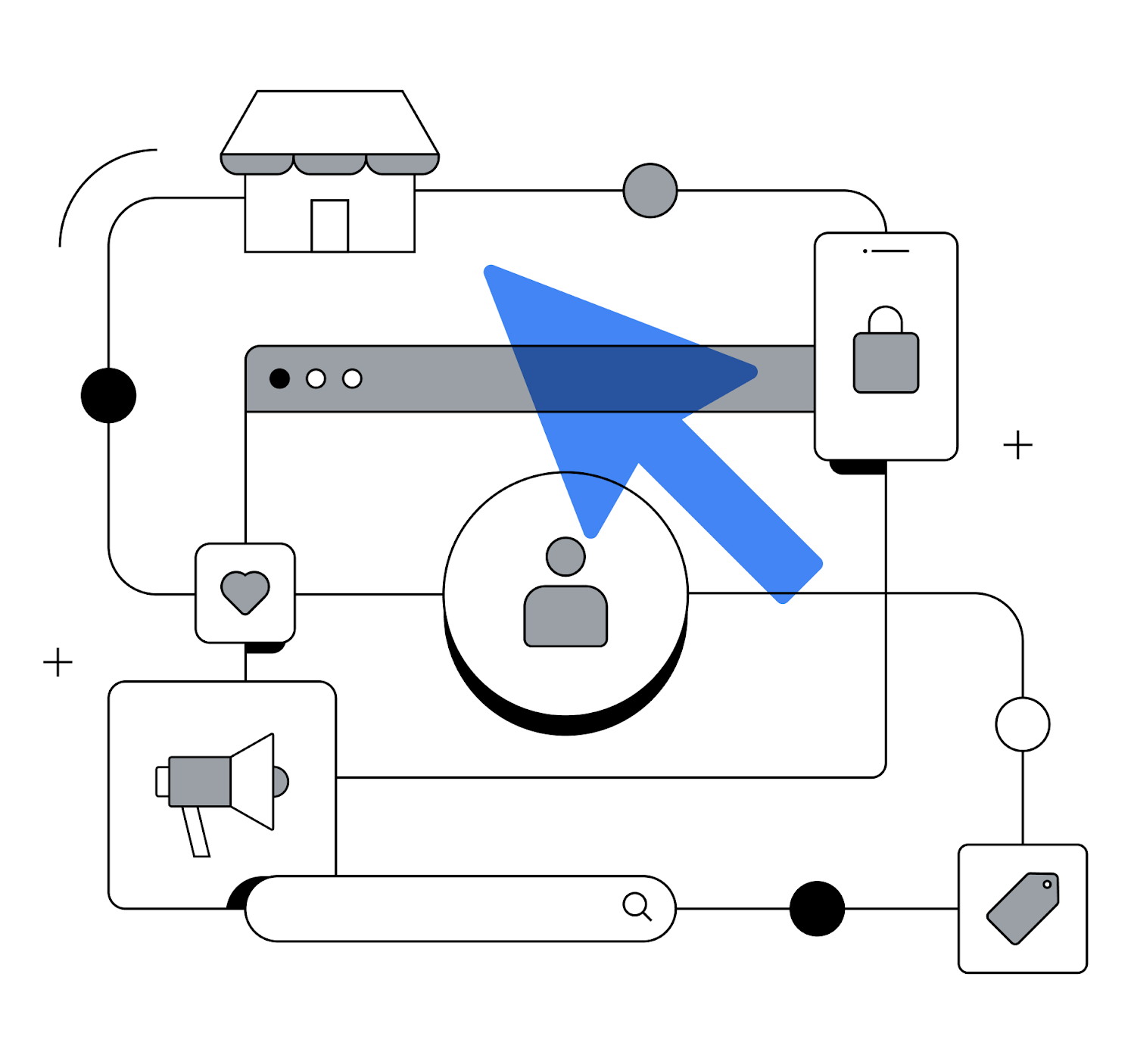
Google’s AI is your business multiplier
to future-proof, drive performance, and reach quality leads
2. Transform demand into revenue
Multiply your results
Drive reliable, strong ROI and unlock the next wave of growth.
x
Multiply your customer connections
Market faster and meet your customers where they are.
Across Ads with Google AI
x
Multiply your expertise
Augment your expertise and creativity to create new value and drive greater impact.
x
Notes:
Speaker Notes:
Phase two of accelerating your lead generation efforts is transforming demand into revenue. As noted at the top, core industries are seeing positive trend lines; and the easiest way to capture and profitably transform this demand is with Google’s AI.
Google’s AI allows you
To multiply your results to:
Capture reliable ROI and drive profitable growth for the future. Optimize performance in real time to get more conversions and value from your budget. Google's AI also helps you unlock incremental results by uncovering new opportunities from search queries, channels, or audiences you may not have considered before.
Think: Value based bidding, which we’ll be covering in this section.
To multiply your customer connections to:
Combine your knowledge with Google’s consumer insights to stay on top of fast-changing consumer needs and trends as they happen across essential channels like Search and YouTube.
Think: Enhanced Conversions for Leads and understanding the customer journey.
To multiply your expertise:
AI learns from you. And you learn from AI. What sets any marketing strategy apart is the human ingenuity behind it. Multiply your marketing expertise and creativity with Google’s AI. Explore the latest trends and insights to spark new ideas and build high-performing ad creative.
Think: Performance Max campaigns, which we’ll be covering in section #3.

Slide 14
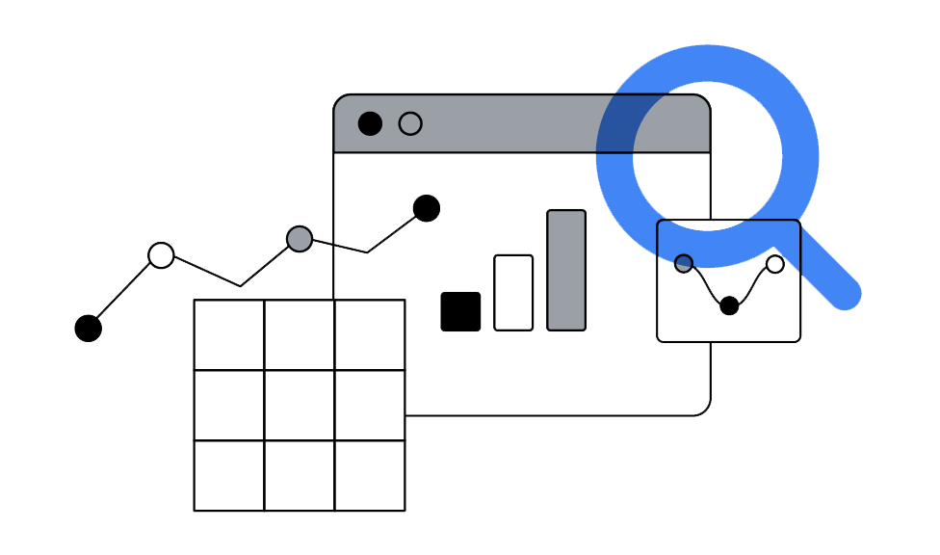
Google’s AI-powered bidding
solve for increasingly complex consumer journeys
2. Transform demand into revenue
+14%
It’s easier than ever to optimize towards the actions that drive value for your business using Value Based Bidding strategies.
Conversion Value Lift
with AI-powered Value Based Bidding vs. Conversion Based Bidding
*Source: Google Internal Data, Global, March 2021
Notes:
Speaker Notes:
The best way to leverage the power of Google’s AI is with Value Based Bidding.
These bidding solutions enable you to both solve for increasingly complex consumer journeys and optimize towards revenue by prioritizing valuable offline and lifetime actions.
In fact, when we work with partners to upgrade from high funnel Conversion Based Bidding to low funnel Value Based Bidding, we see an average uplift of +14% conversion value. All of this translates into greater profitability and return on ad spend for you.

Slide 15
Value Based Bidding in practice
accounting for the predicted value of your customers to help increase profitability
2. Transform demand into revenue
Customer 1
Customer 2
Customer 3
Value $100
Value $300
Value $500
Before
Value Bidding
Bid $10
Bid $10
Bid $10
With
Value Bidding
Bid $5
Bid $10
Bid $15
Notes:
Speaker Notes:
As an example of how this works:
For an advertiser using Conversion Based Bidding, campaigns will prioritize the total number of conversions at a specified target or budget, but will do so irrespective of the final value that those conversions bring to your business.
Alternatively, with a Value Based Bidding strategy, you can specifically report and optimize to the value of a conversion, in order to maximize the impact of your budgets.

Slide 16
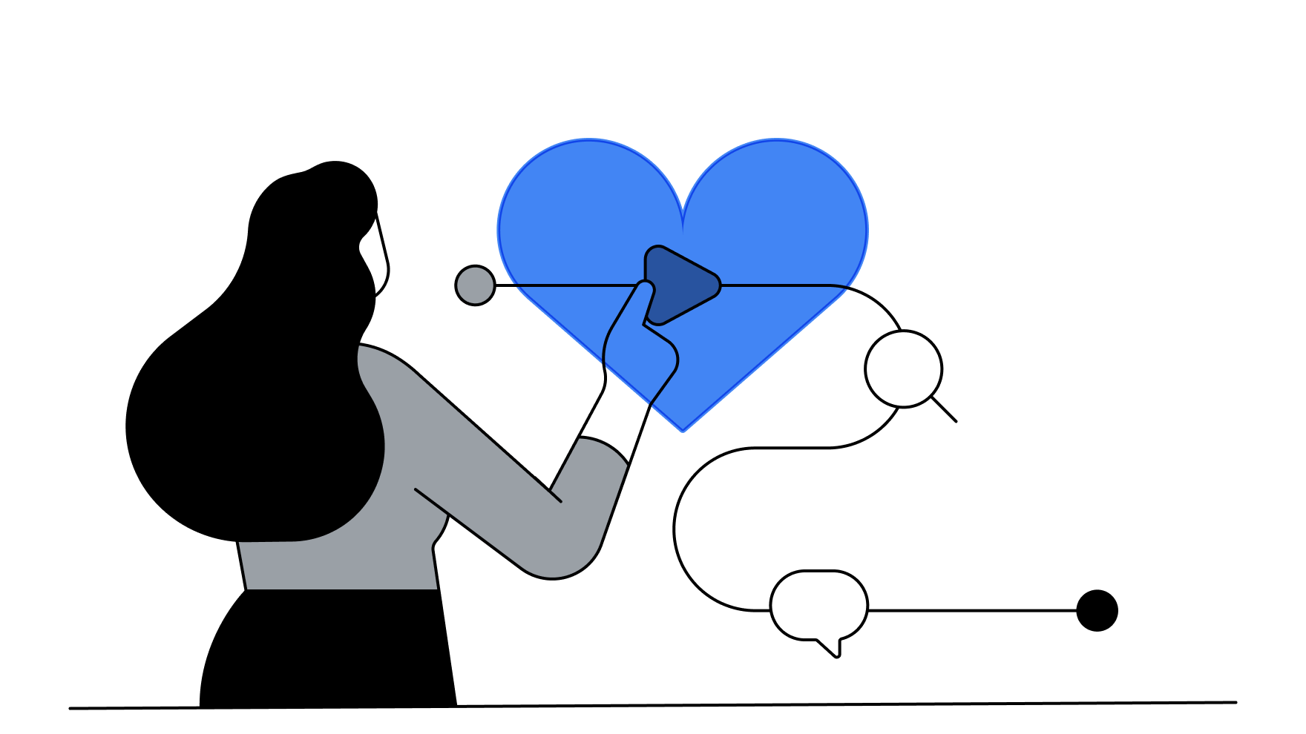
Drive higher value from your budget, today and tomorrow
3.
Notes:
Speaker Notes:
We’ve covered a lot today, from the changing consumer journey to how leveraging your 1P data and insights can help transform demand into revenue.
The final step of accelerating your lead generation efforts is driving higher value from your budget, both today and tomorrow.

Slide 17
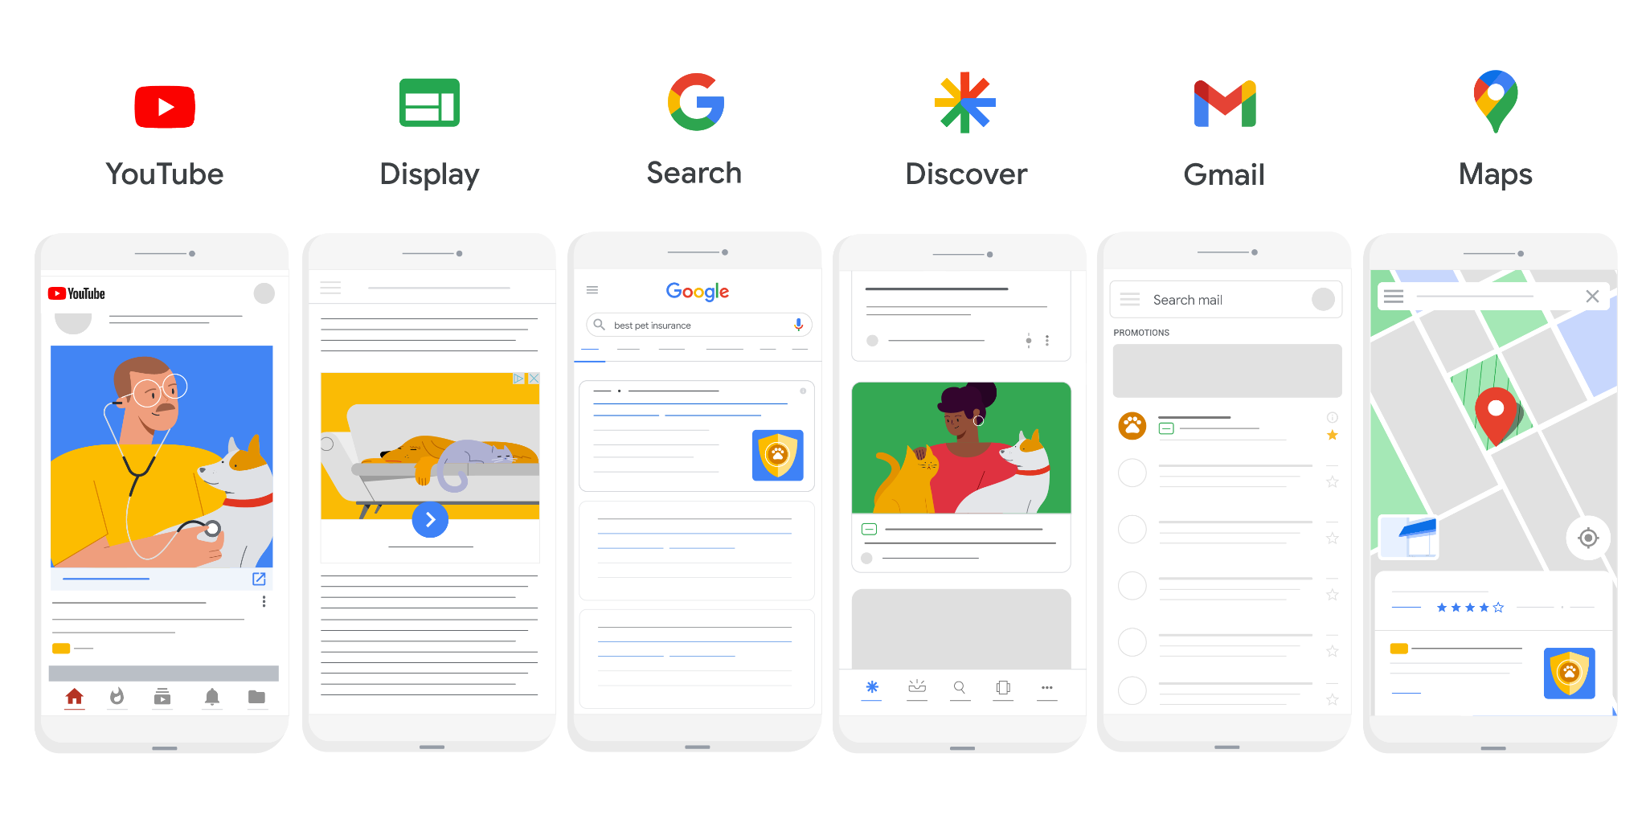
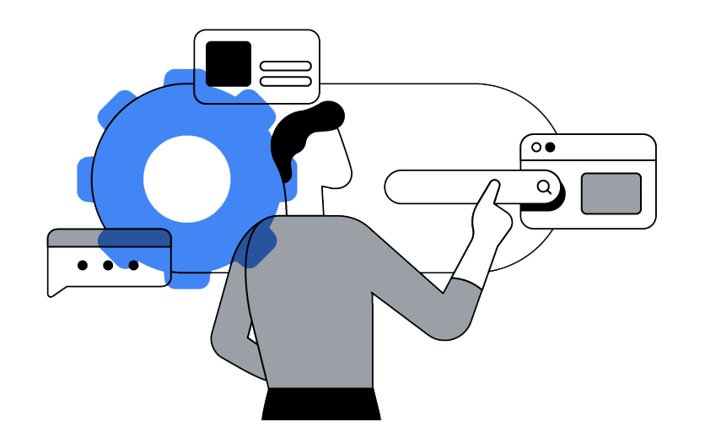
Performance Max
driving scale and growth with a goals-based campaign experience
3. Drive higher value from your budget today and tomorrow
+18%
Total incremental conversions
at a similar cost*
$
Source: Average uplift in performance based on internal studies. Individual results may vary according to campaign details.
Notes:
Speaker Notes:
Given that the lead journey is often fragmented, it’s more important than ever to be present throughout a customer’s entire consideration cycle.
Performance Max enables you to find and reach customers when it’s relevant - and when it’s profitable.
This profitability translates into an increase of 18% total incremental conversions on Performance Max campaigns, while maintaining a similar cost.
Alongside your traditional campaigns, Performance Max enables you to find valuable customers and multiply your conversions across Google’s full range of advertising channels and inventory.
Your next high-ROI (or high value) conversion could come from a search query that isn’t covered by your existing Search keywords, or from a channel that you hadn’t considered. That’s why Performance Max uses the full power of Google’s AI to help you find untapped and incremental conversion opportunities.

Slide 18
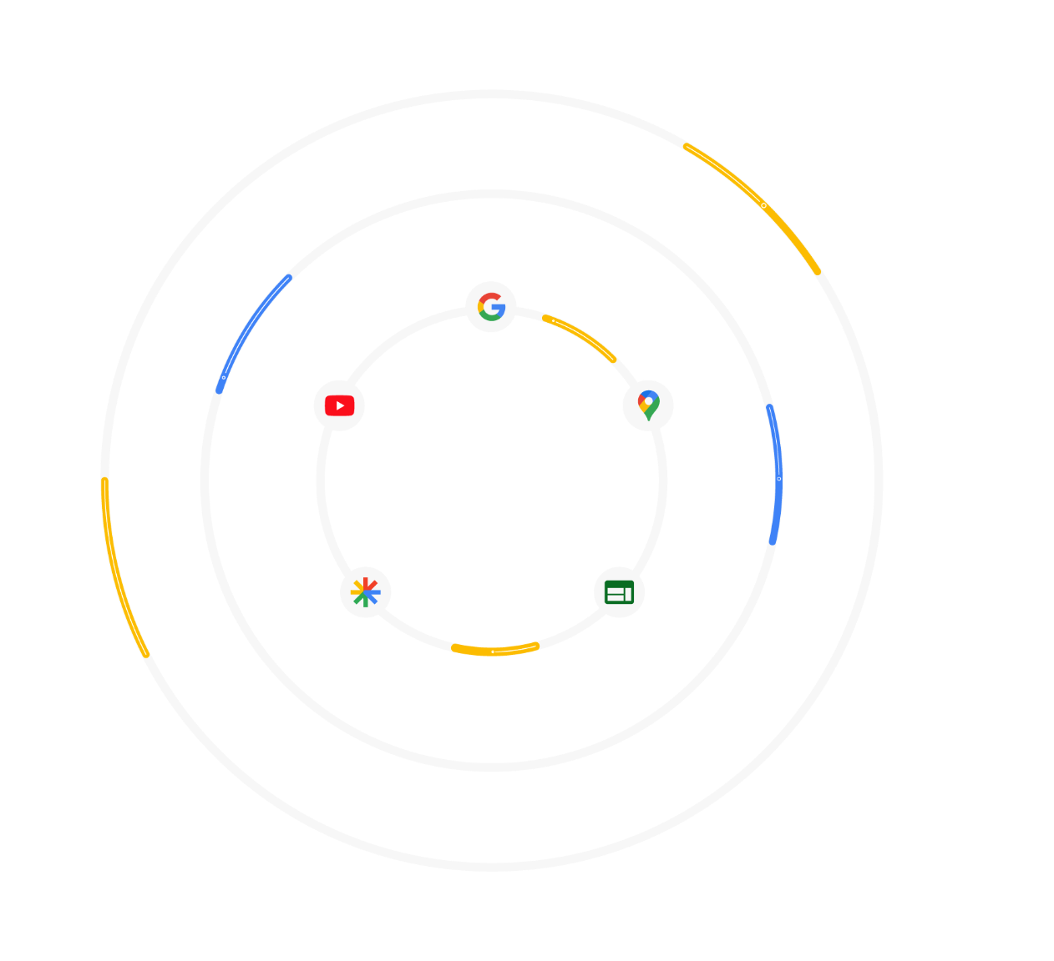
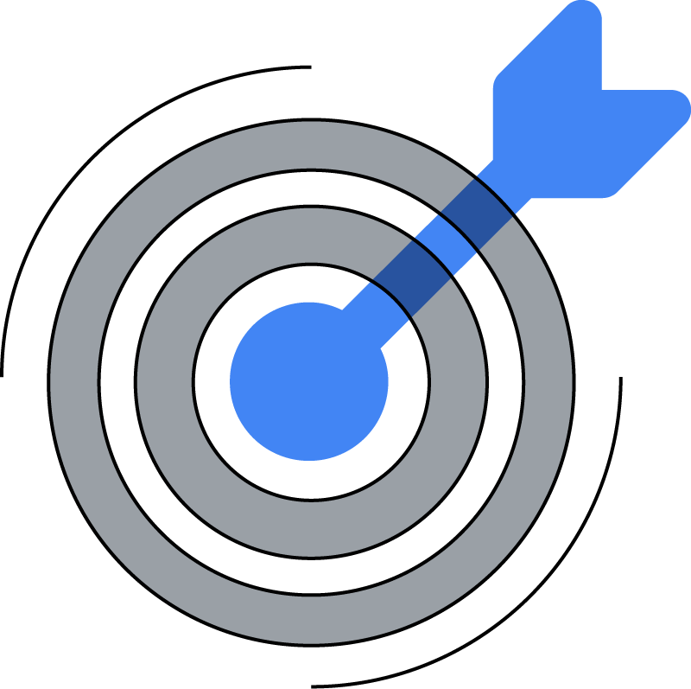
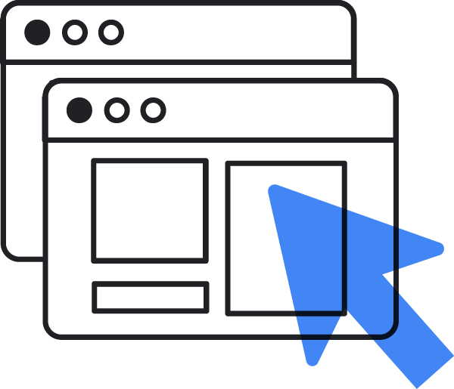
The best of Google’s-AI
combined with Smart Bidding and your offline + lifetime actions
3. Drive higher value from your budget today and tomorrow
Single goal-based campaign that focuses on achieving performance goals with AI across all of Google’s inventory
Campaign Goals
Path-to-purchase aware across channels, so the right ad can be served at the right time according to your marketing objective, no matter where they are on the Google Ads network
Location
Creative Assets
Always serve on the best inventory across all Google channels to automatically reach customers where you can efficiently scale
Targeting Signals
& Brand Safety
Valuable Offline
Conversions
Notes:
Speaker Notes:
As covered, Performance Max profitably reaches your next high value customer across all of Google’s networks. To breakdown how it does this:
Performance Max leverages the best of Google’s AI, from Smart Bidding, to goal-based campaign settings, to funnel awareness across channels.
When you provide creative assets, specified campaign goals, valuable offline conversion data, and inputs on targeting signals - Performance Max delivers results across a single campaign.

Slide 19
New and upcoming
targeting and optimization features to focus on achieving your business goals with Performance Max
3. Drive higher value from your budget today and tomorrow
With the New Customer Acquisition goal, you can optimize for new, high-quality leads.
Simply upload your customer lists and your campaign will optimize towards new consumers.
Introducing
New Customer Only Mode
Grow your business by optimizing
to only new customers
Improve new customer ratio by +13% while reducing acquisition costs for new customers by -19%
Source: Advertisers that use the New Customer Only mode have improved their new customer ratio by 13% with a reduced acquisition cost for new customers by -19%.
Average uplift in performance based on internal studies. Individual results may vary according to campaign details.
Notes:
Speaker Notes:
Performance Max is Google’s flagship campaign type, so we have several new and upcoming features specifically for lead generation advertisers that will help you focus on achieving your business goals.
The latest currently available setting is New Customer Acquisition, which enables you to upload a Customer Match List to acquire net-new leads for your business.
Additional upcoming features will allow you to further refine new customer acquisition efforts with a “New Customer Only Mode” to help grow your business by only optimizing towards new customers.
Additional Info:
If interested in reviewing the Performance Max roadmap in greater detail, you can share these external slides under NDA.

Slide 20
To Recap:
3 strategies to accelerate your lead generation efforts
1.
2.
3.
3.
Leverage your
data so it works
for you.
Transform demand into revenue.
Drive higher value from your budget, today and tomorrow.
Integrate your lead-to-sale journey with Enhanced Conversions for Leads
Optimize towards high value actions with
Google’s AI-powered Value Based Bidding
Multiply your conversions across Google’s full range of advertising channels and inventory on Performance Max
Notes:
Speaker Notes:
Thank you so much for your time today! As a quick recap of what we covered, the three steps to accelerate your lead generation efforts are:
Leverage your data so it works for you.
Accomplished by integrating your high value conversion data.
Transform demand into revenue.
Via Google’s AI-powered bidding.
And, finally, drive higher value from your budget, both today and tomorrow.
With Performance Max campaigns.

Slide 21
Thank you

Slide 22
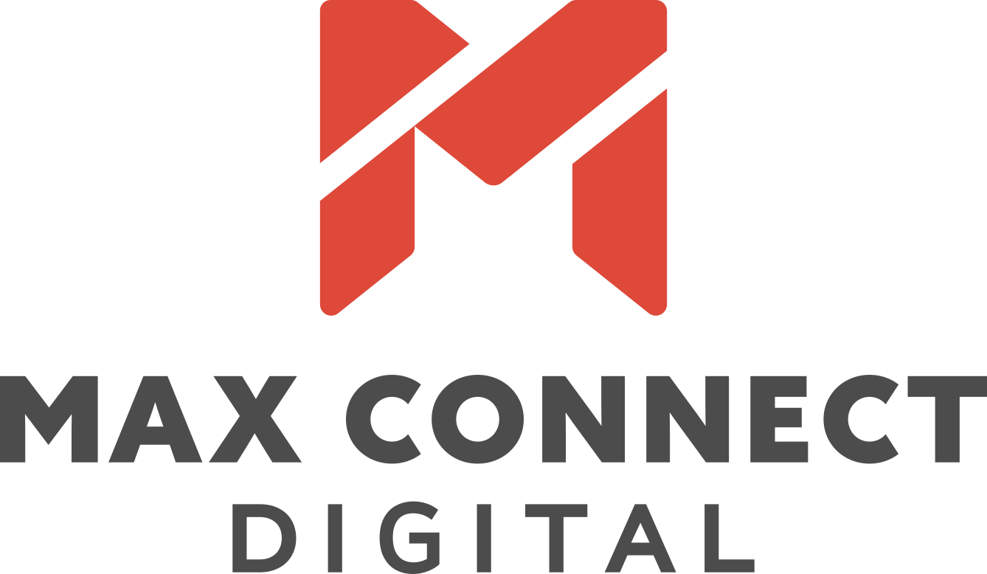
Digital marketing
introduction

Slide 23
Industry Insider Summit:
Lead Generation

Slide 24
LEAD GENERATION
Becoming your own “HypeMan!”
Session Take Aways:
Finding your brand’s unique voice
Telling your story
Developing/Nurturing brand trust
Developing leads

Slide 25
+
Driving holistic performance
+
$
$
+
Channel Performance & Optimization
The right combination of Brand + Performance. Every interaction matters to demonstrate genuine authenticity with continued learning / optimization of campaign channels.
+
+
Robust Digital Ecosystem
Consumers arriving at your website and other digital experiences should see the value proposition & path to purchase.
Unrivaled Growth
When brands are able to create an experience that connects with their customers beyond just a single transaction but engenders brand loyalty, customer lifetime value and creative brand ambassadors, true magic happens.
=
+
+
Hyper-Targeted Audiences
Effectively leverage 1st and 3rd Party Data, proper segmentation and personalization. Empirical audience data used before & on-going to expand reach | performance.
+
Brand Messaging & Offer
Brands need to align with what that consumer segment is looking for and emotionally connect. Align with their Why.
Notes:
When consumers arrive at your website and other digital experiences, they should feel comfortable, clearly see the value proposition of the product and have a well laid out path to purchase. This includes landing pages, nurturing campaigns and remarketing.

Slide 26
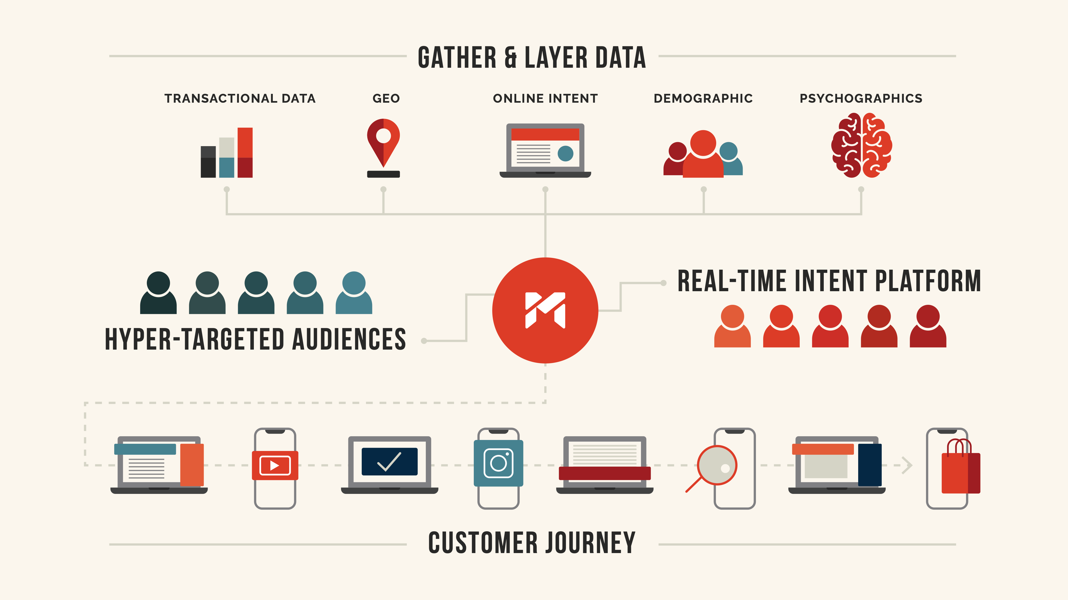

Slide 27
Option 1 OR OPTION 2
LEADS

Slide 28
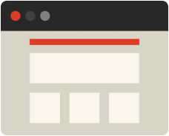
Digital strategy
An omnichannel approach is the best strategy for meeting consumers at every stage of their buying journey and funneling them to an eventual conversion.
Display
Conquest
Social
Pre-roll & CTV
Paid search
Retarget

Slide 29
Key Channels
Display
Pre-roll & CTV
Social
Paid search
Retargeting
Conquesting
Branding
Event Based
In-Market Strategies
Product Specific
Retargeting
Conquesting
Branding
Event Based
In-Market Strategies
Dynamic Video
Retargeting
Meta/LinkedIn
3rd Party Audiences
Event Based
In-Market Strategies
Lead Form Ads
Collection Ads
Dynamic Video
Dynamic Audience Layered
Conquesting
Branded
Event Based
In-Market Strategies

Slide 30
Budget Allocation example
Based on consumer journey
These examples highlight some potential campaign structures by medium, but strategies are created for each industry based on the product, location, and business goals as well as data optimizations from historical performance and benchmarking.

Slide 31
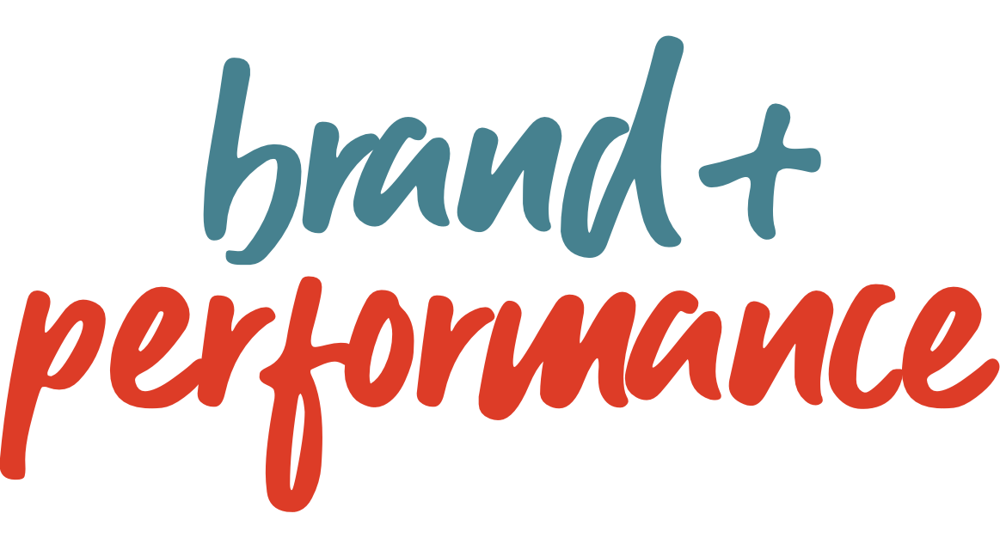
brand
performance
Brands focused on long-term growth, becoming a category leader, and achieving mind- and market-share build awareness and consideration, while driving lead flow and new customers can achieve great efficiency across their total investment*.
Outcomes:
Brand KPIs: Build a loyal customer base, total impressions, website visits and views, brand search growth, direct and organic traffic, mind- and market-share.
Performance KPIs: conversions rates, website site | store revenue, store visits, customer acquisition costs, # of new customers, qualified leads and calls, business outcomes.
results
*MediaPost, May 30, 2023, “Stop Scraping Funnel Bottoms: Go Upstream To Pan For Gold”, Bryan Karas.
*WSJ, Nov 22, 2022, “Airbnb Says Its Focus on Brand Marketing Instead of Search Is Working”, Megan Graham.

Slide 32
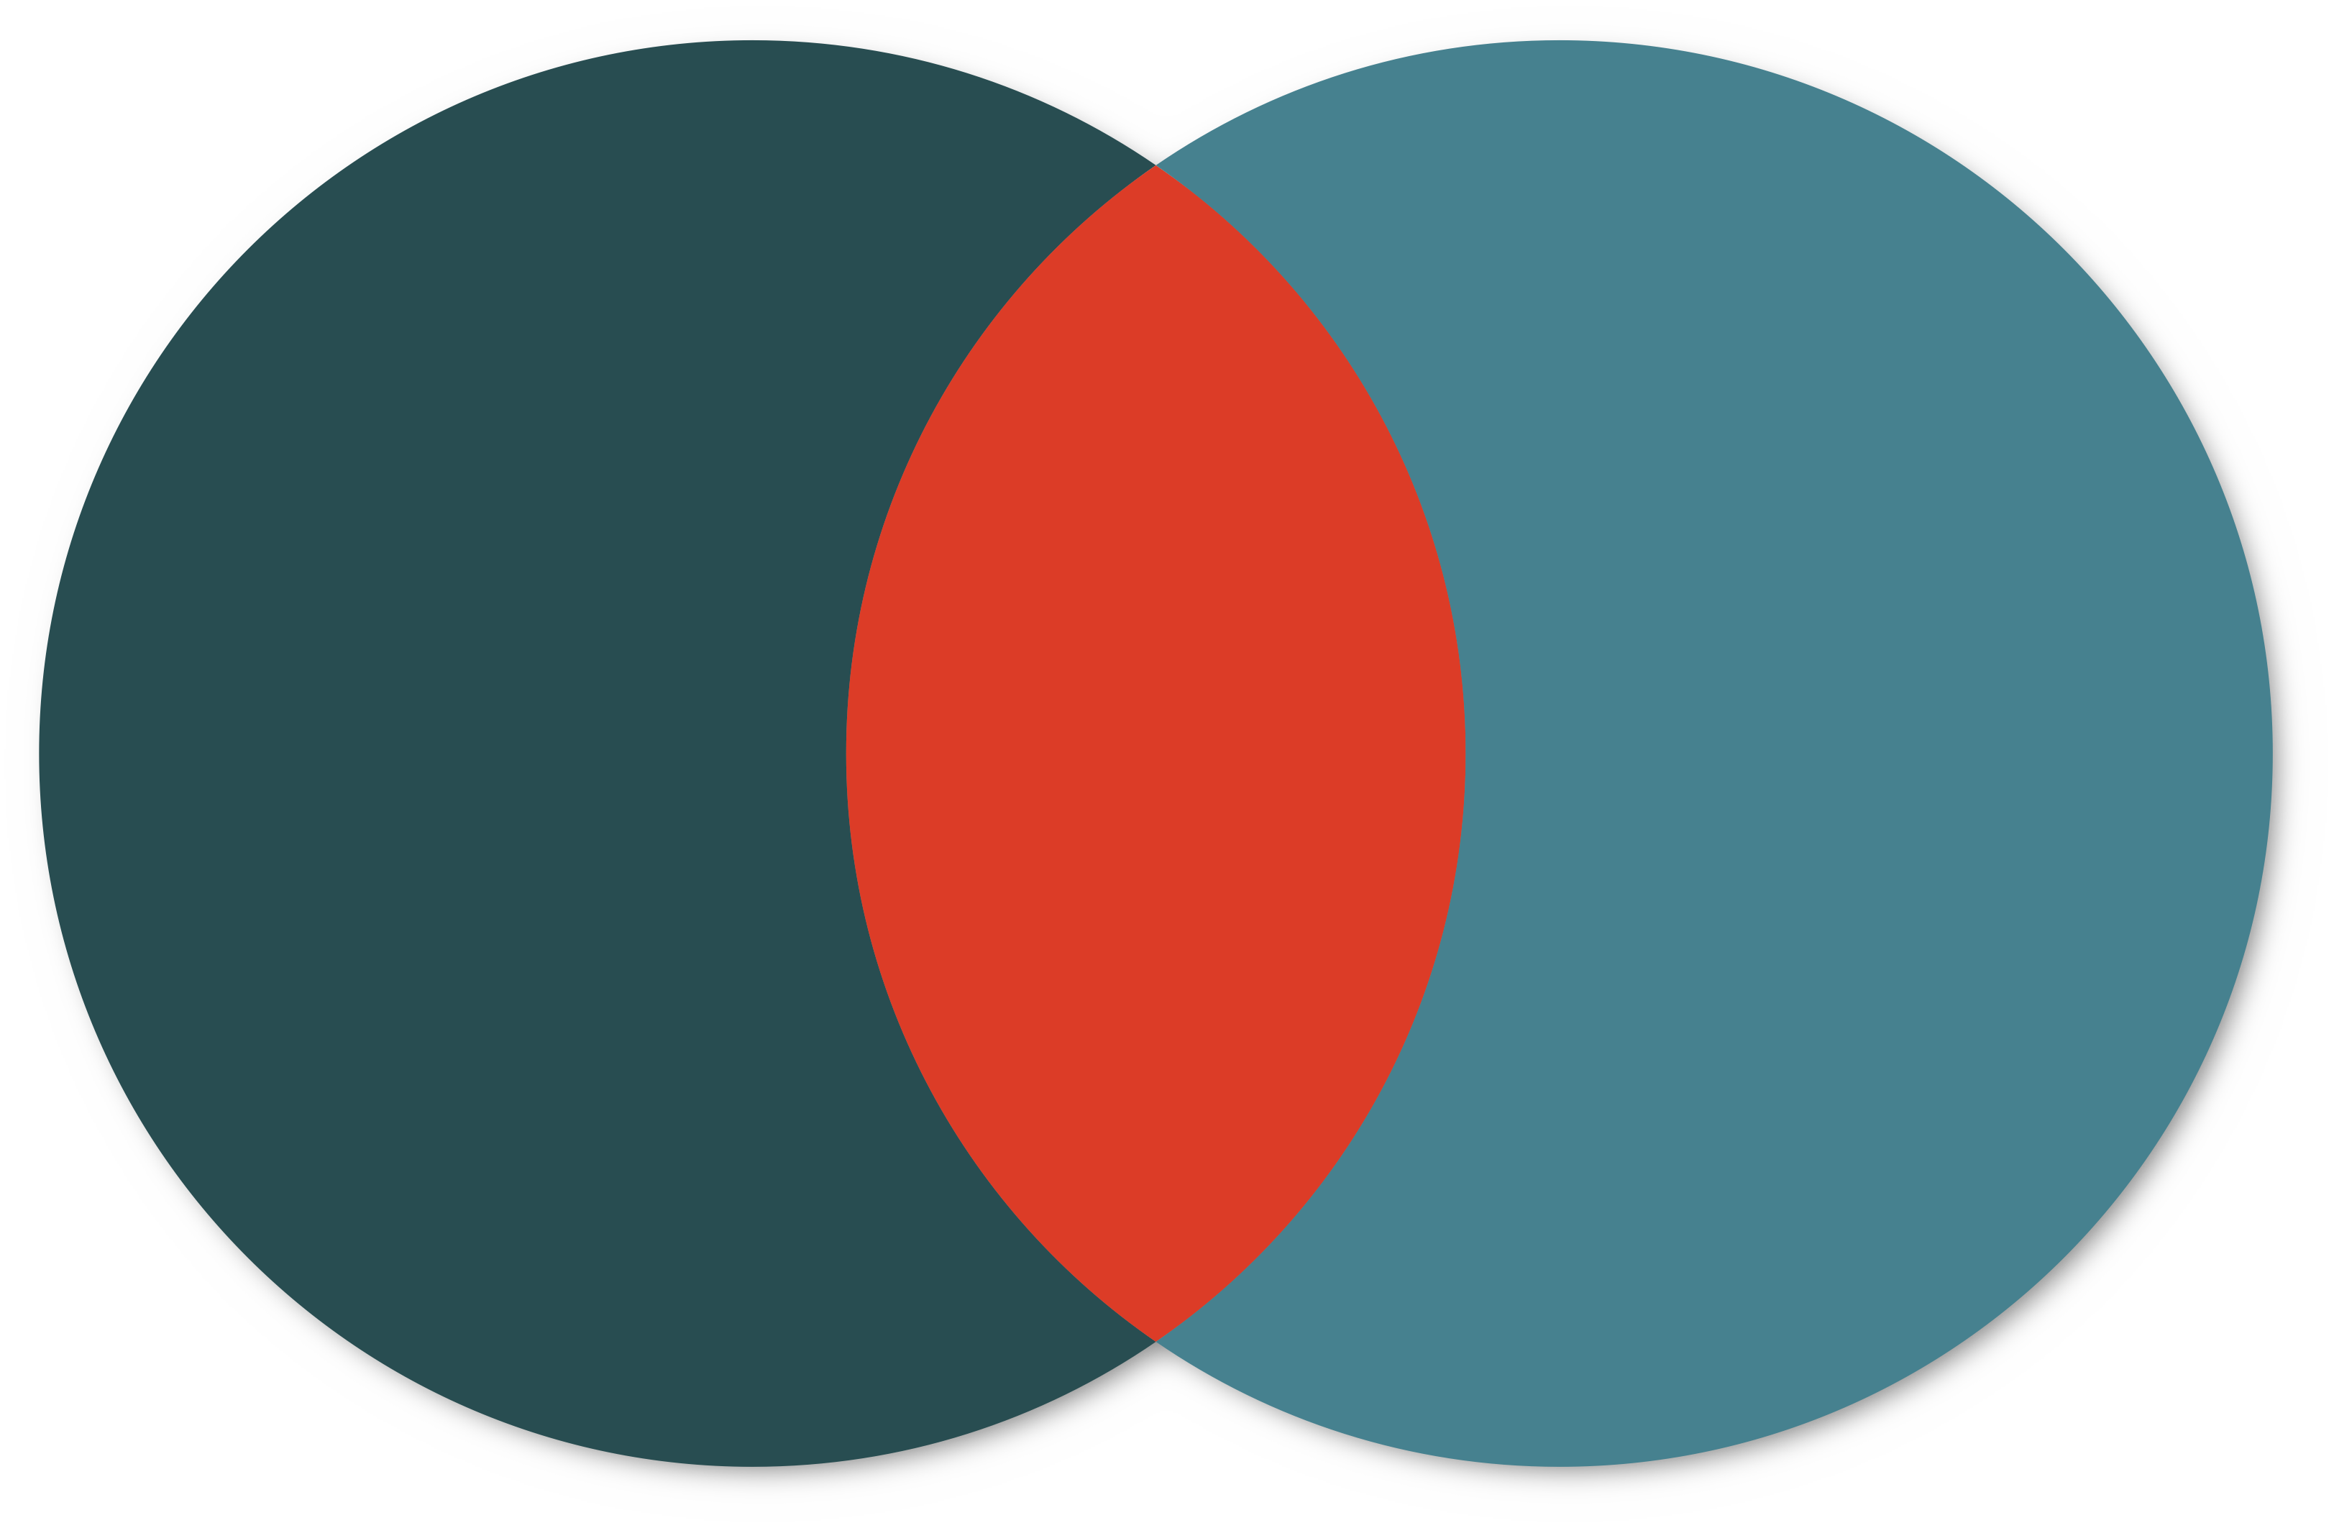
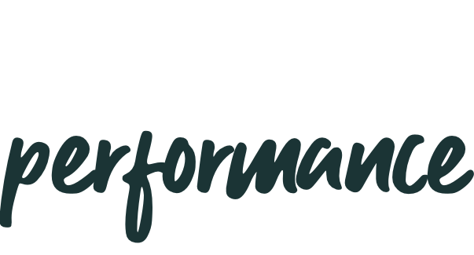
brand
performance
Marketing
=
Marketing
Long-term investment
Bottomline outcome
>
>
>
>
>
Long-term growth
Build loyal customer base
Brand awareness
Mind and market share
High funnel
Results
>
>
>
>
>
Short-term growth
Results now
Click rate
Conversions
Low funnel

Slide 33
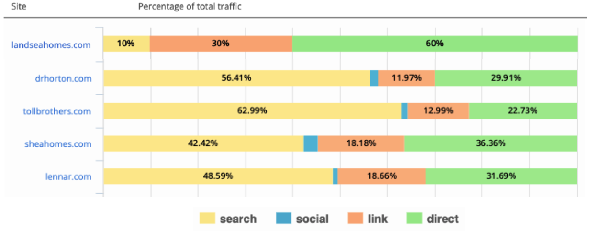
EXAMPLE
60% OF THEIR TRAFFIC IS COMING FROM “DIRECT”.
WHAT WOULD YOU ATTRIBUTE THAT TO?

Slide 34
What Happens When
We only focus
on the “prize”?

Slide 35
“WE Want to switch things up”

Slide 36
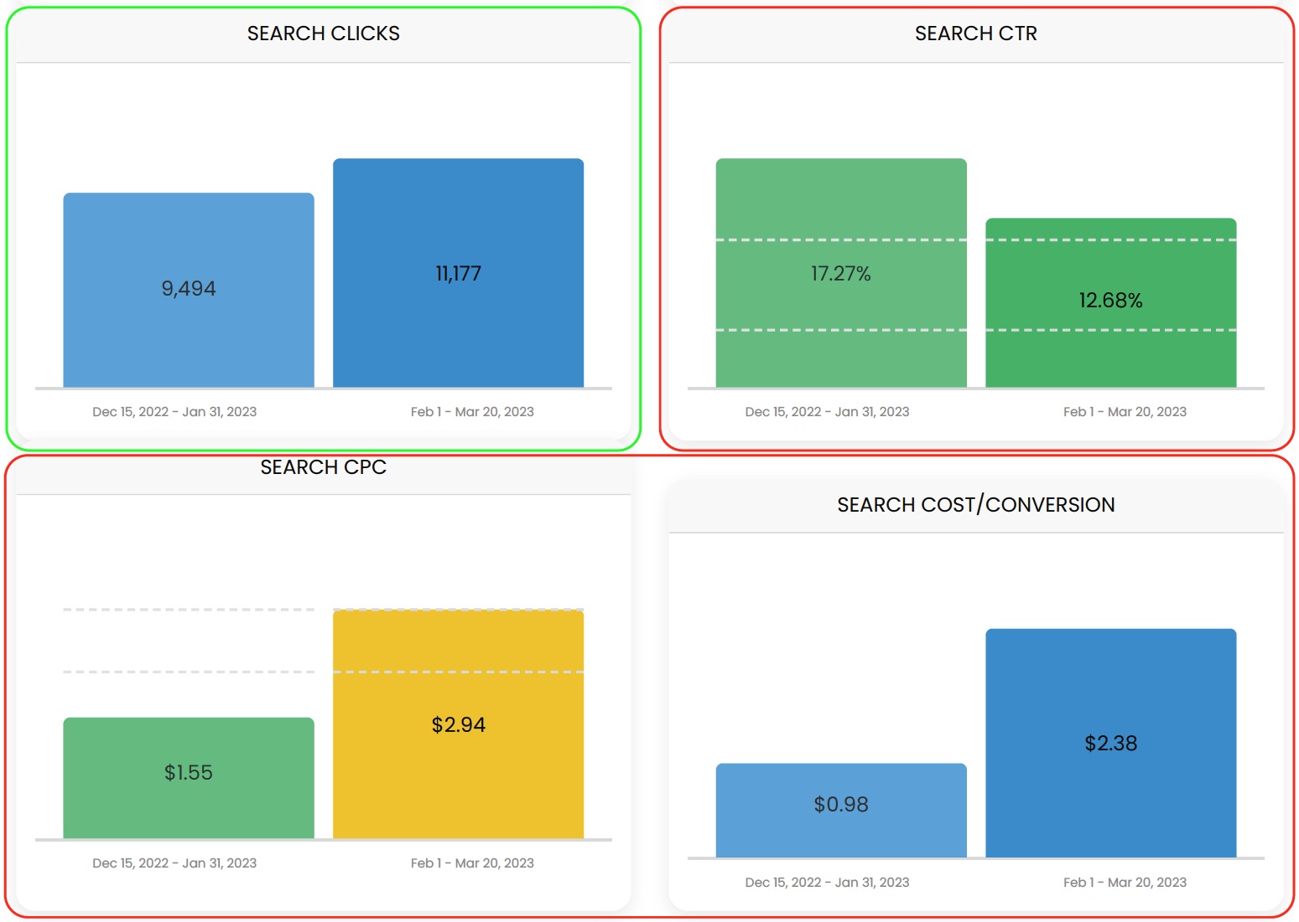
prediction became Reality
Search budget, impressions and clicks are up as a result of this change, but campaign CTRs and all other quality metrics are down substantially.
Cost-per-click is almost double, and the cost-per-conversion has more than doubled.
As brand recognition continues to slip the impact gets worse over time. Without the targeted prospecting efforts this campaign is subject to (volatile) market conditions and is in a completely uncontrolled trajectory.

Slide 37
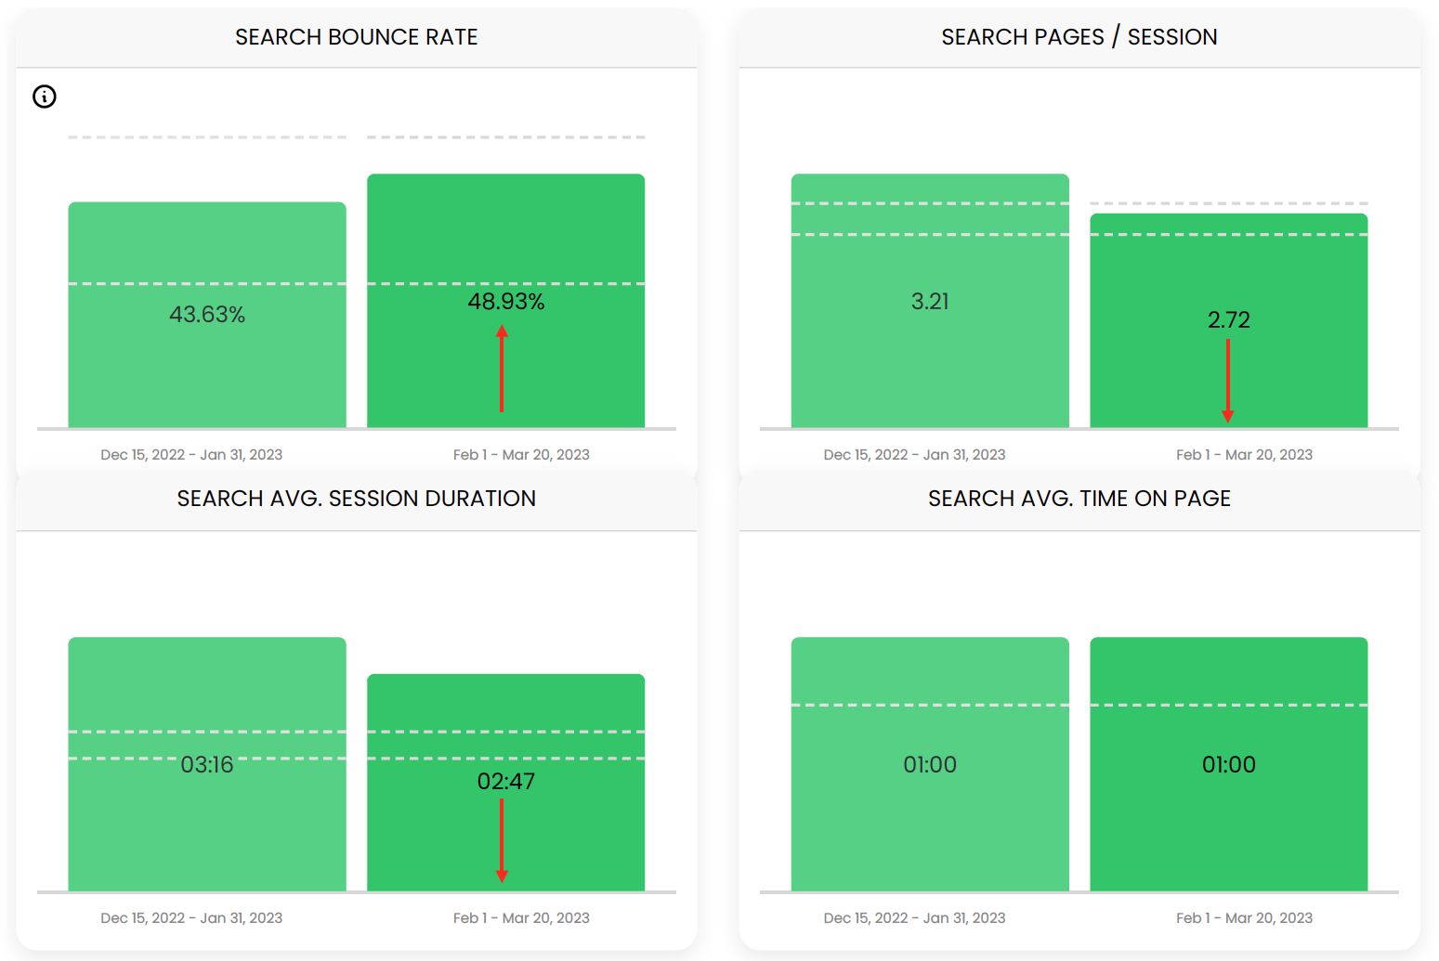
It Hurts Where it matters most
Every single quality metrics has seen a negative impact form this change

Slide 38
Q&A

Slide 39
Thanks!
From the max connect family

