Slide 1
Workshop
CRAFTING A DIGITAL ECOSYSTEM THAT MOVES MORE VEHICLES OFF THE LOT
1:00 pm Main Stage | Carmen Henry, Development Manager, Automotive, Google
Ryan Roblyer, SVP Automotive, MCD
Brinden Sillito, Chief Digital Officer, MCD

Slide 4
7.6 Million
Light-Vehicles sold in 1H 2023, up 13% year-over-year
Wards Intelligence, July 2023.

Slide 5
Light vehicles in inventory as of end of June, translating to 36 days’ supply
1.9 Million
Wards Intelligence, July 2023.

Slide 6
of light vehicle inventory at the end of June was made up of non-luxury segments (minus pickups), up from 32% YOY
35 Percent
Wards Intelligence, July 2023.

Slide 7
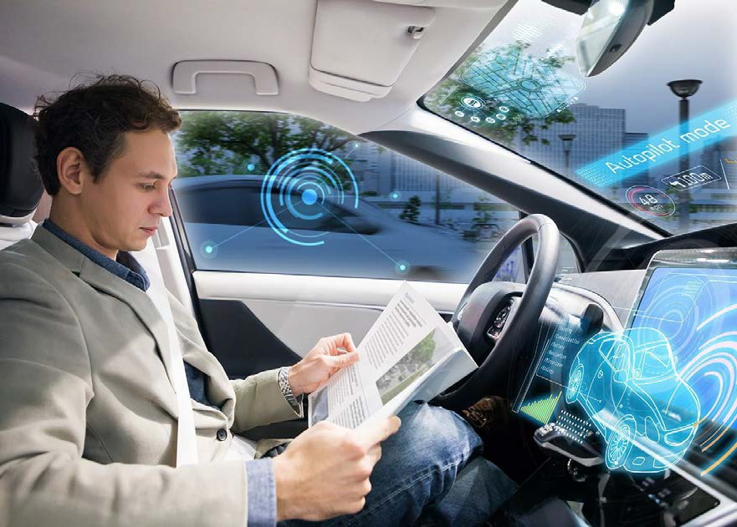
17%
of consumers ﬁnanced a vehicle with a monthly payment over $1,000 in Q2, up from 4.3% in Q2 2019
Edmunds, July 2023.

Slide 8
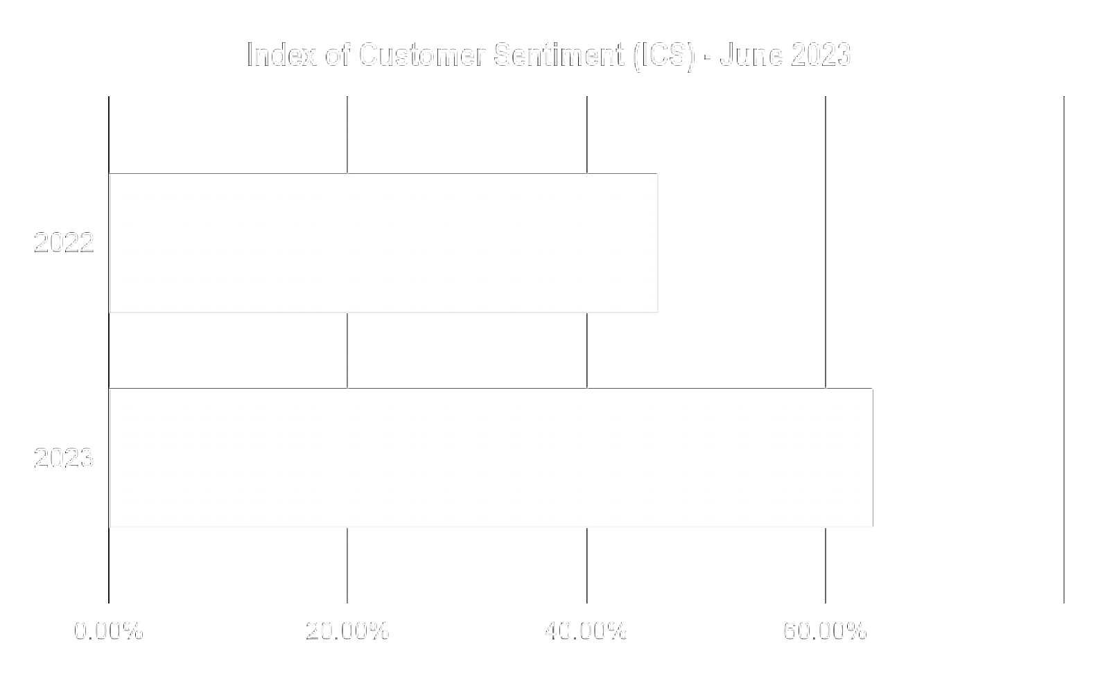
The Index of Customer Sentiment (ICS) reported a 28% increase YOY in June 2023
University of Michigan, Survey Research Center, Surveys of Consumers, June 2023.

Slide 9
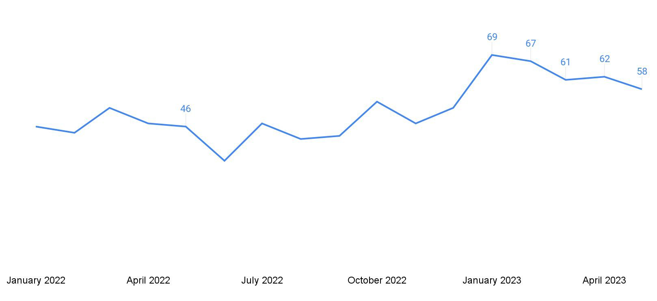
Consumer sentiment on buying a vehicle in the next 12 months
May 2022
University of Michigan, Survey Research Center, Surveys of Consumers, May 2023.

Slide 10
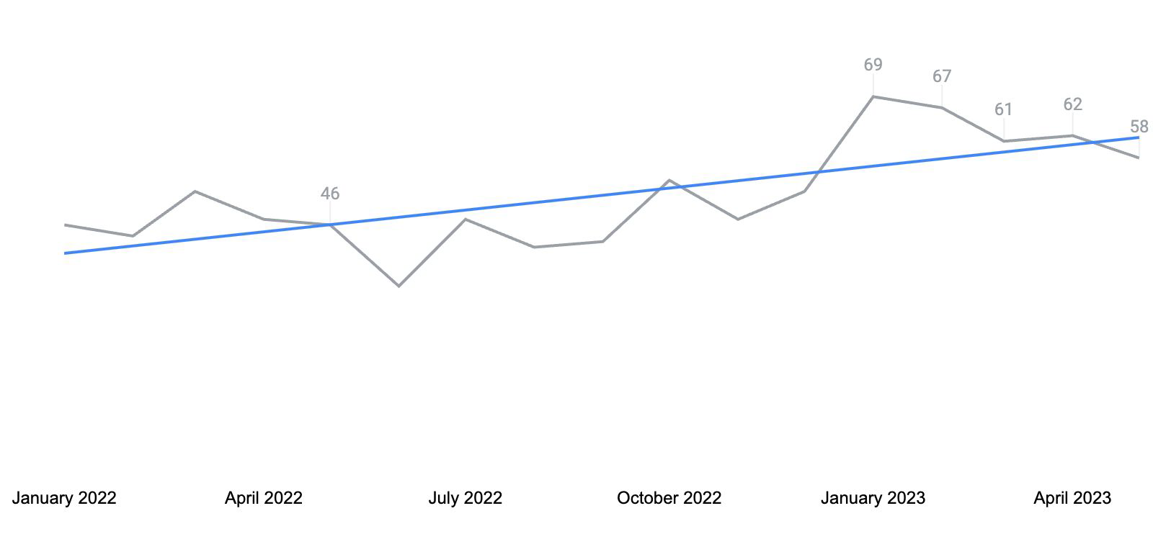
Consumer sentiment on buying a vehicle in the next 12 months
May 2022
University of Michigan, Survey Research Center, Surveys of Consumers, May 2023.

Slide 11
2H 2023…
and Beyond

Slide 12
Percent change in share of registrations, 2019 to 2022
HHI <100K, color scales from white to blue based on intensity of decline
$75K - $99K | $50K - $74K | $40K- $49K | $30K- $39K | $20K - $29K | $15K - $19K | under $15K
-22% | -29% | -36% | -39% | -45% | -41% | -38%
IHS Markit. May 2023. Does not include registrations with unreported HHI.

Slide 13
Americans ages 25 to 61 have student loan debt, with those 35+ having the highest debt amount and share of student debt
36 Million
Ad Age, July 2023.

Slide 14
$37,338
average federal student loan debt, with
$377 as the average monthly cost
Ad Age, July 2023.

Slide 15
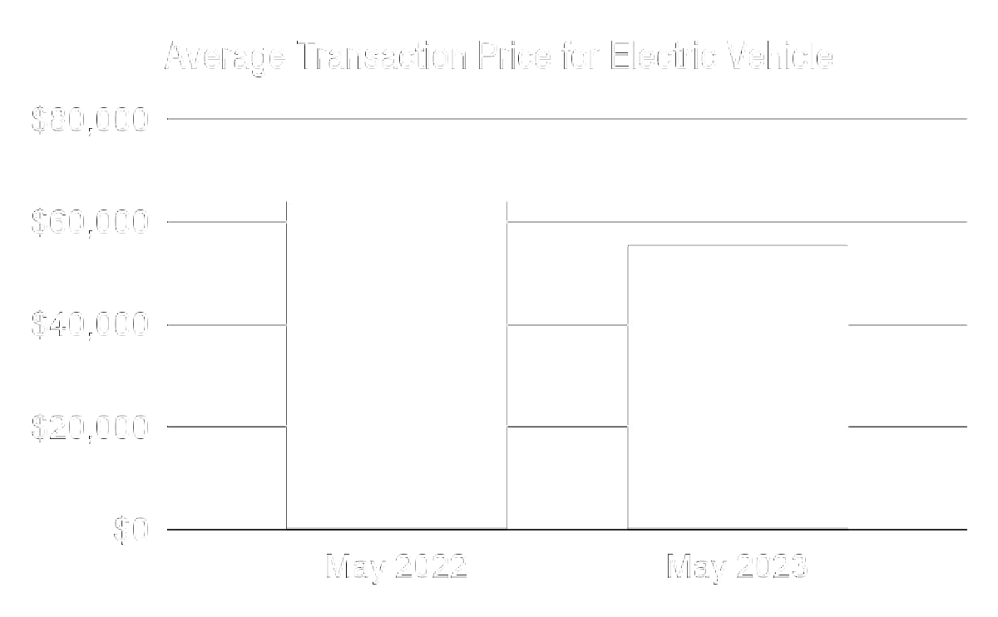
Average prices for EVs dropped by 14% in May 2023, compared YOY
Kelley Blue Book, June 2023.

Slide 16
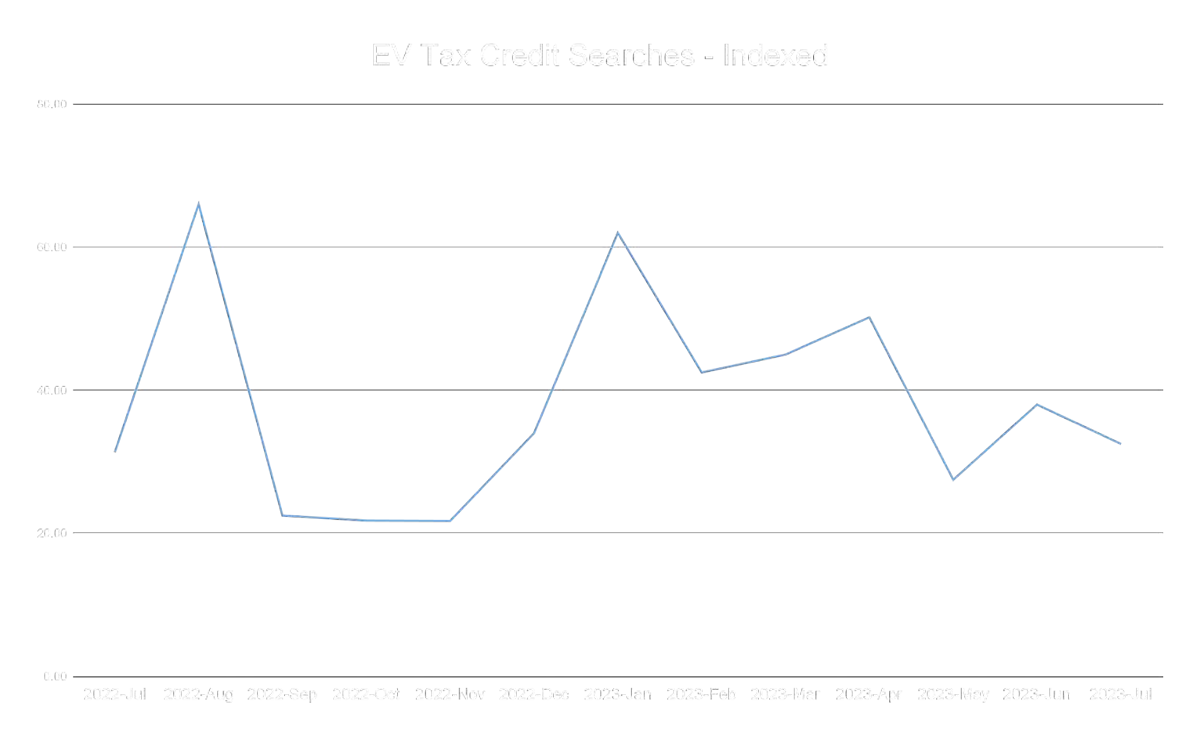
EV Tax Credit Searches in the Past 12 Months

Slide 17
+$11B
of political ad spend expected in support of 2024 elections
Ad Age, July 2023.

Slide 18
of US Auto intenders say customer service is their top priority in deciding between dealerships with similar inventory and pricing
44%
CivicScience. If multiple dealerships had the vehicle you wanted to buy / lease at similar pricing, what factors would influence which dealership you purchased from? n=4,194. May 2023.

Slide 19
Thank you
See you later
Goodbye

Slide 20
Industry Insider Summit:
Crafting a digital ecosystem that moves more vehicles off the lot

Slide 21
Crafting a digital ecosystem
That moves more vehicles
off the lot

Slide 22
Automotive Landscape
7.6 M
Light vehicle sales
this year (+13% YoY)
1.9M
Light vehicle in inventory
(as of end of June)
(36 day supply)

Slide 23
Automotive Landscape
7.1%
Average APR Interest rates
28%
(ICS) Index of
Customer Sentiment
YoY
increase

Slide 24
Automotive Landscape
Average Car prices
Manufacturers Incentives

Slide 25
Automotive Landscape
Good
Vehicle Prices are coming down
Inventory is adequate
BAD
Prices are still high (improving)
Interest rates

Slide 26
Automotive Landscape
2016

Slide 27
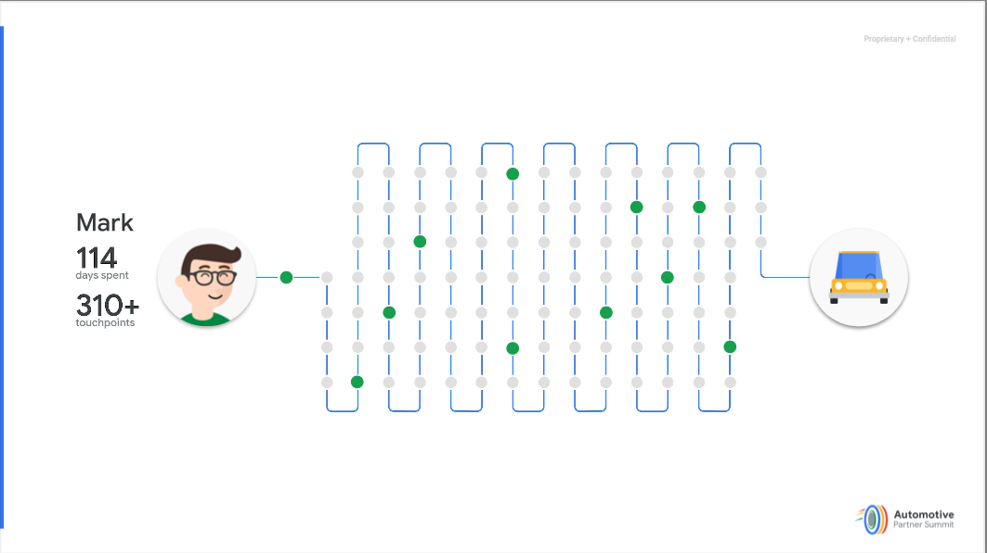
Automotive Landscape
2019

Slide 28
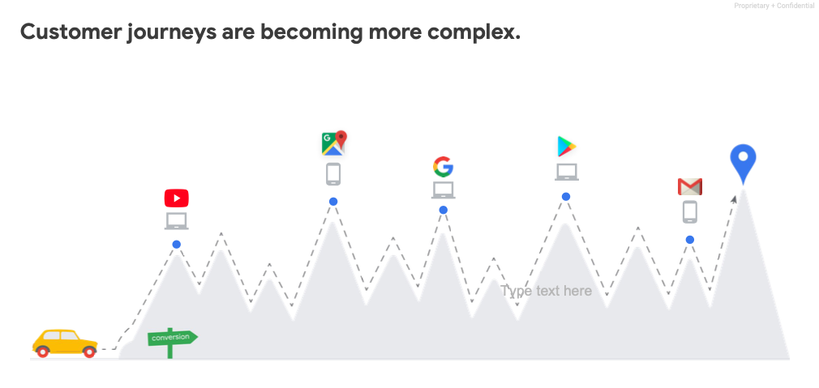
Automotive Landscape
2023

Slide 29
Automotive Landscape
What does this mean for me?
71% of consumers consider online purchase for their next vehicle.
Interest Rates, vehicle pricing, the EV landscape, supply (and many other issues) are causing customers to consider brands and models they did not consider previously.
Research and purchasing decisions are picking up pace.
Historically low Loyalty
Means: Being in front of your customers is more important than ever!

Slide 30
Automotive Landscape

Slide 31
Automotive Landscape

Slide 32
Automotive Landscape

Slide 33
Automotive Landscape

Slide 34
Automotive Landscape
34% of Shoppers DON’T Utilize Google Search Along Their Path to Purchase

Slide 35
Automotive Landscape

Slide 36
SAMPLE DATA
12 month look at a 5 rooftop dealer group
IMPRESSIONS
40,417,429
Over 40 million impressions delivered to people in the market for New or Used Vehicles.
VIEWS
719,769
Over 700k views delivered to people in the market a Vehicle.
CLICKS
Awareness
Interest
Consideration
Engagement
Decision
Purchase
1,002,673
Over 1 million clicks by people in the market.
VDPS
246,207
Total New & Used VDPs.
LEADS
23,269
Total Leads; Forms, Calls, Chats, Driving Directions, Store Visits…etc.
SALES
9,501
Total New & Used Cars sold.

Slide 37
Thanks!
From the max connect family

